Slide 1


Level 2 Safeguarding Training for Early Years 2024-2025
(So-called) honour-based abuse awareness
Copyright © Essex County Council 2024
No part of this publication may be reproduced, stored in a retrieval system of any nature, downloaded, transmitted or distributed in any form or by any means including photocopying and recording, without the prior written permission of Essex County Council, the copyright owner
Notes:
This presentation can be used as part of ongoing training for staff.

Slide 2
Contents
Keeping children safe in Education
So-called ‘honour’-based abuse (HBA) encompasses incidents or crimes which have been committed to protect or defend the honour of the family and/or the community, including female genital mutilation (FGM), forced marriage, and practices such as breast ironing.
Abuse committed in the context of preserving ‘honour’ often involves a wider network of family or community pressure and can include multiple perpetrators.
1
Female genital mutilation
2
Forced marriage
3
Faith based abuse
4
Key documents
Notes:
Discuss that FGM is a safeguarding issue and that all staff need a basic awareness and understanding of this issue

Slide 3
Female genital mutilation

Slide 4
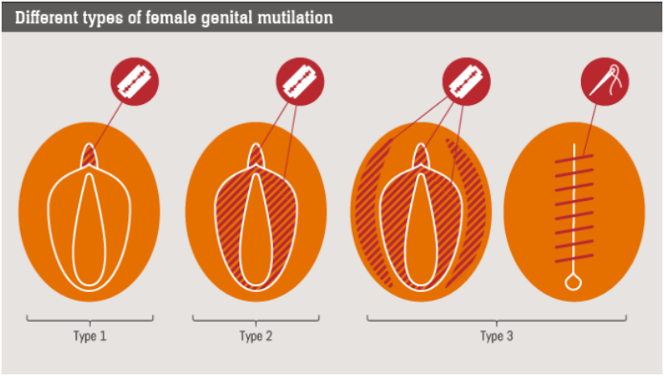
Types of FGM
The World Health Organisation definition of FGM:
Female Genital Mutilation (FGM) comprises all procedures that involve partial or total removal of the external female genitalia, or other injury to the female genital organs for non-medical reasons.
Notes:
Discuss that FGM is a safeguarding issue and that all staff need a basic awareness and understanding of this issue
This also includes vaginal piercings in under 18s
If an under 18 discloses to a teacher that she has had a piercing, mandatory reporting would apply
Talk through each type:
Type 1 – partial to total removal of the clitoris
Type 2 – Partial to total removal of the labial lips
Type 3 – called ‘infibulation’ – partial to total removal of clitoris and labial lips, followed by a covering seal made over the top, leaving a small hole (often the size of a matchstick) for urination and menstruation.
Type 4 – any other damage to the genitalia – piercing, pricking, nicking, incising, cauterizing etc.

Slide 5
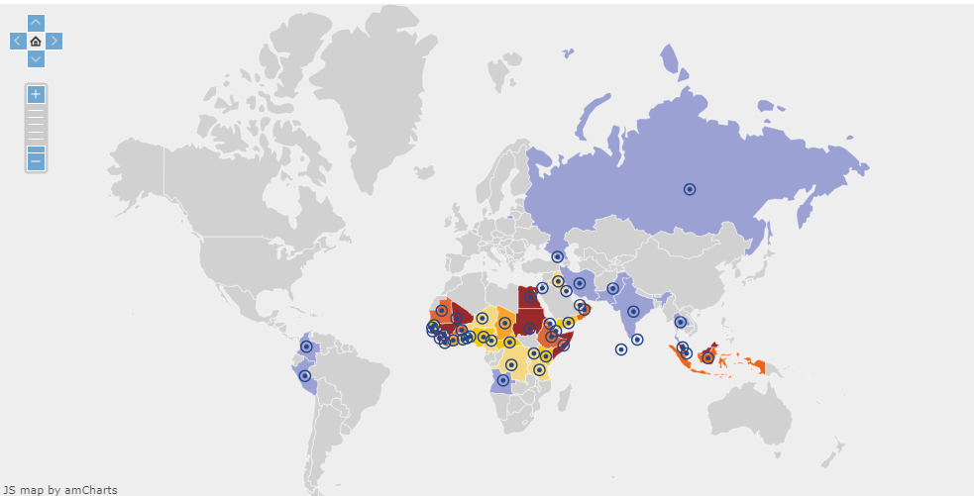
National FGM Centre
The centre website provides an interactive map of prevalence across the world (for all types of HBA)
National FGM Centre / world FGM prevalence map
Notes:
Make the point that the Interactive Map is available online at the National FGM Centre website:
www.nationalfgmcentre.org.uk
FGM is not an African problem – it is worldwide problem
Professionals can use the (free) interactive map to look at prevalence information
When working with a family, professionals not only need to know the country of origin, but more importantly the ethnic group.
Spend a few minutes showing the map and what information can be found on it

Slide 6
Preservation of the female’s virginity
Perceived religious justification (there are no religions that advocate for FGM)
Protection of family honour
Culture
Rite of passage into womanhood
Social acceptance
Marriage / chastity
Perceived health benefits
Cleanliness
Curbing a woman’s sexuality
Mis-information about fertility and childbirth making it safer
It makes a woman more beautiful
It prevents vaginal cancer
Why is FGM practiced?
Notes:
You can add that this is not an exhaustive list
Families may use or have certain cultural beliefs through which they may seek to justify their intentions / actions
Pick out different ‘justifications’ and explain them
Emphasise the safeguarding element – families do this as they think it’s a way of safeguarding their daughters - and the importance of exploring families views around FGM and why they practise.

Slide 7
Health implications
There are NO health
benefits to FGM
Short term
Shock
Haemorrhage
Trauma
Infection (uterus, vagina, urinary, pelvic)
Transmission of disease (including HIV)
Fracture and dislocation of bones due to restraint
Long term
Implantation cysts
Keloid scar formation
Dysuria
Surgery to achieve intercourse
Infertility
Death
Depression
PTSD, trauma, flashbacks
Anxiety
Claustrophobia
Childbirth dangers
Notes:
Pick out different issues and explain them

Slide 8
The Law
The Law
It is an offence under the FGM Act 2003 to:
Perform FGM in the UK or take a girl abroad to be subjected to FGM
Assist the carrying out of FGM in the UK or abroad;
Assist from the UK a non-UK person to carry out FGM outside the UK on a UK national/permanent UK resident.
For someone in the UK to aid, abet, counsel or procure FGM outside of UK.
The Serious Crime Act 2015:
Provides Anonymity to victims
New offence of failure to protect from FGM
Introduce FGM protection orders
Introduces a mandatory reporting duty requiring regulated health and social care professionals to report known cases of FGM in under 18 to the police
Notes:
FGM mandatory reporting duty for teachers Section 5B of the Female Genital Mutilation Act 2003 (as inserted by section 74 of the Serious Crime Act 2015) places a statutory duty upon teachers, along with regulated health and social care professionals in England and Wales, to report to the police where they discover (either through disclosure by the victim or visual evidence) that FGM appears to have been carried out on a girl under 18. Those failing to report such cases may face disciplinary sanctions. It will be rare for teachers to see visual evidence, and they should not be examining pupils or students, but the same definition of what is meant by “to discover that an act of FGM appears to have been carried out” is used for all professionals to whom this mandatory reporting duty applies.

Slide 9

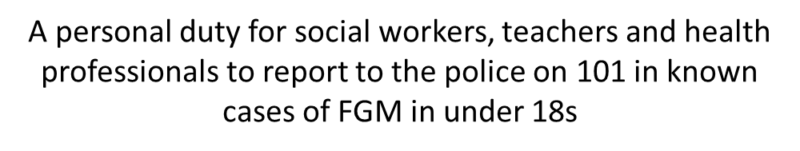


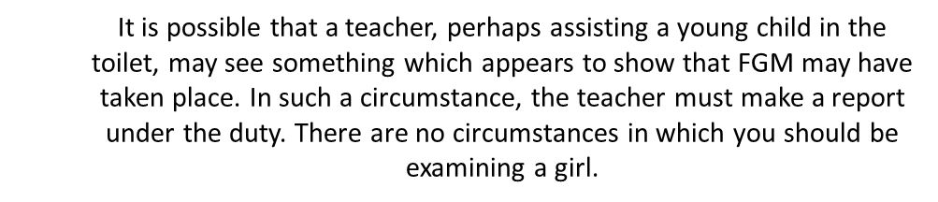


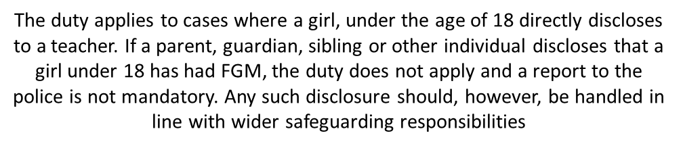
Mandatory reporting duty
Notes:
FGM mandatory reporting duty for teachers Section 5B of the Female Genital Mutilation Act 2003 (as inserted by section 74 of the Serious Crime Act 2015) places a statutory duty upon teachers, along with regulated health and social care professionals in England and Wales, to report to the police where they discover (either through disclosure by the victim or visual evidence) that FGM appears to have been carried out on a girl under 18. Those failing to report such cases may face disciplinary sanctions. It will be rare for teachers to see visual evidence, and they should not be examining pupils or students, but the same definition of what is meant by “to discover that an act of FGM appears to have been carried out” is used for all professionals to whom this mandatory reporting duty applies.

Slide 10

High risk indicators
A female child discloses she has undergone FGM (if under 18, mandatory reporting applies)
A parent/carer discloses they believe FGM is a requirement and/or indicates they plan to arrange FGM for their daughter
A female child has a family member who has already undergone FGM
A female child / other individual discloses she or another female is at risk of FGM or has undergone FGM
Notes:
Discuss the types of indicators that may be seen.
Remember the basics of listening to a child if they disclose something to you – do not put words in their mouth or ask leading questions
The chances are it will all be very innocent but be curious

Slide 11
Other risk indicators
A female child discloses she is worried about a holiday and/or upcoming ceremony/ coming of age party
A female child returns from a holiday and appears to be in pain or discomfort, or is absent from school
Parent(s)/carer(s) are going on holiday (to a country of high prevalence of FGM) and are reluctant to discuss the details of the holiday with the setting
A female child ’s behaviour changes
A female child has not returned from a holiday when she was supposed to, especially from a country where FGM is practiced

Slide 12
Talking with parents and carers
Before a referral is made to Social Care, efforts should be made to explore concerns with the child and / or the parent/carer first (unless to do so would put the child in danger)
  Research prevalence of FGM in the relevant country
  Use a female worker wherever possible
  Use simple language and straight forward questions – be curious
  Use appropriate language with the family and terms they are familiar with
  Ensure an independent interpreter is used, where this is required
Notes:
The schools guidance form the National FGM centre talks you through the process of talking to children and families, and explores use of appropriate language

Slide 13
Advice and guidance
National FGM Centre school's guidance (2019)
Provides advice and consultation
Support for teachers on speaking to parents
Advice on risk indicators of potential FGM
Support for families
Support for schools around awareness / training
For further advice and guidance on FGM you can contact the Children and Families Hub
Notes:
The schools guidance form the National FGM centre talks you through the process of talking to children and families

Slide 14
Forced marriage

Slide 15
Definition:
A forced marriage is one entered into without the full and free consent of one or both parties and where violence, threats or any other form of coercion is used to cause a person to enter into a marriage - threats can be physical or emotional and psychological
No one can force someone into marriage – some families force marriage because they:
think it’s an important part of religion or culture
are worried about the family’s reputation and honour (in some cultures also known as 'izzat')
want the family’s money to stay together
want to marry their children off in exchange for money
don’t approve of their child being gay, lesbian, bisexual or transgender
don’t want their children to have relationships or sex
feel pressured by the community or other family members to follow traditions
want to keep family values and honour
It is illegal in the UK
It is not the same as an arranged marriage - in an arranged marriage, the person involved still has a choice

Slide 16
Faith-based abuse

Slide 17
There are a variety of definitions associated with abuse linked to faith or belief
Child abuse linked to faith or belief: national action plan – GOV.UK (www.gov.uk)
The National Action Plan includes the following
when referring to Child Abuse Linked to Faith or Belief (CALFBW)
The concept of belief in:
witchcraft and spirit possession, demons or the devil acting through children or leading them astray (traditionally seen in some Christian beliefs),
the evil eye or djinns (traditionally known in some Islamic faith contexts) and dakini (in the Hindu context);
ritual or multi murders where the killing of children is believed to bring supernatural benefits or the use of their body parts is believed to produce potent magical remedies;
use of belief in magic or witchcraft to create fear in children to make them more compliant when they are being trafficked for domestic slavery or sexual exploitation.

Slide 18
ECC Early Years and Childcare website:
Safeguarding pages
Model Child Protection Policy (for settings, and childminders)
Level 2 training presentations (including this presentation)
Key safeguarding information and documents
Safeguarding audit
Templates for reporting and recording concerns
Termly forum presentations and briefings
How to report a concern about a child
How to report a concern about a member of the workforce

Slide 19
Useful links
    Working together to safeguard children 2023: summary of changes (publishing.service.gov.uk)
    Early Help and Team Around the Family Workshops
    ESCB - Preparing for Difficult Conversations – training
    Early Help Drop In Poster (ESCB)
    Essex Support Services / Directory of Services
    Refuge runs (free of charge / 24 hour) National Domestic Abuse Helpline: 0808 2000 247
    NSPCC - signs, symptoms and effects of domestic abuse
    Safe Lives - young people and domestic abuse
    Southend/Essex /Thurrock domestic abuse partnership

Slide 20
Key documents
Keeping Children Safe in Education (DfE 2024)
SET (Southend, Essex and Thurrock) Safeguarding and Child Protection Procedures (ESCB 2022)
Working Together (DfE 2023)
What to do if you're worried a child is being abused (HMG, 2015)
Relationships, Education (RE) and Relationships and Sex Education (RSE) and Health Education (DfE, 2019)
PREVENT Duty Guidance (HMG, 2023) - Counter-Terrorism and Security Act 2015
Effective Support for Children and Families in Essex (ESCB 2021)
Sharing nudes and semi-nudes: advice for education settings working with children and young people (UKCIS, 2020)
Teaching online safety in school (DfE, 2019)
Filtering and Monitoring Standards (DfE 2023)
Promoting and supporting mental health and wellbeing in schools and colleges - GOV.UK (www.gov.uk)

Slide 21

The Education Safeguarding Team
Head of Education Safeguarding and Wellbeing:
Jo Barclay
Education Safeguarding Advisers:
Alex Darvill (South and West)
Derai Lewis-Jones (Mid and NE)
Matthew Lewis
Education Safeguarding Officer (MARAC)
Gemma Harris
educationsafeguarding@essex.gov.uk

