Slide 1
Essex
Children
and
Families Hub

Slide 2
Early Help Triage Steps - Summary
Request for Support Outcomes – 2022/23
46, 432
In 2022/23, there were 46, 432 EHTS created across Essex (up from 43, 811 In 2021/22)
184.2
Average number of EHTS per working day (up from the 2021/22 average of 173.8)
3, 896.3
Average number of EHTS per month (up from the 2021/22 average of 3, 650.9)
2,948
In 2022/23, there were 2,948 Children subject of Contacts sent to Family Solutions for consideration of intervention
(up from 2,833 in 2021/22)
8,894
In 2022/23, there were 8,894 Children subject of Contacts sent to A&I teams for consideration of intervention
(down from 9,222 in 2021/22)

Slide 3
C&F Hub – Structure Chart
Relationship-based support for families at first presentation of need
Service Manager
Team Manager
Team Manager
Domestic Abuse Lead
Team Manager
Lead 0-19yrs
6 x TAFSOs
2 x Family Navigators
3 x Team Managers
11.5 x Senior Practitioners
1 x SEND Senior Practitioner
12.5 x Social Workers
21.5 x C&F Advisors
Police Representative
Health Representative
5 x Pods – with named Senior Practitioners

Slide 4
Making a Request for Support
If you have explored the Essex Effective Support for Children and Families document and are still unsure about whether to make a Request for Support or would like to discuss consent, call the Hub on 0345 6037627 and ask for the Consultation Line.
Professionals can report Immediate safeguarding concerns by phoning the Hub on 0345 6037627 and asking for the Priority Line
all non urgent Request for Support for Level 3 and 4 services can be made via the online Portal.

Slide 5
Making a Request for Support
The Hub will receive all High risk domestic abuse notifications (considered at MARAC) and all missing notifications from Police
The Hub also receives Requests for Support related to Children with Disabilities, Occupational Therapy and Private Fostering

Slide 6
Information to include in RFS
What are the concerns and observed impact of concerns on child – provide some clarity about any opinions shared, separate from facts
What are the strengths in the family?
Timelines e.g TAF meetings – when have they been held and over what time period?
What support has been explored / offered and when, what support has the family found helpful?
Parent’s views of the RFS being submitted about their family?
Contact details for both parents.
When professionals advise that parents are not engaging, have you had a conversation with parents about what the barriers to engagement are?
Voice of the child, if known.

Slide 7
Consent
All Level 3 and 4 Requests for Support require parental consent, unless it places a child at risk of significant harm
The Request for Support form will ask if you have obtained consent from
Requests for Level 3, Family Solutions, always require parental consent

Slide 8
Consent – what the Hub considers
Informed consent has been provided by parent / carer for a RFS to be made – are they aware what they are consenting to?
Presenting concerns / previous history / culminative impact of concerns – do they warrant progressing to obtain consent from a parent / carer?
Attempts referrer has made in obtaining consent?
Conversations around Consent are ongoing throughout a family’s contact with Children’s Social Care. Consent for the Hub to undertake enquiries is separate from consent to undertake an assessment and / or s17 enquiries

Slide 9
What we will discuss as part of triage
We will discuss the content of the RFS with parent / carer
If the RFS is made by a professional, we will disclose to the parent / care who this is
We explore consent for the RFS and to contact other professionals who are working with the family (incremental consent)
Parents are also able to obtain a copy of the Request for Support via our Transparency Team

Slide 10
Children & Families Hub – other functions
Requests for Information = average of 50 per day
Legal enquiries for Children not currently open to Children’s Social Care
Ofsted checks
Disclosure and Barring checks

Slide 11
Contact Details
Service Manager
Carole Eden, carole.eden@essex.gov.uk
Team Managers
Vanessa Roberts, vanessa.roberts@essex.gov.uk
Rebecca Lowes, rebecca.lowes@essex.gov.uk
Deb Kemp, deb.kemp@essex.gov.uk

Slide 12
Essex Level 2 Offer
Working together to Safeguard Children outline the Statutory responsibilities of all agencies in supporting families at the earliest and safest point of need.
County wide, there is an extensive Level 2 offer available to partner agencies, which can be accessed prior to considering submitting a request for support at Level 3 or 4 for families.
Below is information and links to available Level 2 support.

Slide 13
Level 2
Early Help Offer
Team Around the Family Support Officers
ECC Local Offer
Family Navigators – Castle Point and Rochford
Quadrant based Early Help Drop ins
Start Well – Essex Child and Family Wellbeing Offer
Directory of services

Slide 14
Team Around the Family Officers
Pathway from Hub to TAFSOs
Case discussions at Level 2 Threshold of Need – can be virtual or in person. Can support with signposting and guidance for TAF meetings.
Supporting partner agencies with TAF meetings.
‘Step down’ support from Family Solutions (Level 3) and Children’s Social Care (Level 4).
Facilitate workshops on Early Help and Preparing for Difficult Conversations
Facilitate weekly Early Help Drop in Sessions.

Slide 15
Contacts Details - TAFSOs
Email - TAFSO@essex.gov.uk
Mid - Lyn Pipe - lyn.pipe@essex.gov.uk
South - Jo Shea - Jo.shea@essex.gov.uk
North - Leah Pilbury - leah.pilbury@essex.gov.uk
West – James Collins – Rochelle.burgher@essex.gov.uk
Alison Duguid, Lead for Pre Birth to 19 - alison.duguid@essex.gov.uk

Slide 16
Directory of Services
Directory of services | Essex County Council

Slide 17
Quadrant Based Early Help Drop ins

Slide 18
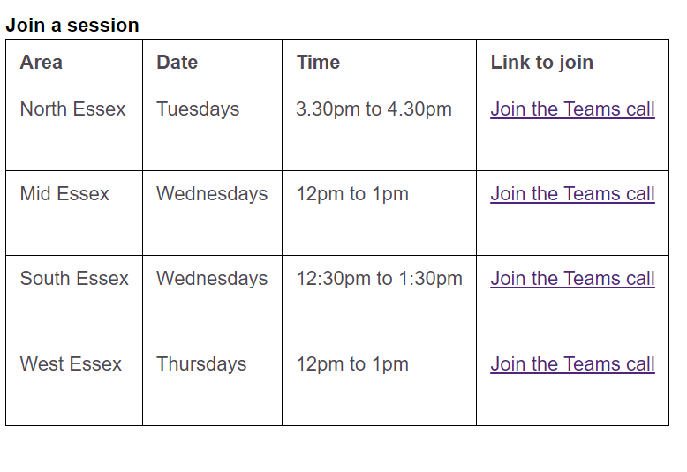
Quadrant Based Early Help Drop ins

Slide 19
ECC Local Offer
Essex County Council: Special Educational Needs and Disabilities (SEND) | Essex Local Offer

Slide 20
Essex Child and Family Wellbeing Service
Essex Child and Family Wellbeing Service – www.essexfamilywellbeing.co.uk

Slide 21
6

Slide 22
6
Any Questions?

