Slide 1
Early Years Safeguarding Forum
Autumn 2022

Slide 2
General update
To change image:
Delete existing image and insert new by clicking on icon
or
Right-click, change picture
If new picture causes placeholder to resize or rotate
Click on ‘Reset’ under ‘Slides’ tab on Ribbon
To resize or reposition image within placeholder:
Picture Format> Crop
Resize using white circles at corners
Move by click+hold on grey area of image then drag to position
Jo Barclay
Head of Education Safeguarding and Wellbeing

Slide 3
Updated / new materials
Level 2 presentations: EYCP / Education Safeguarding Training:
Keeping children safe in Early Years - can be used for induction and annual level 2 training for all staff - Powerpoint, 1157KB
Inspecting Safeguarding in Early Years - Powerpoint, 501KB
Female Genital Mutilation - Powerpoint, 646KB
PREVENT - Powerpoint, 397KB
Understanding the Children and Families Hub, Powerpoint, 498KB
Settings may wish to provide their staff with a certificate once they have completed the ECC Level 2 training, to evidence that they have accessed it
Level 2 safeguarding training schedule 2022/23: EYCP / Education Safeguarding Training:
Model Child Protection Policy: EYCP / model templates and policies

Slide 4
Updated / new materials
Confirmation of safeguarding documents received: EYCP / model templates and policies
Safeguarding information for visitors: EYCP / model templates and policies
Reporting and recording templates: EYCP / model templates and policies
CP file transfer guidance and template: EYCP / model templates and policies
CP case / records review template
Safeguarding audit

Slide 5
Harmful Sexual Behaviour (HSB)
Ofsted review 2021
Hackett continuum
‘zero tolerance’ in all settings
CP Policy
Useful websites and resources:
NSPCC
NICE Guidance (2016)
Lucy Faithfull Foundation

Slide 6
Learning from Child Safeguarding Practice Reviews

Slide 7
Child Safeguarding Practice Reviews (CSPRs)
Child Safeguarding Practice Reviews replaced Serious Case Reviews just over 3 years ago as part of a number of changes to Local Safeguarding Children Boards
The arrangements are called Multi-Agency Safeguarding Arrangements (MASA) more info can be found here
These arrangements place a shared and equal duty on three Statutory Partners-the local authority, police and health - to work together to safeguard and promote the welfare of all children in their area (including equitable funding)
The Statutory Partners are responsible for considering whether to carry out a Child Safeguarding Practice Review (CSPR)
Notes:
The length and process of a CSPR depends on the complexity of the case. Some are carried out over 2 – 3 days, some take several months, the process is much more flexible and less rigid than it was for Serious Case Reviews which means we can tailor the process appropriately to the case.
All reviews have a multi-agency panel who review the case and a lead reviewer who is either internal or external. The lead reviewer is responsible for compiling the report.
Family members and significant other key people are always invited to contribute to reviews, they may not always take up this offer but we always offer them the opportunity
Guidance says that all reviews need to be published

Slide 8
The National Panel
This is an independent panel, that has statutory powers, is independent of the Government and can make its own decisions
Local authorities have to notify the panel
if a child dies or is seriously harmed and abuse or neglect is known or suspected:
in their area
outside of England, but they’re normally resident in their area
to report the death of children looked after by a local authority whether or not abuse or neglect is known or suspected
The panel have also produced a number of national reports on a number of topics
Notes:
Adolescents at risk of criminal exploitation
Sudden Unexpected Death of Infants
Non-accidental injury in under 1s
Supporting vulnerable children and families during covid 19
Domestic abuse

Slide 9
Learning and recommendations from reviews
Learning starts as soon as an incident has been identified, often involved agencies will look at their internal practices and any learning arising from the incident
If there is learning identified through the rapid review process then this is shared with agencies
Learning and themes will emerge throughout the review process
Key learning is highlighted in the final report which supports the final recommendations
The report is then disseminated to agencies who are responsible for sharing it with their workforce
Notes:
Learning and themes that emerge during the review process are shared by the agencies involved in the reviews, ESCB are also exploring other ways of getting this learning out to the wider partnership through regular learning bulletins and other tools that we are constantly developing
published reports are on the ESCB website

Slide 10
Current learning themes from reviews
Challenging decisions and escalating if needed
Evidence change within families and how this will be sustained
Early help, Team Around the Family meetings and lead professional
Teenage suicide
Mental health of young people
Increasing awareness of the SET Procedures across the workforce
Case recording and decision making
Parental mental health and substance misuse
Assessments/context and family history
Being curious
Children not being brought to appointments
Voice of the child
Thinking about the whole family and system

Slide 11
Hearing the voice of the child in the safeguarding system
Recent reviews in Essex have highlighted that the child’s voice, wishes, thoughts and feelings are not evident in the records that organisations hold.
ESCB have produced some resources to support organisations to think about how they could improve this area of practice
ESCB have produced a video, power point and factsheets that you can share with colleagues and discuss in staff meetings. There are additional resources from other safeguarding partnerships
Voice of the child resources

Slide 12
Effective Support for Children and Families in Essex
Early Years Safeguarding Forum

Slide 13
Session aims
By the end of the session you should:
Know what the Essex Effective Support document is and where to find it
Understand the different levels of need and the support that is available at each level
Be confident to use the Indicators of Possible Need to make an assessment on the level of need a child/family is presenting
Know how to find and contact agencies in Essex who support children and families at Levels 1, 2, 3 and 4

Slide 14
Effective safeguarding
Effective Support is underpinned by effective safeguarding systems within the setting
Safeguarding training is essential. It is important that, as the Key Practitioner, you are confident your staff are able to recognise abuse and act appropriately.
Do all staff receive effective Level 2 training at induction and then annually?
Do you arrange regular safeguarding CPD opportunities for your staff through the year?
How do you check your staffs safeguarding knowledge?
Are you familiar with the contents of Effective Support, Working Together and the Early Years Framework?
Do you attend Level 3 training every 2 years and access CPD opportunities regularly?
Do you know how to find and contact the key agencies who support families in Essex?
Be familiar with the support systems in Essex. Safeguarding is most effective when Key Practitioners are ready to respond to concerns before they occur.
Do all records include the detail of the concern, how the concern was followed up and resolved and a note of the setting’s actions and rationale’s for decisions?
Do you undertake regular reviews of all Child Protection files to monitor concerns and record these on the file?
Robust recording systems and regular reviews of Child Protection files is key. Good record keeping and regular, planned reviews of records support the effective management of safeguarding concerns.

Slide 15
What is the Effective Support document?
Effective support is the method we use to work out how much support a child and their family needs.
‘Effective Support for Children and Families in Essex’ is a document produced by the Essex Safeguarding Children Board (ESCB).
The setting’s response to a safeguarding concern should be guided by the information in the document.
You can access the Effective Support Booklet on the ESCB ‘Request Support for a child’ page.

Slide 16
I have a safeguarding concern – what are my first steps?
Assessing the level of need

Slide 17
Children and Families Hub Consultation Line
If you have concerns about a child and want an opportunity to talk these through with a social worker before deciding the best course of action, contact the Children & Families Hub on 0345 603 7627 and ask for the Consultation line.
The Children and Families Hub is the first port of call when you have a safeguarding concern about a child.
All consultations with the Children & Families Hub must be recorded by the caller

Slide 18
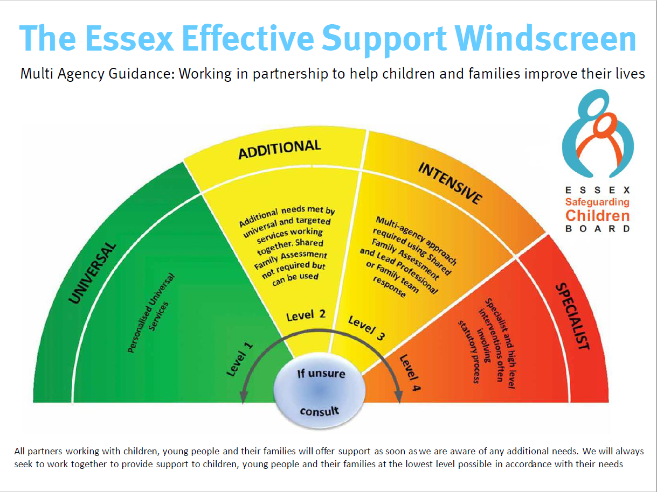
1

Slide 19
The four levels of need
1
2
3
4
Universal
All children and families who live in the area have core needs such as social relationships, parenting, health and education.
Additional
Children and families with additional needs who would benefit from or who require extra help to:
Improve education
Improve parenting and/or behaviour
Meet specific health or emotional needs of the child and/or parent
Improve their material situation
Respond to a short term crisis such as bereavement, parental separation
Intensive
Vulnerable children and their families with multiple needs or whose needs are more complex, such as children and families who:
Have a disability resulting in complex needs
Families affected or impacted by crime
Poor attendance/ behaviour in school
Substance misuse
Domestic abuse
Insecure housing
Financial instability
Physical or mental health difficulties
Neglect
Exploitation
Poor early years development
Poor family relationships
Specialist
Children and young people who have suffered or are likely to suffer significant harm as a result of abuse or neglect.
Children with significant impairment of function/learning and/or life limiting illness.
Children whose parents and wider family are unable to care for them.
Families involved in crime/misuse of drugs at a significant level.
Families with significant mental or physical health needs.
Families who are homeless.

Slide 20
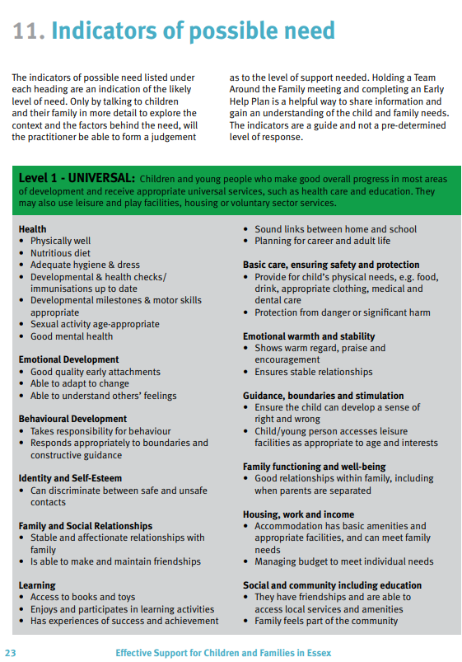
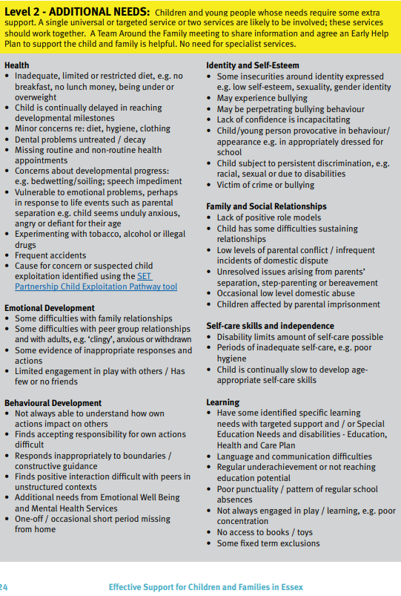
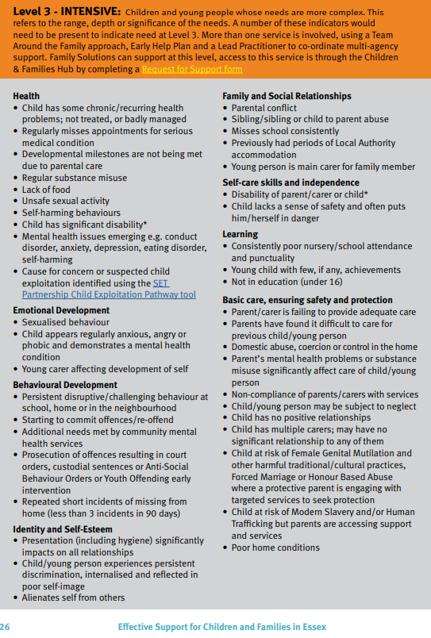
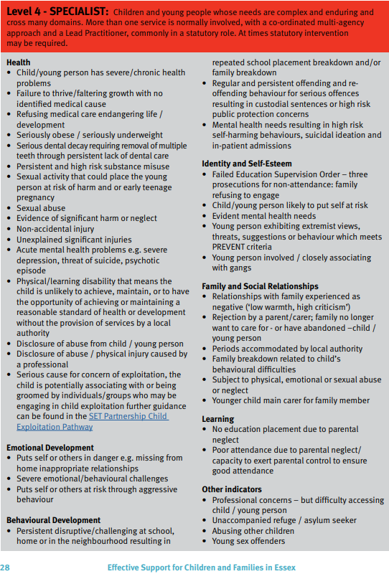
Indicators of possible need
Pages 23 – 29 of the Effective Support document contain ‘Indicators of Possible Need’ tables for each Level.
Support for practitioners to understand what need might look like at each level and which level a family might fall under based on the needs you have identified.
Each level is split into categories of need: health; emotional development; behavioural development; identity and self-esteem; family and social relationships; self-care skills and independence; learning; emotional warmth and stability; basic care, ensuring safety and protection; guidance, boundaries and stimulation; housing work and income; and family functioning and well-being.

Slide 21
Once I know the level of need – which agencies do I approach?
Understanding the support available at each level of need

Slide 22
Level 1 - Universal
Level of need table
Levels and Referral Routes | Open access to provision
Needs | All children and families who live in the area have core needs such as social relationships, parenting, health and education.
Services (examples) | Early years, education, primary health care, maternity services, housing, community health care, youth provision, leisure services, community and voluntary organisations and faith groups. Children are supported by their family and in universal services to meet all of their needs.
Outcome | Children, young people and their families make good progress in most areas of development.

Slide 23
Level 2 - Additional
Level of need table
Levels and Referral Routes | One or more services provide voluntary additional support to meet the child and family needs. This is co-ordinated by a service that knows the child/family best. An Early Help Plan and Team Around the Family meeting is helpful to bring the family and involved services together to share information and agree what would be helpful.
Needs | Children and families with additional needs who would benefit from or who require extra help to: • Improve education • Improve parenting and/or behaviour • Meet specific health or emotional needs of the child and/or parent • Improve their material situation • Respond to a short-term crisis such as bereavement, parental separation
Services (examples) | Parenting support, commissioned early help services. School holiday and short breaks provision for disabled children. Extra health support for family members, behavioural support. Housing support. Additional learning support, help to find education and employment. Emotional Wellbeing Mental Health Service support to schools, Speech and Language Therapy, Family Hubs (formerly children’s centres). Targeted youth work. Services provided on a voluntary basis.
Outcome | The life chances of children and families are improved by offering early help additional support.

Slide 24
Level 2 support - Early Help
Community
Based
Services
Early
Help Plans
Team Around
The Family
(TAF)
Seek advice
and
guidance
Directory of Services
Essex Local Offer for children with additional needs
A tool to use with the family to discuss and record the needs, strengths, goals and views that they identify, leading to a plan to support them.
Early Help Plan resources (any format can be used)
Multi-agency meeting to enable information and co-ordination between the family and services
Team Around the Family Support Officers (TAFSO) tafso@essex.gov.uk
Early Help Drop-in sessions
Children and Families Hub Consultation Line can provide information, advice and guidance about having difficult conversations, Early Help Plans, Team Around the Family meetings and additional external services available.

Slide 25
Level 3 - Intensive
Level of need table
Levels and Referral Routes | A multi-disciplinary / agency Team Around the Family (TAF), led by a Lead Practitioner, shares information and co-ordinates intensive services and support to meet the child and family needs. An Early Help Plan could be created to set out how the family and involved services will work together to meet the child’s needs. Individual agency internal routes to access intensive support or complete a Children & Families Request for Support form to access Family Solutions.
Needs | Vulnerable children and their families with multiple needs or whose needs are more complex, such as children and families who: • Have a disability resulting in complex needs• Families affected or impacted by crime • Poor attendance/ behaviour in school • Substance misuse • Domestic abuse • Insecure housing • Financial instability • Physical or mental health difficulties • Neglect • Exploitation • Poor early years development • Poor family relationships
Services (examples) | Because of the complexity of needs, especially around behaviour and parenting, a multidisciplinary/agency co-ordinated plan developed with the family is needed, co-ordinated by a Lead Practitioner or family (key) worker. A wide range of services providing additional and intensive intervention might be involved in meeting the family’s needs. Families needing substantial support to care for a disabled child*. Services provided on a consensual basis.
Outcome | Families are empowered to address their needs and build better futures.

Slide 26
Level 3 support
Level 2
support
options
Consultation
Line
Family
Solutions
Alternative
Level 3
service
Prior to requesting services at level 3, practitioners are expected to have worked with the family at Level 2
Early Help Plan
Team Around the Family meetings (TAF)
Community based services
Children and Families Hub Consultation Line can provide information, advice and guidance
Consent based
Supporting Families Outcome Framework used to identify 3 or more needs requiring intensive support
Shared Family Assessment (SFA) identifies family needs and brings together agencies
Accessed via a Request for Support
The Children and Families Hub may identify an alternative Level 3 service which better suits the needs to the child and family

Slide 27
Level 4 - Specialist
Level of need table
Levels and Referral Routes | Children’s Social Care, Child Protection Care Proceedings, Youth Treatment Orders/ Custody Hospital in-patient Complete a Request for Support Form (RFS) to request support for children & families If you have an immediate safeguarding concern call the Essex County Council Children & Families Hub on 0345 603 7627 and ask for the priority line. Statutory notifications to Youth Offending Service Statutory health assessments
Needs | Children and young people who have suffered or are likely to suffer significant harm as a result of abuse or neglect. Children with significant impairment of function/learning and/or life limiting illness. Children whose parents and wider family are unable to care for them. Families involved in crime/misuse of drugs at a significant level. Families with significant mental or physical health needs. Families who are homeless.
Services (examples) | Children’s Social Care, Youth Offending Service • Criminal Justice system • Emotional Wellbeing and Mental Health Service • In patient and continuing health care • Fostering and residential care • Health care for children with lifelimiting illness • Services for children with profound and enduring disability
Outcome | Children and /or family members are likely to suffer significant harm/ removal from home/ serious and lasting impairment without the intervention of specialist services, sometimes in a statutory role.

Slide 28
Level 4 support
IMMEDIATE
risk
Submit a
Request for
Support
Consultation
Line
If a child is at IMMEDIATE risk of significant harm, telephone Children and Families Hub on 0345 6037627 and ask for the Priority Line.
Or dial 999
A Request for Support must be submitted to Children’s Social Care if:
Has suffered significant harm (child protection)
Is likely to suffer significant harm (child protection)
Has significant developmental or disability needs, which are likely only to be met through provision of Children’s Social Care family support services with agreement of the child’s parents (children in need)
Children and Families Hub Consultation Line can provide information, advice and guidance
They may signpost to other services at Level 4 that are more appropriate
Pages 16 – 19 of Effective Support provides detailed guidance on what happens to a Request for Support at Level 4

Slide 29
2
Links to the Children and Families Hub introduction video and the
ESCB Effective Support page can be found below:
Welcome to the Children and Families Hub - YouTube
Concerns about the welfare of a child (escb.co.uk)

Slide 30
Final thoughts
Are you now more familiar with the contents of the Essex Effective Support document?
Do you better understand the levels of need within Essex and know how you might make an assessment?
Are you more confident of what services are available and where you can access them?
How will what you have learnt today impact your practice when you return to your setting?

Slide 31
This information is issued by: Essex County Council
Contact us: educationsafeguarding@essex.gov.uk Essex County Council County Hall, Chelmsford Essex, CM1 1QH
Essex_CC
facebook.com/essexcountycouncil
The information contained in this document can be translated, and/or made available in alternative formats, on request.
Published Nov 2022

Slide 32
Recording concerns
Written records are made in an appropriate and timely way, held securely, shared appropriately and (where necessary) with consent
Record of referral must be retained
Evidence that any agreed action following referral has been taken promptly to protect the child from further harm
Parents / carers made aware of concerns unless to do so would put child at further risk

Slide 33
Keep an accurate record of:
date and time of the incident/disclosure
date and time of the report
name and role of person to whom concern was reported and their contact details
name and role of person making the report (if different to above) and their contact details
names of all parties involved in the incident, including any witnesses to an event
what was said or done and by whom
any subsequent action taken to look into the matter
any further action taken (such as a referral being made)
whether it was referred (and reason why not)
were parents informed (and reason why not)
Make sure the report is factual. Any interpretation or inference drawn from what was observed, said or alleged should be clearly recorded as such. The record should always be signed by the person making the report.

Slide 34
Recording concerns – two
Do you record rationale for decision-making?
Do you record advice received? By whom?
Do you hold all emails / notes of discussions / meetings on the CP file?
Do you record when you have shared information with other partners (and why?)
Do you have only individual CP files, no family files and hold all information in one place?

Slide 35
Recording concerns – three
Electronic / paper records?
Who quality assures the recording systems?
‘DELAY OR NEGLIGENCE IN PASSING ON CONCERNS TO THE RELEVANT AGENCIES’ (Ofsted 2021) – how do you evidence effective processes in your setting?
How are you recording ‘early help’?
Where is the child’s voice in your records?
How do you evidence (appropriate) feedback to staff?

Slide 36
Reviewing concerns
Where is the check in the system? How are cases reviewed?
Cumulative concerns = ‘persistent’ abuse = referral?
Re-assessment of concern
Is the situation improving?
Is risk being addressed?
Are professionals being challenged if required where agreed action is not taken?
Is someone speaking to the child to check current situation?
How do you evidence the review process?

Slide 37
Reporting concerns
For concerns a child is being harmed or neglected (or is at risk of this), access the Essex County Council website where you can make a request for support to the Children & Families Hub
Where a child is at immediate risk of significant harm, call the Children & Families Hub on 0345 603 7627 and ask for the 'Priority Line', or call the Police
The Children and Families Hub also offers a consultation line for professionals providing advice and guidance. Call 0345 603 7627 and ask for the 'Consultation Line’
What are the procedures in your setting for reporting concerns? Are all staff aware how to?

Slide 38
Education Safeguarding Team
New email address for the team: educationsafeguarding@essex.gov.uk
Essex Education online booking system

