Slide 1
Safeguarding forums for Early Years settings
Spring 2023

Slide 2
Agenda
Welcome
Update from Jo Barclay - Head of Education Safeguarding
Private Fostering Service
Safeguarding training requirements
Sexualised behaviour

Slide 3
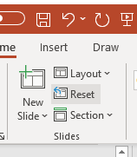
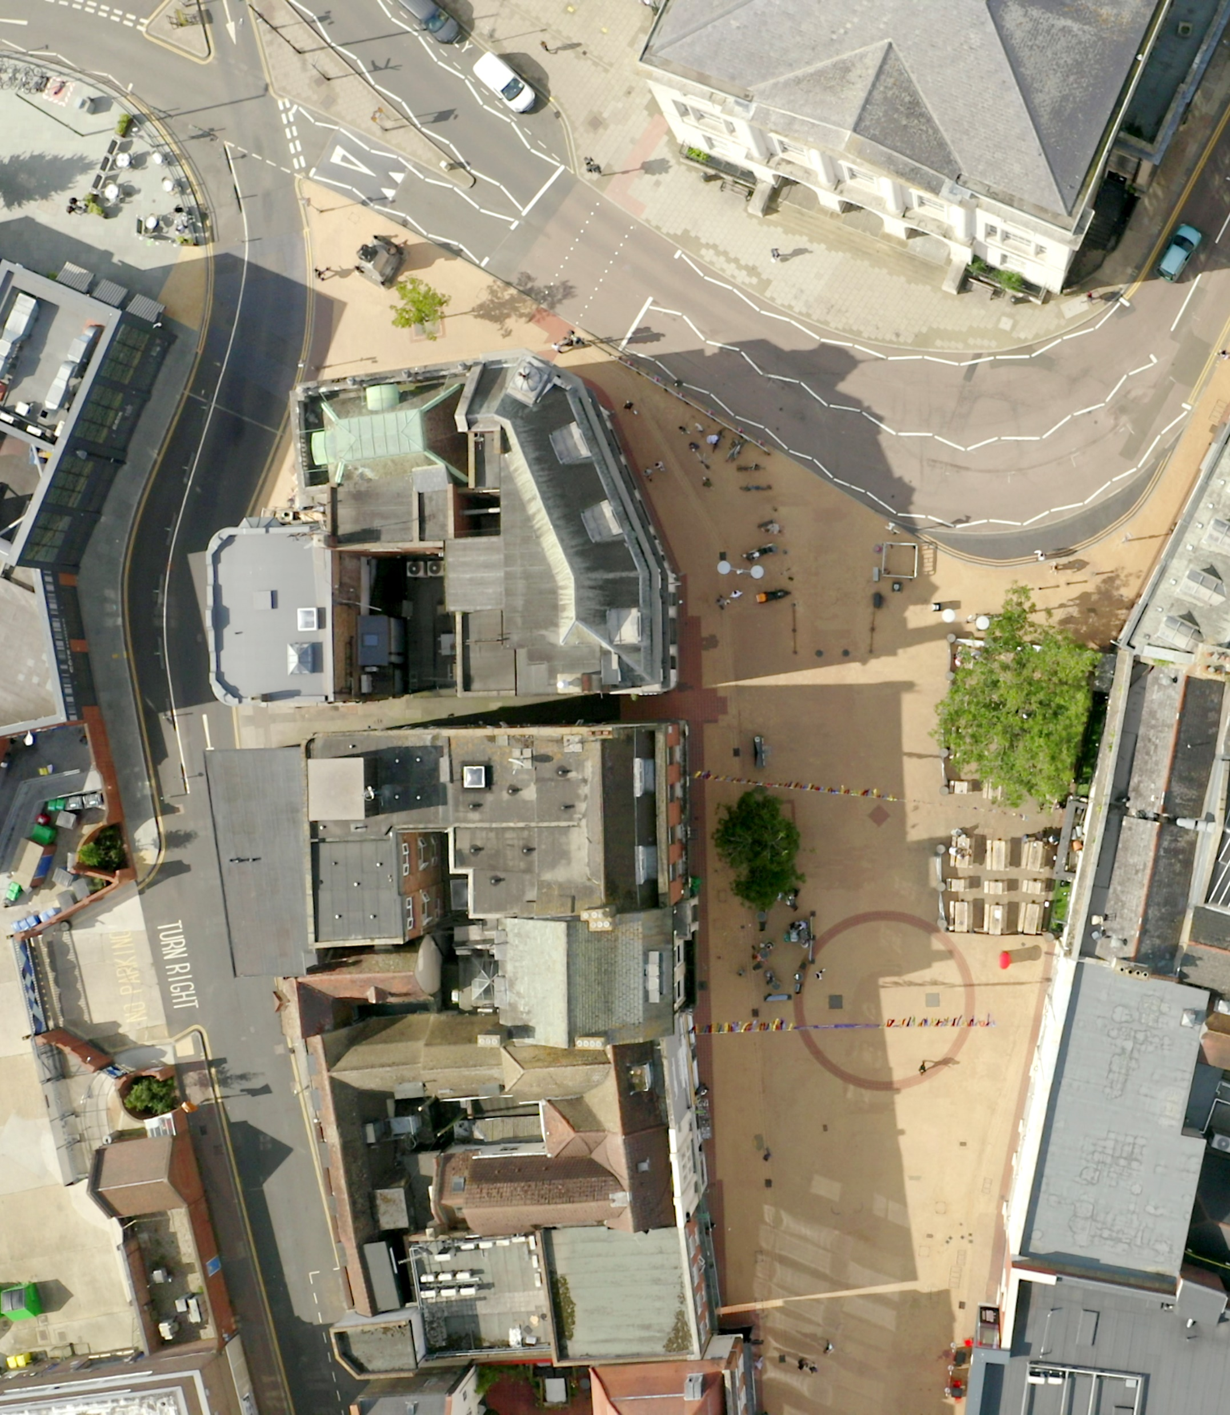
Safeguarding update
To change image:
Delete existing image and insert new by clicking on icon
or
Right-click, change picture
If new picture causes placeholder to resize or rotate
Click on ‘Reset’
under ‘Slides’ tab
on Ribbon
To resize or reposition image within placeholder:
Picture Format> Crop
Resize using white circles at corners
Move by click+hold on grey area of image then drag to position

Slide 4
Early Years website:
  Visitors to setting leaflet
  Safeguarding topics
  Confirmation of documents received
  Templates for CP files
  Risk assessment templates
  Model CP policies
  Audit

Slide 5

General updates
Safeguarding audit:
Baseline data
‘health check’ for settings
Report to ESCB
  Child Protection file Guidance
Understanding and Supporting Behaviour guidance

Slide 6
Prevent: UK Threat Level = Substantial
  Regional threat priority areas for Eastern Region agreed October 2022: Extreme Right Wing Terrorism (ERWT), Self-Initiated Terrorism (S-IT) and Extremism in Prison
  Islamist Terrorism: assessed that threat remains present across region and nationally, and an attack from Islamist terrorists at any time is likely. Assessed that if Islamist terrorist attack were to occur in UK, use of a vehicle as a weapon is likely, use of bladed and blunt-force weapons is highly likely and use of fire as a weapon is unlikely. Radicalisation remains concern within region, both online and in person. Accessing extremist material online continues to present significant concern to CT Policing - has regularly appeared in Islamist Extremist intelligence in the region in the previous six months
  Extreme Right Wing (Terrorism): assessed that attack in the UK is a realistic possibility - if attack were to occur, use of a vehicle as a weapon is likely, use of bladed and blunt-force weapons is highly likely and use of fire as a weapon is likely. Individuals with an ERW ideology using online platforms to promote views and access extremist material, also references to minors (under the age of 18) engaging in ERW activity. Approximately 20% of ERW reporting in this period relates to individuals under the age of 18
  Emerging vulnerabilities:
    September 2022 - reported that ERW stickers, depicting Nordic Sun Wheel with the words “White Supremacy” and stickers promoting individuals joining “The White Defence League” located in Clacton
    December 2022 - a Combat-18 sticker was located in Chelmsford
  25 referrals from Essex (15 from Education)

Slide 7
Upcoming training from the ECC Education Safeguarding Team
Train the trainer
Key safeguarding information for new DSLs
For DSLs who will be delivering Level 2 training to all staff
Search for “Safeguarding Level 2 training presentations for early years - Train the Trainer” on the booking system
For New Designated Safeguarding Leads / Deputy Leads who have not yet completed Level 3 training
Search for “Safeguarding Briefing for new Designated Safeguarding Leads/Headteachers” on the booking system

Slide 8
Upcoming training from the ECC Education Safeguarding Team
Brook Traffic Light Tool
Brook Traffic Lights Tool provides guidance to help adults identify, understand and respond to young people’s sexual behaviours. It supports professionals to recognise sexual behaviours and assess whether they are age and developmentally appropriate or harmful
Search for “Brook Traffic Light Training - sexual behaviours in children and young people” on the booking system

Slide 9
Private Fostering
        Team Manager: Adwoa Solomon

Slide 10
The Origins of Private Fostering
In 2000, nine year old Victoria Climbie suffered chronic neglect and sustained multiple injuries which resulted in her death.
Victoria had been being cared for by her Great Aunt in what would now be considered a Private Fostering Arrangement.
As a result of Victoria’s tragic death, there was a Government Inquiry which made recommendations to try to better safeguard and protect children in similar circumstances.

Slide 11
What is Private Fostering?
When a child/young person under 16 (18 if disabled) lives with someone who is not a close relative for more than 28 days, this is called ‘Private Fostering’.
The law considers a close relative to be a grandparent, brother / sister, uncle / aunt (this can be by marriage) or step-parent.
It is a legal requirement for parents and private foster carers to notify the Local Authority when a private fostering arrangement is made. This needs to happen at least 6 weeks before the arrangement is due to start, or if the child/young person arrives suddenly, no more than 48 hours after he or she has arrived.
Private Fostering is a private arrangement that is made between the parent and the private foster carer. Private foster carers are not Local Authority Foster Carers and the children/young people within the arrangements are not Looked After Children.

Slide 12
Examples of Private Fostering
A young person living with the family of a boyfriend, girlfriend or a friend.
A child or young person living with an extended family member, for example a Great Aunt, Great Grandparents or a Cousin.
A child or young person living with a family friend, perhaps as a result of parental separation, arguments at home or because their parents are overseas or working away.
Children/young people who are in this country as part of an educational exchange programme and will be staying with a host family for a period longer than 28 days.

Slide 13
Responsibilities Towards the Child
The private foster carer becomes responsible for providing the day to day care of the child. However, the child’s parent remains legally responsible for the child.
The Private Fostering Team ask parents and private foster carers to share information and agree practicalities around the day to day care of the child/ young person. This includes details such as how long the arrangement will last, who will keep in touch with the child’s school, who can give consent over medical matters, how the child/young person will be provided for financially, agreeing what support the child/young person’s parents will provide and deciding how contact with family members will happen.

Slide 14
What are the Duties of the
Local Authority?
Once the Local Authority is made aware of a private fostering arrangement, a member of the Private Fostering Team will visit the arrangement within seven days.
Formal checks with the police and other agencies are made to ensure that the child is safeguarded and that the private foster carers are able to provide a reasonable standard of care.
An assessment is completed to consider the child/young person’s needs and the private foster carer’s ability to meet them
If the arrangement continues, we undertake regular visits to the home to offer advice and support and ensure the arrangement continues to be suitable.

Slide 15
Your
Responsibilities…
Your responsibilities
Partner agencies have a responsibility to notify Essex County Council immediately if they become aware of any Private Fostering arrangement and believe the Local Authority have not/will not be notified.
If at any time you become concerned about anything affecting the Private Fostering Arrangement, please contact us immediately.
How can you help us?
Promote awareness and understanding of Private Fostering within your own teams and with members of the public where ever possible.
Help with distribution of leaflets and posters as widely as possible.
We may contact you and other involved agencies requesting information about the child and/or the private foster carers
.

Slide 16
Reg 24 vs Private Fostering
Difference between Reg 24 placement and PF arrangement.
Reg 24.
Social Care will have had previous involvement and are actively involved in making the decision where the child should live.
The Carer goes through a viability assessment which will determine if the child is placed there. This is a Local Authority placement.
The placement can be made with someone who can be a relative, friend or other person connected with the child.
Financial support can be made available.
Cases are presented to a Fostering Panel for final decision.

Slide 17
Reg 24 vs Private Fostering
Private Fostering
There could have been previous, or maybe current, Local Authority involvement. The decision for the child to live with the family, is NOT made by the Department.
Safeguard checks and a dedicated Private Fostering assessment are completed, and must be done within 42 days.
Carers are not approved by the Department. The decision on suitability is taken by The Agency Decision Maker.
There is no financial support provided by the Private Fostering team. If it is decided that the child is a Child in Need, then a referral can be made to the relevant team.
Visits are carried out every six weeks at minimum and, every three months after the arrangement has been ongoing for one year.

Slide 18
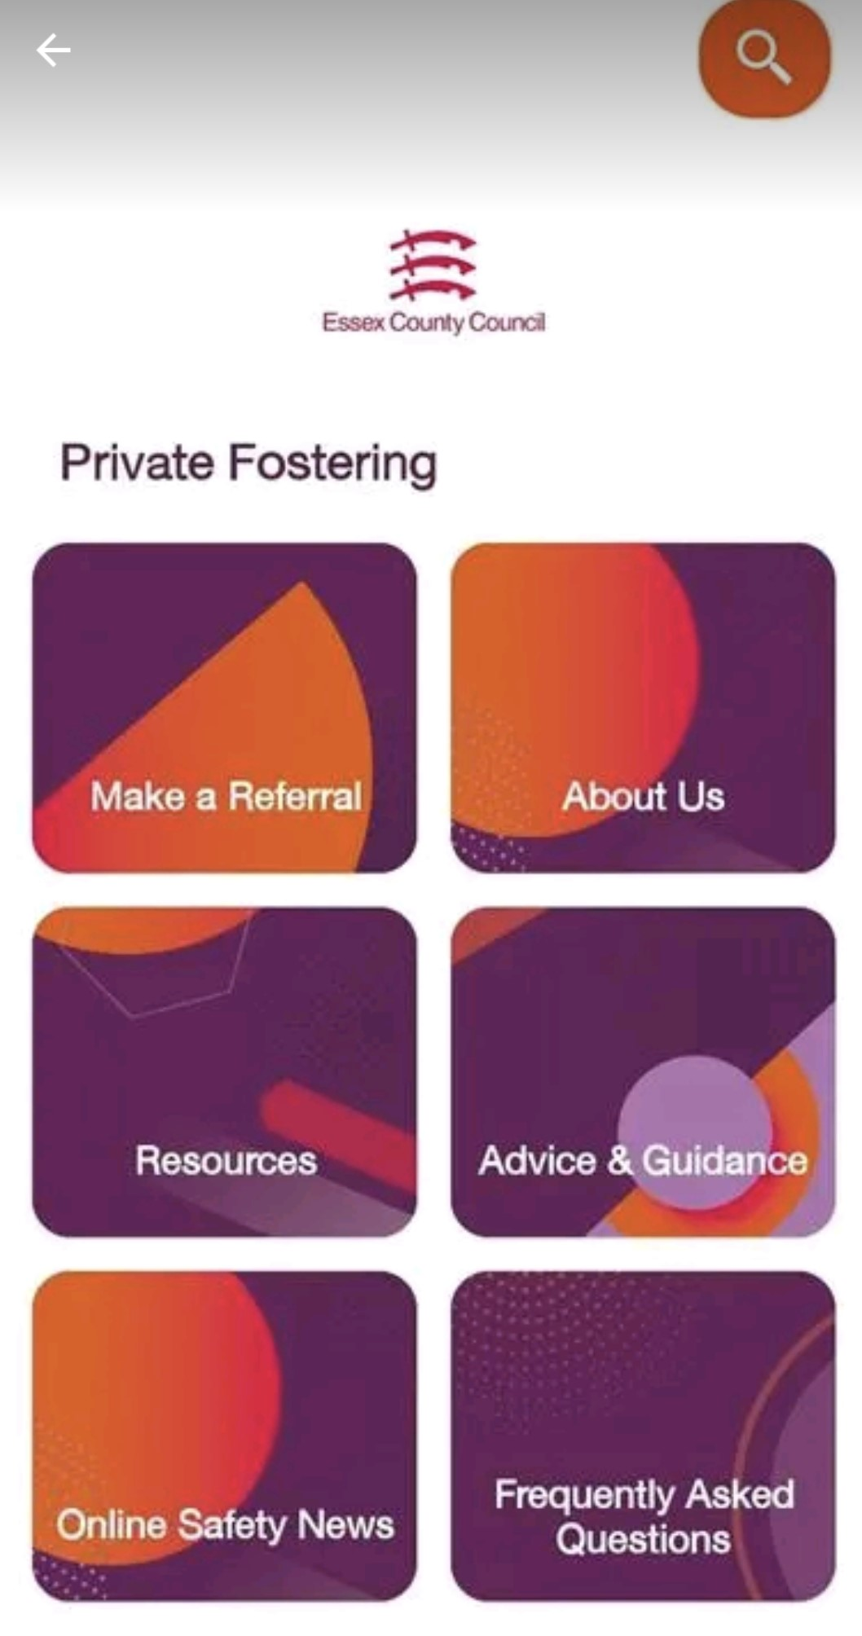
Private Fostering App
The Private Fostering app went live in October 2021 .This gives information on what Private Fostering is and the responsibilities of all stakeholders

Slide 19
How do I find out more?
You can make a referral to the Private Fostering Team via the Children and Families HUB by following this link
Report a concern about a child: Report a concern about a child - Essex County Council
You can also contact The Children and Families Hub on
0345 603 7627
Internal referrals for children or young people already known to CSC can be made via the Private Fostering Notification Form on Mosaic.

Slide 20
Safeguarding training requirements
For Early Years settings and Childcare Providers in Essex

Slide 21
Training requirements for Essex settings
Training type | Who? | How often?
Level 1 training | All staff | Once
Level 2 training | All staff | Annually + Ongoing CPD
Level 3 training | DSL Deputy DSL | Every 2 years + Ongoing CPD
The EYCP safeguarding training pages provide an overview of the training requirements and links to the different training options

Slide 22
Statutory and local training requirements
Statutory Guidance
“Must have regard to”
Local Guidance
Early years foundation stage (EYFS) statutory framework
Working Together to Safeguard Children
Keeping Children Safe in Education
The Prevent Duty Guidance for England and Wales
Essex Safeguarding Children Board (ESCB) Learning and Development Page
Under the ‘Important Information’ Heading on the right hand side there is:
Early Years Training Levels October 2021
ESCB Safeguarding Training Levels October 2021

Slide 23
Level 1 training
Safeguarding Children Level 1 e learning- Basic awareness (free of charge)
or
Email escb.training@essex.gov.uk if you would like to deliver Level 1 training to a group via PowerPoint
  Level 1 training provides an introduction to safeguarding.
  All staff should complete Level 1 training once and it should be part of induction for new staff.
Delivery
  The ESCB offer Level 1 training in two formats:
    An online e-learning course that delegates can complete themselves
    Via a PowerPoint that Designated Safeguarding Leads can deliver to staff in groups

Slide 24
Level 2 training
Level 2 presentations for in-house delivery by the DSL, and a certificate template (we offer Train-the-trainer sessions to support DSLs who choose this option)
Anster Level 2 sessions can be booked through the Education Essex Online Booking System
  For all staff
  Undertaken as part of induction within 5 days
  Repeated annually
Delivery options
    The DSL can deliver Level 2 training to staff. We have provided the resources to enable this. This option is free
    Staff can access Level 2 training externally – Anster are the preferred provider
    Staff can access Level 2 training from an alternative provider. The Lead (Safeguarding) Practitioner is responsible for checking that the outcomes of the course match the Level 2 training outcomes set by the ESCB and that staff are aware of the Essex context for safeguarding

Slide 25
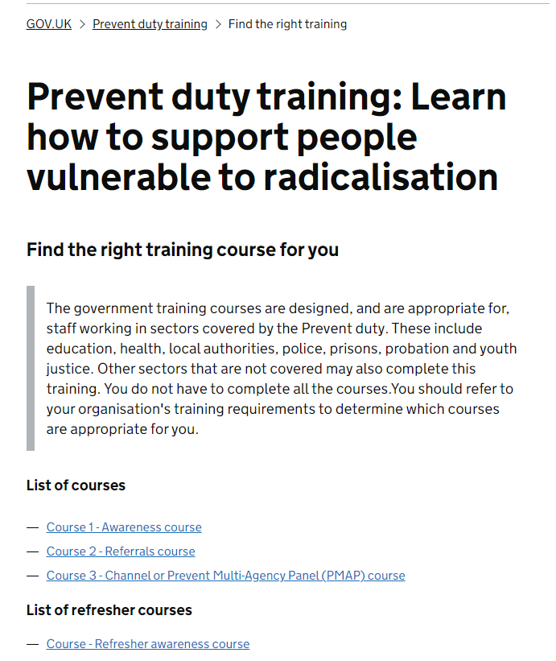
PREVENT training
  The Prevent Duty Guidance – all staff subject to the Prevent duty (this includes Early Years Settings) must undertake Prevent training
  New Government PREVENT training programme:
  Prevent duty training: Learn how to support people vulnerable to radicalisation
    Course 1 – Awareness Course
    Course 2 – Referrals Course (for DSLs and DDSLs)
    Course 3 – Channel or PMAP course (for DSLs if the setting is invited to Channel Panel)
    Course 4 – Refresher awareness course
    We recommend all staff take the Awareness Course and then take the refresher course annually. A log should be kept of this.
    DSLs and DDSLs should take the awareness course and referrals course, as well as the refresher awareness course annually.

Slide 26




Level 2 – CPD for all staff
Training courses
  Staff could attend additional training courses on topics
Staff meetings
  The DSL could source and present bite-size safeguarding training on various topics during staff meetings
E-bulletins
  Staff could be encouraged to sign up to safeguarding e-bulletins
Email
  Articles and news items on safeguarding topics could be sent to staff

Slide 27

Staff induction training
  Each new staff member should have safeguarding training as soon as possible after they start their new role in your setting. If they are working with children on their first day, you want to ensure they know how to identify safeguarding concerns and know where to report them.
  Induction training should include:
  Level 1 training
  Level 2 training
  PREVENT Awareness training
  Any other training you deem necessary

Slide 28
Level 3 training
  All Lead (Safeguarding) Practitioners, Deputy Lead (Safeguarding) Practitioners and Childminders must undertake full Level 3 training every 2 years
  Level 3 training courses are not offered by ECC
  You can choose a course from any provider, as long as the Lead (Safeguarding) Practitioner/Childminder deems the course to be suitable (our team is not able to offer this service)
  The Essex Safeguarding Children's Board (ESCB) document 'ESCB Training Levels' sets out the expected outcomes for training levels, including Level 3. The document can be accessed under the 'Important Information' section on the ESCB Learning and Development page
  In Essex, our preferred provider is Juniper Education, as the course is delivered within the Essex context. The course is entitled “Designated Person for Child Protection in Early Years Settings - Safeguarding Level 3" or “Designated Person for Child Protection in Early Years Settings - Safeguarding Level 3 *CHILDMINDER SESSION” and you can search for it on the Juniper website
  Designated Safeguarding Leads should also undertake Prevent awareness training

Slide 29

Level 3 – CPD for DSLs/Lead Practitioners
  During the 2 years between Level 3 training, Designated Safeguarding Leads must update their knowledge and skills at regular intervals
Training courses
  DSLs/Deputies could attend additional training courses on topics
Safeguarding forums
  The DSL / Deputy DSL should attend the termly ECC EY Safeguarding forums for important updates and training
E-bulletins
  DSLs/Deputies could sign up to safeguarding e-bulletins
Articles and information pages
  Articles and news items on safeguarding topics could be read

Slide 30




Training sources
ESCB – Learning and Development
SETDAB – Domestic Abuse training
NSPCC training and NSPCC information pages
EYCP training pages – Level 2 PowerPoints
Gov.uk resources

Slide 31
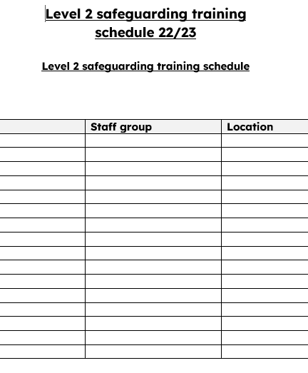
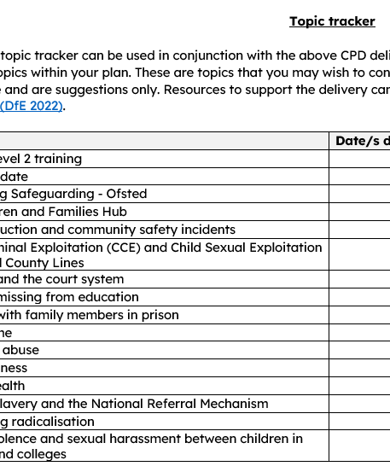
Training schedule
  We recommend safeguarding training is planned and tracked. This would include:
  A record of induction training for each staff member
  A record of Level 1 and Level 2 training for each staff member, and the dates it is updated
  A record of Level 3 training for DSLs and DDSLs, and the dates it is updated
  A record of CPD training undertaken by all staff
  We recommend settings create a ‘training schedule’ to support the regular delivery of a variety of safeguarding training and CPD opportunities.
  We have provided a ‘training schedule’ template, which includes a topic tracker, on the EYCP training page. This can be amended as needed.

Slide 32
Sexualised behaviour between children – introduction
  It is normal for some children to display sexualised behaviour towards other children as they develop. However, sexualised behaviour between children that has become harmful must be addressed.
  Examples of sexualised behaviour between children can include:
  inappropriate or unwanted sexualised touching;
  upskirting, which typically involves taking a picture under a person’s clothing without them knowing;
  inappropriate comments of a sexual nature online or offline, for example sexual or sexist name-calling.

Slide 33
Sexualised behaviour between children – context
  National attention to sexualised behaviour between children from 2021
  Everyone’s Invited and other websites included testimony from children and adults about their experience of sexualised behaviour and culture in schools and other settings
  Ofsted rapid review 2021:
  32 schools and colleges visited
  discussions with over 900 children
  further discussions with school leaders, teachers, governors, local safeguarding partners, parents and other stakeholders

Slide 34
Sexualised behaviour between children – Ofsted Rapid Review recommendations as they apply to Early Years settings
  Whole setting approach
  Education: helping children to learn about healthy relationships
  Staff knowledge: to understand when sexualised behaviour may have become harmful and when to take action
  Local safeguarding partners: where appropriate, working closely with Social Care, the police, health, using Early Help…
  Record-keeping: essential practice for all safeguarding concerns and can help to identify trends, patterns
Notes:
Although these behaviours would tend to occur more in schools than in Early Years settings, they can occur in Early Years settings, and Early Years children could be affected by the experiences of their older siblings in schools.
It is essential that all staff understand the importance of challenging inappropriate behaviours between children, many of which are listed below, that are actually abusive in nature. Downplaying certain behaviours, for example dismissing sexual harassment as ‘just banter’, ‘just having a laugh’, ‘part of growing up’ or ‘boys being boys’ can lead to a culture of unacceptable behaviours, an unsafe environment for children and in worst case scenarios a culture that normalises abuse leading to children accepting it as normal and not coming forward to report it.
Child on child abuse is most likely to include, but may not be limited to: • bullying (including cyberbullying, prejudice-based and discriminatory bullying); • abuse in intimate personal relationships between children; • physical abuse such as hitting, kicking, shaking, biting, hair pulling, or otherwise causing physical harm (this may include an online element which facilitates, threatens and/or encourages physical abuse); • sexual violence, such as rape, assault by penetration and sexual assault; (this may include an online element which facilitates, threatens and/or encourages sexual violence); • sexual harassment, such as sexual comments, remarks, jokes and online sexual harassment, which may be standalone or part of a broader pattern of abuse; • causing someone to engage in sexual activity without consent, such as forcing someone to strip, touch themselves sexually, or to engage in sexual activity with a third party; • consensual and non-consensual sharing of nudes and semi nudes images and or videos (also known as sexting or youth produced sexual imagery); • upskirting, which typically involves taking a picture under a person’s clothing without their permission, with the intention of viewing their genitals or buttocks to obtain sexual gratification, or cause the victim humiliation, distress or alarm; and • initiation/hazing type violence and rituals (this could include activities involving harassment, abuse or humiliation used as a way of initiating a person into a group and may also include an online element).
DISCUSSION:
Are you confident that children know how to report child on child abuse, within the context of an Early Years setting?
Are you confident all staff recognise child on child abuse (and do not dismiss it as inappropriate behaviour)?

Slide 35
Sexualised behaviour – identifying, understanding and responding
  Knowing how to identify, understand and respond to sexualised behaviour in children helps adults to support healthy development and to protect children from harm
  Typical behaviour which is developmentally appropriate in Early Years settings may present in different ways. For example through:
  games
  talking
  questions
  role-play
  touching

Slide 36
Sexualised behaviour – identifying, understanding and responding
  When children display sexualised behaviour which increases their vulnerability and / or causes harm to other children, adults must take action which supports and protects children
  Some children may be at increased risk of exposure to, or of developing, harmful sexual behaviour. This includes children who:
  have experienced abuse or neglect
  have been exposed to domestic or family violence
  have had disruptions to their development or socialisation
  live with disability

Slide 37
Sexualised behaviour – considering the behaviour
  Is the behaviour age appropriate?
  What is the relationship between the children? Think about their age, any additional needs, power imbalance
  Was the behaviour spontaneous, or planned / was there an element of threat?
  Where did the behaviour take place? Was it in public, or in private?
  Does the behaviour appear to have been a one-off, or has it been more regular (check records)?
  Are there any other concerns about the child / what is their context?

Slide 38
Sexualised behaviour – responding to the behaviour
  If the behaviour was spontaneous, in public, and without any apparent threat or power imbalance, then an educational response may be appropriate – for example speaking with the child / all children, using resources as required
  If the behaviour contains more concerning elements, the setting may need to consider a more targeted response, consulting with statutory services as appropriate
  All sexualised behaviour in children will need a response. The response will vary depending on the circumstances

Slide 39
Sexualised behaviour – examples in Early Years children
  Developmentally appropriate: interest in body parts and functions, comfortable being nude, body touching and holding own genitals, talking with familiar adults about their body parts (for example during bath time)
  Causing concern: preoccupation with sexualised behaviours, pulling other children’s clothing down against their will, explicit sexualised language, touching the genitals of other children in preference to other activities
  Causing harm: simulation of sexual touch or sexual activity, disclosure of sexual abuse, forcing other children to engage in sexual activity, persistently touching other children’s genitals, indication of a sexually transmitted infection
  Remember: all sexualised behaviour in children will need a response. The response will vary depending on the circumstances

Slide 40
Sexualised behaviour – resources
  The ECC Education Safeguarding Team has produced Child on Child Abuse – Harmful Sexual Behaviour guidance. The guidance is primarily for schools but may be useful for Early Years settings. There are a number of separate appendices including risk assessment templates, safety plans, and common language framework:
  Child on Child Abuse - Harmful Sexual Behaviour (Essex Schools Infolink)
  The NSPCC website includes information about ways to promote healthy relationships in Early Years settings, and ‘pants’ resources (the ‘Underwear Rule’, lesson plans, information for parents, guidance):
  NSPCC Learning

Slide 41
educationsafeguarding@essex.gov.uk

