Slide 1
Level 2 Safeguarding Training for Early Years 2023-24
Female Genital Mutilation (FGM) Awareness
Essex Education Safeguarding Team September 2023 Copyright © Essex County Council 2023 No part of this publication may be reproduced, stored in a retrieval system of any nature, downloaded, transmitted or distributed in any form or by any means including photocopying and recording, without the prior written permission of Essex County Council, the copyright owner
Notes:
Discuss that FGM is a safeguarding issue and that all staff need a basic awareness and understanding of this issue

Slide 2
What is FGM?
The World Health Organisation definition of FGM:
Female Genital Mutilation (FGM) comprises all procedures that involve partial or total removal of the external female genitalia, or other injury to the female genital organs for non-medical reasons.
Notes:
This also includes vaginal piercings in under 18s
If an under 18 discloses to a teacher that she has had a piercing, mandatory reporting would apply

Slide 3
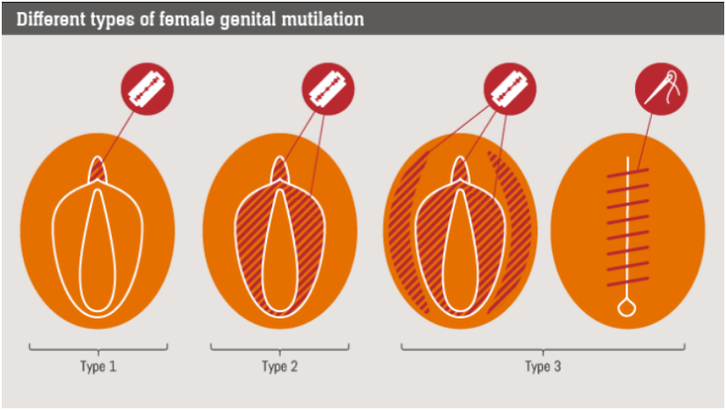
Types of FGM
Notes:
Talk through each type:
Type 1 – partial to total removal of the clitoris
Type 2 – Partial to total removal of the labial lips
Type 3 – called ‘infibulation’ – partial to total removal of clitoris and labial lips, followed by a covering seal made over the top, leaving a small hole (often the size of a matchstick) for urination and menstruation.
Type 4 – any other damage to the genitalia – piercing, pricking, nicking, incising, cauterizing etc.

Slide 4
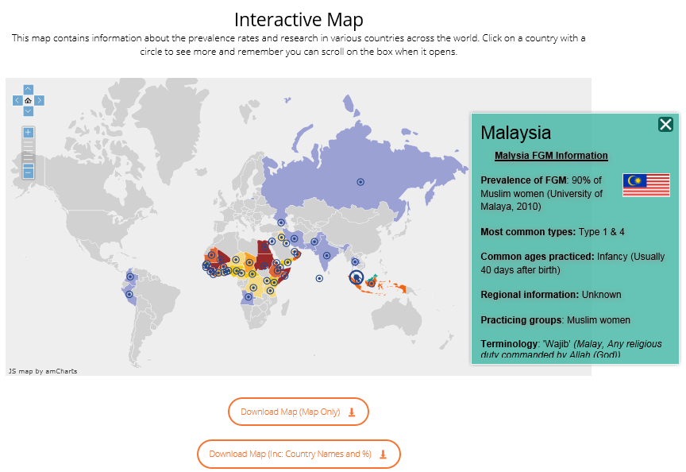
Interactive map
Notes:
www.nationalfgmcentre.org.uk
FGM is not an African problem – world wide problem
Professionals can use the (free) interactive map to look at prevalence information
When working with a family, professionals not only need to know the country of origin, but more importantly the ethnic group.
Spend a few minutes showing the map and what information can be found on it

Slide 5
Why is FGM practised?
Preservation of the girl’s virginity
Protection of family honour
Rite of passage into womanhood
Marriage
Perceived health benefits
Cleanliness
Perceived religious justifications. There are no religions that advocate for FGM.
Safeguarding
Notes:
Pick out different ‘justifications’ and explain them
Emphasise the safeguarding element – families do this as they think it’s a way of safeguarding their daughters - and the importance of exploring families views around FGM and why they practise.

Slide 6
Health Implications There are NO health benefits to FGM
Physical
Death
Severe pain and shock
Broken limbs from being held down
Injury to adjacent tissues
Urine retention
Increased risk of HIV and AIDS
Uterus, vaginal and pelvic infections
Infertility
Psychological
Depression
Post-natal depression
Psychosexual problems
Sexual dysfunction
PTSD
Trauma and flashbacks
Anxiety
Claustrophobia
Notes:
Pick out different issues and explain them

Slide 7
The Law and FGM
FGM Act, 2003
Illegal to perform in the UK
Illegal to perform outside the UK
Illegal to organise FGM (including to buy plane tickets
14 years imprisonment
Serious Crime Act, 2015
Mandatory reporting for certain professionals
FGM Protection Orders
Parental liability
Anonymity for survivors

Slide 8
Case study
A child in your setting has told another child that she is excited to be going away to her ‘mum’s country’ for a holiday and that she has been told she will be meeting lots of family and getting lots of presents.
You have a conversation with the girl, and she confirms the holiday, and says it’s for 4 weeks. She also mentions that her ‘mum’s country’ is Pakistan. She says she has never been before, but that her mum has told her ‘now is an important time’
Does this warrant a referral to social care?
What next steps should you take?
Notes:
Does this warrant a referral to social care – No. More information is needed.
Next steps
Look at Pakistan on the world prevalence map. Does the girl come from an affected ethnic group?
Contact NFGMC worker for advice
The NFGMC will most likely ask you to gather more information from girl and parents such as but not limited to:
Girl: can you find out any more information from the girl about the holiday? Who else is going? Where are they going in Pakistan? When are they going?
Parents: Who else is going? Where are they going? When are they going? Broach the question of FGM: “Have you heard of FGM? Female Circumcision? What do you know about it? Is it an issue that has affected your family?”
If the information gathered causes concern, NFGMC will advise to refer to Children & Families Hub

Slide 9
Talking to parents or carers:
Always use a female worker where possible
Research where the family is from, looking at ethnic groups and prevalence before your visit
Use simple language and ask straightforward questions – be curious
Use the term the family is familiar with for FGM (can be found on world map)
Always use a qualified trained female interpreter who speaks the same dialect

Slide 10
Education, FGM, BF, CALFB pathway
Notes:
School example but you can make the point that it is useful to share – similar scenarios may apply to Early Years settings

Slide 11
Working in Partnership with the National FGM Centre
Provide advice and consultation
Support for professionals on speaking to parents
Advice on the risk indicators of potential FGM
Support for families
Support for settings around awareness/training
School Guidance (National FGM Centre, 2019)
For further advice and guidance on FGM, you can contact the Essex Children & Families Hub and ask to speak with the FGM Adviser

Slide 12
Early Years key safeguarding documents
Statutory framework for the early years foundation stage (DfE, 2023)
Children learn best when they are healthy, safe and secure, when their individual needs are met, and when they have positive relationships with the adults caring for them
Safeguarding children and protecting professionals in EY settings: online safety considerations for managers (DfE, 2019)
SET Procedures (ESCB, 2022)

Slide 13
Early Years key safeguarding documents (2)
Working together to safeguard children (HMG, 2023)
What to do if you're worried a child is being abused (HMG, 2015)
PREVENT Duty Guidance (HMG, 2015)
Essex Effective Support for Children and Families (ESCB, 2021)
Keeping children safe in education (DfE, 2023)

Slide 14
Early Years and Childcare website safeguarding pages:
Templates for reporting and recording concerns
Termly forum presentations and briefings
How to report a concern about a child
How to report a concern about a member of the workforce
Model Child Protection Policy (for settings, and childminders)
Level 2 training presentations (including this presentation)
Key safeguarding information and documents
Safeguarding audit

Slide 15
Education Safeguarding Team
Head of Education Safeguarding and Wellbeing:
Jo Barclay
Education Safeguarding Advisers:
Alex Darvill (South and West)
Derai Lewis-Jones (Mid and NE)
Matthew Lewis
Education Safeguarding Officer (MARAC)
Gemma Harris
educationsafeguarding@essex.gov.uk

