Slide 1
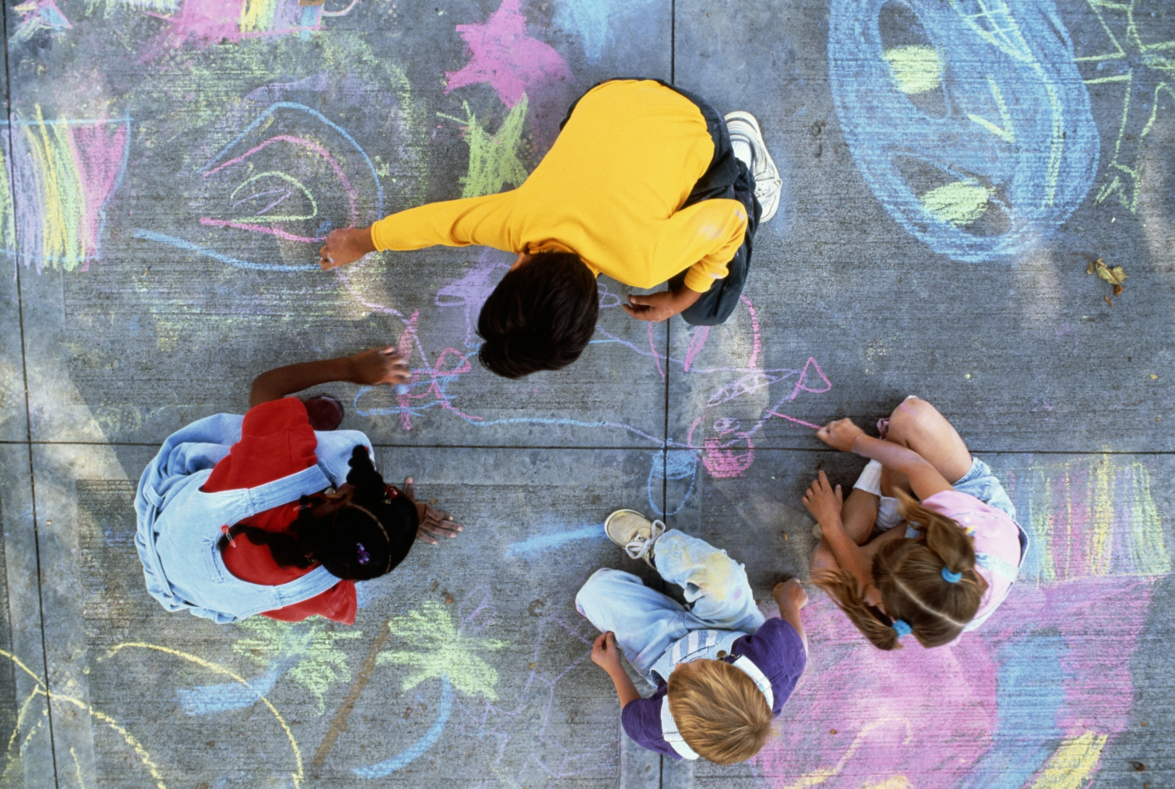

Keeping Children Safe in Education:
Prevent training for education settings
Copyright © Essex County Council 2025
No part of this publication may be reproduced, stored in a retrieval system of any nature, downloaded, transmitted or distributed in any form or by any means including photocopying and recording, without the prior written permission of Essex County Council, the copyright owner
Notes:
This presentation can be used as part of ongoing training for staff.

Slide 2
Contents page:
1
What is Prevent?
5
Websites
Prevent in Essex
2
Prevent Duty guidance 2023
6
3
Definitions and key terms
4
Channel and prevent referrals

Slide 3
What is Prevent? (Home office Video)
Prevent: An Introduction (youtube.com)
Notes:
We will explore these documents in more detail on the next few slides

Slide 4
What is PREVENT?
1 July 2015, the Counter-Terrorism and Security Act 2015 placed a new duty on schools and other providers of education and care, in the exercise of their functions to have ‘due regard to the need to prevent people from being drawn into terrorism’.
Home Office guidance on what this means for schools and other providers: Prevent Duty Guidance - (updated 2023)
The Prevent strategy published by the government in 2011 is one of four elements in the Governments counter terrorism CONTEST strategy:
Prevent people from becoming terrorists or supporting terrorism.
Pursue to stop terrorist attacks.
Protect to strengthen our protection against a terrorist attack.
Prepare to mitigate the impact of any attack.
Notes:
The guidance states that schools should be safe spaces in which children and young people can understand and discuss sensitive topics, including terrorism and the extremist ideas that are part of terrorist ideology, and learn how to challenge these ideas.

Slide 5
Prevent Duty Guidance
Strategy
Education duty Guidance
Summary
Notes:
We will explore these documents in more detail on the next few slides

Slide 6
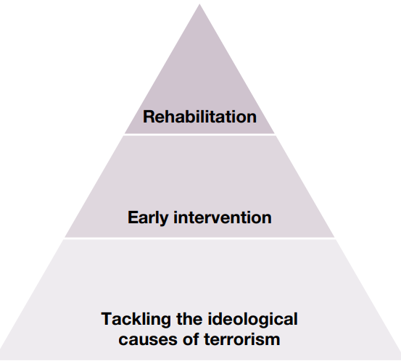
Prevent Duty guidance 2023 – Strategy
The 2023 Prevent Duty guidance has three specific strategic objectives:
To tackle the ideological causes of terrorism
To intervene early to support people susceptible to radicalisation
To enable people who have already engaged in terrorism to disengage and rehabilitate
Notes:
The Prevent model (right) shows how the strategy tackles the ideological causes that lead to radicalisation. Then, intervenes to support those susceptible to radicalisation and rehabilitates those engaged with terrorism.

Slide 7
Prevent Duty guidance 2023
Schools Should:
Teach the fundamental British values of democracy, the rule of law, individual liberty, mutual respect and tolerance of those with different faiths and beliefs to ensure learners have the knowledge, skills and values that will prepare them to be citizens in modern Britian.
Be safe spaces in which children / young people can understand and discuss sensitive topics, including terrorism and the extremist ideas that are part of terrorist ideology, and learn how to challenge these ideas.
Be mindful of their existing duties to forbid political indoctrination and secure a balanced presentation of political issues.
Notes:
These duties are imposed on maintained schools by sections 406 and 407 of the Education Act 1996. Similar duties are placed on the proprietors of independent schools, including academies (but not 16-19 academies) by the Independent School Standards

Slide 8
Prevent Duty guidance summary
  Students’ resilience to extremist ideology is strengthened by providing a safe space to debate controversial issues and develop their critical-thinking skills and knowledge so they can challenge extremist narratives.
  Many teenagers look for answers to questions about identity, faith and belonging, and are in search of adventure and excitement. Extremist groups claim to offer answers and provide a strong sense of identity to vulnerable young people.
Extremist groups are sophisticated in their use of the internet and social media, and this is often how they spread their ideology. This has made young people more susceptible to extremism, whether from Islamists or the far right.
Schools already help safeguard pupils from drugs, gangs and sexual exploitation. Radicalisation can have a similarly devastating effect on individuals, families and communities and protecting pupils from this is an important part of a school’s overall safeguarding role.
Notes:
For discussion: What does your school do to prevent radicalisation?
Children from all kinds of different backgrounds can become radicalised
You need to be aware of the factors that make your pupils more vulnerable to radicalisation. The following is a guide only, and you need to use your professional judgment to assess their vulnerability.
Young people often struggle with their sense of identity, and this can make them vulnerable to extremist influence. Some may feel distant from their cultural or religious heritage, or isolated from the prevailing British culture, which may lead them to question their place in British society.
Personal circumstances, such as tensions in the family or having experienced a traumatic event, can also increase vulnerability. Extremists prey on low self-esteem, perceptions of injustice and feelings of failure combined with a sense of grievance, often triggered by firsthand experience of racism or discrimination. If your pupils have special educational needs, or find it difficult to interact socially, empathise or understand the consequences of their actions, they may be more vulnerable to radicalisation.
External factors, such as tensions in the local community, events affecting their country or region of origin, having friends or family who have joined extremist groups, and exposure to narrow points of view, are also a factor.

Slide 9
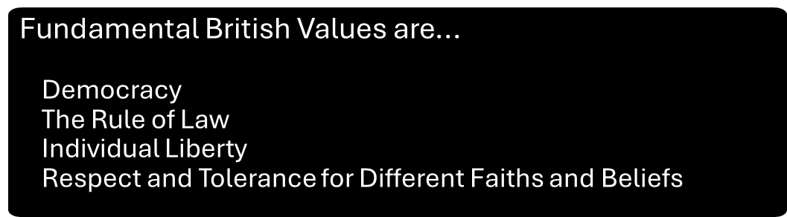

Whole school approach
Permissive environments
Risk and vulnerabilities
Push and Pull factors
Notes:
We will explore these documents in more detail on the next few slides

Slide 10
Permissive environments
A ‘permissive environment’ may be characterised as being tolerant of behaviour or practices strongly disapproved of by others, such as an environment where radicalising ideologies are permitted to flourish. Permissive environments can exist both online and offline. Permissive online environments can contribute to online radicalisation.
Radicalisers create and take advantage of permissive environments to promote or condone violence and to spread poisonous ideologies that undermine values and society
Prevent seeks to tackle ideological causes of terrorism by limiting exposure to radicalising narratives (online and offline) and to create an environment where radicalising ideologies are challenged / not permitted to flourish
Established terrorist narratives exhibit common themes such as antisemitism, misogyny, antiestablishment, anti-LGB / gender-questioning grievances and religious or ethnic superiority
Encouragement of terrorism, including glorifying the commission or preparation of acts of terrorism, fundraising for the purposes of terrorism, and inviting support for a proscribed terrorist organisation, are all criminal offences
Notes:
Glossary of terms - GOV.UK relevant to the Prevent duty guidance 2023.

Slide 11
Pull factors
Push factors
    offering a sense of community
    promising fulfilment or excitement
    becoming part of a wider mission
    offering a narrow, manipulated version of an identity
    offering inaccurate answers or falsehoods to grievances
    encouraging conspiracy theories
    promoting an ‘us vs. them’ mentality
    blaming specific communities for grievances
    encouraging the use of hatred and violent actions to get justice
    encouraging ideas of supremacy
    isolated
    they do not belong
    they have no purpose
    low self-esteem
    anger or frustration and a sense of injustice
    confused about life or the world
    real or perceived personal grievances
Notes:
All staff should be aware of the push and pull factors that may increase a child’s vulnerability to being radicalised. Radicalisation is a process similar to the grooming process in other abuses, and staff should be vigilant about indicators

Slide 12
Categorising risk
Low risk signs:
Holding strong non-violent or non-extremist values
Criticising government policies
Taking interest in international affairs
Adopting visible signs
Being active on social media
Supporting non-violent causes
Showing new interest in political ideology or religion
Medium risk signs:
Legitimising the use of violence to defend an ideology or cause
Accessing extremist or terrorist websites, forums or publications
Expressing dehumanising views
Expressing interest to travel to a conflict zone
Being in contact with online groups or individuals known to support extremist ideology
Expressing persistent intolerance towards groups of people perceived as ‘other’.
Showing a fixation on weaponry or explosives
Being obsessed with massacre or mass violence or past terrorist activity.
High risk signs:
Verbally or physically attacking someone due to their race, religion or sexuality
Committing violent acts guided by a violent extremist group or ideology
Producing or sharing terrorist material in person or online
Recruiting others to a proscribed terrorist group or organisation
Having a ‘kill list’ or plan to carry out mass violence

Slide 13
Definitions and key terms
Extremism, Terrorism and Radicalisation
Right Wing Extremism
Islamist Extremism
Left Wing, Anarchist and Single-Issue Extremism
Mixed, unstable and Unclear
Notes:
We will explore these documents in more detail on the next few slides

Slide 14

Definitions and key terms
EXTREMISM IS:
The promotion or advancement of an ideology based on violence, hatred or intolerance which aims to:
Negate or destroy fundamental rights and freedoms
Undermine, overturn or replace the UK’s system of parliamentary democracy and democratic rights
Intentionally create a permissive environment for others to achieve results in.”
TERRORISM IS:
To ensure appropriate staff are competent to work in partnership with the local authority
children’s social care by:
  Contributing to the assessment of a child's needs;
  Implementing agreed actions to meet those needs
RADICALISATION IS:
to ensure that the setting’s system for recording concerns or files relating to child protection processes for individual children are kept safely and securely and appropriately transferred at time of transition from one setting to another

Slide 15

Right-Wing Extremism
This category covers sub-ideologies, including Cultural Nationalism, White Nationalism and White Supremacism. These themselves span a range of extreme beliefs such as antisemitism, anti-Islam, neo-Nazi, ethno-nationalism or anti-establishment

Slide 16
Islamist Extremism
Islamist extremist inspired acts of terrorism are perpetrated or inspired by politico-religiously motivated groups or individuals who support and use violence as a means to establish their interpretation of an Islamic society.

Slide 17
Left-wing, Anarchist and Single-Issue Extremism
Extreme Left-Wing
Anarchist Extremism
Single Issue Extremism
Extremists who believe in using violence and serious criminality to abolish existing systems of Government and replacing them with anarchist, socialist or communist systems
.
Extremists who believe in using violence to replace current systems of Government and law enforcement with a system that prioritises complete liberty and individual freedom
Extremists who endorse violence and serious criminality focused on a specific topic, such as animal rights

Slide 18
Mixed, Unstable and Unclear Ideologies
Mixed - ideology presented involves a combination of elements from multiple forms of extremist ideologies
Unstable - shifts between different ideologies
Unclear - individual does not present a coherent ideology yet may still be vulnerable
Involuntary Celibates (Incel) ideology:
Incels are individuals or communities that largely exist online.
They are characterised by extreme misogyny and notions of male superiority but do in some cases possess views of racial hatred.
Incels believe that although men are entitled to sex, attractiveness is determined by predetermined genetic factors which women choose when selecting a partner. This, they believe is why they are unable to form relationships or sexual experiences.
Incels blame society for this, ascribing fault to the social and political structures which privilege women, like the feminist movement.

Slide 19
Radicalisation using technology
Digital radicalisation:
The internet (including the Dark Web) has become a mechanism that groups with extreme views and ideologies can utilise to find those with similar views
Apps like WhatsApp, Telegram and Discord provide the opportunity for groups and individuals to meet and befriend individuals in order to radicalise them - End-to-end encryption offered by offered by these apps enables the discussions to remain hidden
Online Gaming:
The world of online gaming provides a digital space for extremists to lure vulnerable individuals into spaces where they can be radicalised
In-game functions such as ‘team-speak’ facilitate this as it enables individuals to vocally communicate with others in-game without being ‘friends’ with them
The connectivity of online gaming therefore provides extremists with the opportunity to befriend vulnerable people, luring them into groups who (under the pretext of gaming) can radicalise persons

Slide 20
Channel Panel:
Voluntary support programme to provide support at early stage to people identified as vulnerable to being drawn into terrorism
Multi-agency panel (Head of Education Safeguarding and Wellbeing sits on panel for Education)
Education setting invited to join meeting to contribute information and be involved in planning (where an individual is linked to the setting)
Young person could refuse to consent, but that may constitute a child protection concern if not willing to work with agencies and considered at risk
Appropriate intervention and support will be identified to address concerns, educate the individual and provide a counter-narrative
Notes:
Each local authority has a Channel Panel – this meets monthly in Essex and all agencies are represented.

Slide 21
Prevent in Essex
Notes:
We will explore these documents in more detail on the next few slides

Slide 22
Jo Barclay Head of Education Safeguarding and Wellbeing – is the Prevent Lead for Education in Essex
There is a Prevent Strategic Board to oversee arrangements in Essex and implement Essex Prevent Strategy (Prevent Lead sits on this)
There is also a Prevent Police Team that works across the Eastern region

Slide 23
Responding to Prevent concerns
If settings have Prevent-related concerns and feel a child is at risk of radicalisation or harm the DSL may:
contact the Education Safeguarding Team (Jo Barclay or Matt Lewis) for advice
consult with the Children and Families Hub at Social Care
contact the Eastern Region Counter-Terrorism Policing Team – the team will provide advice and guidance including about whether the setting should make a Prevent referral
Telephone: 01245 452 196 / Email: prevent@essex.police.uk
Any setting considering a referral to Prevent should at the same time submit a Request for Support to the Children and Families Hub
Any setting submitting a referral to Prevent should at the same time submit a Request for Support to the Children and Families Hub
PREVENT response section on Essex Schools Infolink

Slide 24
Useful Websites
Notes:
We will explore these documents in more detail on the next few slides

Slide 25
Useful Websites:
Action Counters Terrorism (ACT) – a website to engage the community in reporting concerns about people who may be involved in extremism / radicalisation
Child Net / Trust me - A resource which could start conversations around extremism and extreme online content
Counter Terrorism Policing | Home
Counter Extremism – Preventing Radicalisation in Schools - developed by the London Grid for Learning (LGfL)
Educate Against Hate - Prevent Radicalisation & Extremism - Government advice and trusted resources for schools to safeguard students.
Act Early

Slide 26


This information is issued by: Essex County Council
Contact us:
educationsafeguardingteam@essex.gov.uk
Education Safeguarding Team
Essex County Council
County Hall, Chelmsford
Essex, CM1 1QH
Essex_CC
facebook.com/essexcountycouncil
The information contained in this document can be translated, and/or made available in alternative formats, on request.
Published September 2025

