Slide 1
Safeguarding forums for Early Years Settings
Autumn 2023

Slide 2
Agenda
Safeguarding update
2. Prevent Duty
3. Working Together To Safeguard Children 2023
4. Early Years Questionnaire

Slide 3
Education Safeguarding Team
Head of Education Safeguarding:
Jo Barclay
3 x Education Safeguarding Advisers:
Alex Darvill
Matthew Lewis
Derai Lewis-Jones
1 x Education Safeguarding Officer:
Gemma Harris (MARAC)
educationsafeguarding@essex.gov.uk
EYCP / Safeguarding (essex.gov.uk)

Slide 4
Inspectors will make the following judgements:
Overall effectiveness
Quality of education
Behaviour and attitudes
Personal development
Leadership and management
Inspectors will take range of evidence into account:
Discussion with leaders, staff, parents and children
Joint learning walk
observations
Inspection Handbook for Early Years (January 2024)

Slide 5
Before the Inspection
a list of current staff and their qualifications / DBS and other checks
a register/list showing the date of birth of all children on roll and routine staffing arrangements
a list of children present at the setting during the inspection (if not shown on the register)
all logs that record accidents, exclusions, children taken off roll and incidents of poor behaviour
all logs of incidents of discrimination, including racist incidents
complaints log and/or evidence of any complaints and their resolutions
safeguarding and child protection policies
fire-safety arrangements and other statutory policies relating to health and safety (including paediatric first-aid arrangements)
a list of any referrals made to the local authority designated person for safeguarding, with brief details of the resolutions
details of all children who are an open case to social care/children’s services and for whom there is a multi-agency plan

Slide 6
protect children from serious harm, both online and offline
are vigilant, maintaining an attitude of ‘it could happen here’
are open and transparent, sharing information with others and actively seeking expert advice, when required
ensure that all those who work with children are trained well so that they understand their responsibilities and the systems and processes that the provision operates and are empowered to ‘speak out’ where there may be concerns
actively seek and listen to the views / experiences of children, staff and parents, taking prompt but proportionate action to address concerns where needed
have appropriate child protection arrangements, which:
identify children who may need early help, and who are at risk of harm or have been harmed. This can include, but is not limited to, neglect, abuse, grooming, exploitation, sexual abuse and online harm
secure the help that children need and, if required, refer children in a timely way to those who have the expertise to help
manage safe recruitment and allegations about adults who may be a risk to children
are receptive to challenge and reflective of their own practices to ensure that safeguarding policies, systems and processes are kept under continuous review
All settings should have an open and positive culture around safeguarding that puts childrens’ interests first

Slide 7
Documentation - how are they implemented in practice?
Recruitment records
Staff qualifications and deployment
Staff training for safeguarding practice and procedures
Records of complaints

Slide 8
The following are examples of what may constitute ineffective safeguarding:
insufficient action being taken to remedy weaknesses following a failure of safeguarding arrangements that meant children may have not been safe
safeguarding allegations about staff members are not being handled appropriately
clear evidence of serious failures in safeguarding practice that lead pupils or particular groups of pupils not to be safe in school
statutory requirements, such as breaches of the requirements for Disclosure and Barring Service (DBS) checks, are not being met
pupils have little confidence that the setting will address concerns about their safety, including risk of abuse, because leaders have not taken their views seriously and/or addressed relevant concerns
pupils, particularly vulnerable pupils, not on the school site and the school are either not clear where those pupils are or are not able to give reassurances as to the appropriate steps taken to safeguard them when off-site - can include children absent from education and children attending inappropriate, unregistered or unmonitored alternative provision.
Ofsted Inspection Handbook for Schools

Slide 9
Minor improvements – Inspectors will provide opportunity to put right (this should not affect judgement, although multiple minor improvements may suggest wider weaknesses)
In deciding if provider has capacity to improve, Inspectors will consider the extent to which leaders:
Are able to identify and prioritise the right issues
Take appropriate and timely action to tackle identified issues
Have a track record of improvement
Have done all that can reasonably be expected
Reaching final judgements

Slide 10
where there is failure to meet one or more of safeguarding and welfare requirements
failures have significant impact on children’s health, safety and wellbeing
Leaders do not demonstrate understanding of requirements
Previous non-compliance to same requirements
Actions for failures to meet requirements have not been completed satisfactorily
Failure to meet requirements is so serious that Inspectors judge a WRN is necessary
Significant failure to meet safeguarding and welfare requirements - Inspectors will usually issue a welfare requirements notice (WRN)

Slide 11
DSL Supervision Offer 2023/24
Pilot - 175 DSLs from 150 schools took part: 1to1 supervision, group supervision, Ad Hoc support
Coaching, mentoring, and discussion / Team Around the Family Meetings, (TAFs) attendance at statutory meetings, including a debrief meeting to support and develop understanding of decision making
10 protected, regular, 2-hour sessions, at a time that suits the supervisee, on an individual or group basis, and ad hoc supervision, in urgent cases
£1500 per year – can be split between schools who wish to partner up

Slide 12
Prevent update:
Prevent duty guidance - places no new legal requirements or additional responsibilities on education settings
The Prevent duty: safeguarding learners vulnerable to radicalisation - GOV.UK (www.gov.uk)
How to complete a risk assessment to assess the risk of people becoming terrorists or supporting terrorism - GOV.UK (www.gov.uk)
ACT Early | Prevent radicalisation
Educate Against Hate blog: advice for schools on discussion and approach to difficult issues, including ongoing conflicts

Slide 13
Prevent: current information
UK threat level remains as SUBSTANTIAL (meaning an attack is considered likely)
The primary threat both regionally and nationally is from Islamist Extremist Groups, whilst an attack from individuals with an Extreme Far Right mindset/ideology remains a realistic possibility
There were 150 Prevent referrals across the region in the last reported quarter
43% referrals from the Education sector (9% increase)
Majority deemed vulnerability present, but no CT ideology or risk
50% Channel Panel case are for under 18 year-olds
Increase of 7 referrals in Essex (decrease in Education referrals)
Notes:
Islamist Extremist Groups – Home Office preferred term

Slide 14
Working Together to Safeguard Children 2023
Updates

Slide 15
Title changes Applies to all ‘education providers’
Working Together to Safeguard Children 2023:
A guide to multi- agency working to help, protect and promote the welfare of children.
Notes:
We are going to outline for you, very briefly, the key changes to WT. Further guidance will follow from the ESCB over the coming months. Highlighted words are new to the title.
The new document follow an independent review of Children’s social care and is linked to the Government Strategy Stable Homes Built on Love and the Children's Social Care National Framework statutory document issued December 2023

Slide 16
Safeguarding is ….
Working Together to Safeguard Children 2023:
providing help and support to meet the needs of children as soon as problems emerge
protecting children from maltreatment, whether that is within or outside the home, including online
preventing impairment of children’s mental and physical health or development
ensuring that children grow up in circumstances consistent with the provision of safe and effective care
promoting the upbringing of children with their birth parents, or otherwise their family network through a kinship care arrangement, whenever possible and where this is in the best interests of the children
taking action to enable all children to have the best outcomes in line with the outcomes set out in the Children’s Social Care National Framework
Notes:
Direct to
Early Help drop in’s
The Essex directory of services
Appendix B has links to vast number of resources (Government and others)

Slide 17
Chapter 1 : Shared Responsibility
Working Together to Safeguard Children 2023
‘Successful outcomes for children depend on strong partnership working between parents/carers and the practitioners working with them. Practitioners should take a child-centred approach to meeting the needs of the whole family.’
Notes:
Chapter one is a new chapter

Slide 18
Chapter 1: A shared responsibility
A child centered approach within a whole family focus:
Effective partnership working with parents and carers happens when practitioners build strong, positive, trusting, and co-operative relationships
Verbal and non-verbal communication should be respectful, non-blaming, clear, inclusive, and adapted to parents and carers needs
Practitioners empower parents and carers to participate in decision-making to help, support and protect children
Practitioners involve parents, carers, families, and local communities in designing processes that affect them, including those focused on safeguarding children
Notes:
The following should also be considered here as set out in the Children’s Social Care National Framework.
Child’s welfare is paramount
Children’s wishes and feelings are sought, heard and responded to
Children’s social care works with the whole family
Children to be raised within their family network wherever possible
LA to work with other agencies to identify need and should consider he economic and social circumstances impact in on the children and family.

Slide 19
Chapter 1: A shared responsibility
Expectations for multi-agency working - Senior/Middle leaders (HT / DSL / Lead Practitioner):
Collaborate: decision based on a shared practice approach, constructive debate and analysis of all information.
Learn: teams have time to engage in peer learning and knowledge exchange
Resource: managers ensure children receive the holistic support from a wide range of agencies
Include: managers support staff to identify and challenge discrimination, disparity, and negative stereotypes
Mutual challenge: constructive challenge within and across agencies is actively encouraged, independent judgements are valued alongside collective decision-making to avoid groupthink
Notes:
Expectations for mutli-agency working (applies to all agencies)
Structured at 3 levels - strategic leaders, senior and middle managers and direct practice
SENIOR/MIDDLE Head Teachers DSL’s and Nursery managers

Slide 20
Chapter 1: A shared responsibility
Expectations for multi-agency working – Direct practice (teacher/practitioner):
Collaborate: practitioners share information to get a complete picture and ensure the child’s voice is at the centre and the right support is provided
Learn: learn together by drawing on the best available evidence from their individual fields.
Resource: build strong relationships across agencies
Include: recognise the differences between, and are confident to respond to, circumstances where children experience adversity, and situations where children face harm due to parental abuse and neglect
Mutual challenge: practitioners challenge themselves and each other, question each other’s assumptions, and seek to resolve differences of opinion in a restorative and respectful way

Slide 21
Chapter 2: Multi-agency working
The Local Authority, ICB and police remain as 3 statutory Safeguarding Partners (LSP’s)
Education Providers are still not a statutory partner but have been recognised and named as a Relevant Agency – Para 70 outlines the responsibility for a relevant agency
School responsibilities are outlined in Para 79
Education Leaders to have greater involvement in Multi Agency Safeguarding Arrangements (MASA) – Para’s 103-104
More detailed section on Dispute Resolution in Para’s 110-113 (any changes to local arrangements will be detailed in the SET Procedures)
Notes:
Para 70 - as a relevant agency education needs to have a clear understanding of it’s responsibilities in relation to
safeguarding children locally,
co-operating with safeguarding partners to improve, implement and monitor effectiveness of safeguarding arrangements,
share information and data
ensure all safeguarding arrangements are fully understood and rigorously applied within their organisation.
Schools responsibilities are detailed and outlined in para 79 and includes responding to safeguarding audits of quality and compliance as requested by the LA and other local safeguarding partners (ie ESCB!) another one due this September!!
Dispute resolution - Safeguarding partners and relevant agencies will be expected to act in accordance with arrangements for their area and will be expected to understand each others differences of views. A local arrangement will be agreed for both isolated incidents as well as intractable recuring ones.

Slide 22
Chapter 3: Providing help, support and protection.
Three sections covering Early Help, Safeguarding and promoting the welfare of children and Child Protection. The main changes within Chapter 3 are:
Early help is support for children of all ages that improves a families resilience and outcomes or reduces the chance of a problem getting worse. It is a system of support delivered by the Local Authority and their partners (Universal Services) (Para. 118)
Assessments for Early Help should consider how the needs of the different family members impact each other.
All staff should be alert to potential need for early help.
Appropriate training for professionals to know when to share information, recognise abuse, neglect and exploitation including coercive behaviour, emerging threats and families with multplie needs.
Notes:
There are 3 parts to Chapter 3
Other factors consider in Early Help include
focussing on developing a families capacity to function effectively including positive routines and problem solving as well as making use of the family network.
Family needs and how they have an impact should include education, mental and physical health, finances, housing, substance use and crime.
Specific needs such as disability, those with EAL, father and male carers, and those who identify as LGBTQ+
Disabled, SEN, young carer, bereaved, RIC, missing, slavery trafficking, exploitation of any sort, challenging family circumstances, substance misuse, mental ill health, care leavers or those returned to family from care, risk of PEX

Slide 23
Chapter 3: Providing help, support and protection, cont’d.
The main changes within Chapter 3 are:
Safeguarding and promoting the welfare of children clarifies a broader range of practitioners can be the lead practitioner for children and families receiving support and services under section 17 of the Children Act 1989
Child protection introduces new national multi-agency child protection standards to set out actions, considerations and behaviours for improved child protection practice and outcomes for children
ESCB will provide further clarity in due course for any changes to local arrangements
Notes:
The Lead Practitioner can be from range of people. For CP enquiries this will always be a social worker.
The lead practitioner will have the appropriate skills knowledge and capacity to carry out assessments undertake direct work with families and co-ordinate services.
School staff can be Lead Practitioners for Early Help

Slide 24
Next steps:
Update any school/setting policies with the latest link/reference
Update governors on key changes
Ensure staff receive an update on the changes within the guidance
Ensure staff receive updated training on identifying which children and families would benefit from early help (para 123)
Consider TAFSO training offer via ESCB
Working Together to Safeguard Children

Slide 25
Further guidance and support:
Working Together to Safeguard Children
Working together to safeguard children 2023: summary of changes (publishing.service.gov.uk)
Working Together to Safeguard Children - Summary of Changes 2023 - NSPCC
London Grid for Learning - Working Together 2023 - Implications for Schools - Slides
Early Help and Team Around the Family Workshops
ESCB - Preparing for Difficult Conversations – training

Slide 26
Essex Safeguarding Children Board (ESCB)
The ESCB website provides information and resources for education settings, including:
Child Safeguarding Practice Review (CSPR) reports: Learning from CSPRs
ESCB bulletins – the latest can be found here: ESCB Safeguarding Updates - March 2024
Training reminder: if you decide to use an external provider for staff safeguarding training, please ensure that you check the ESCB Training Levels document, which sets out the level of safeguarding children training recommended by ESCB for staff and volunteers (this is based on the level of contact staff have with children, young people, and their families)
Training opportunities: ESCB - Learning and Development

Slide 27
ESCB Child Safety resources – information/signposting for parents and carers
Essex Safeguarding Children Board (ESCB)
Safer Sleep
Includes Thinking Tool to prompt conversations to reduce risk of Sudden Unexpected Deaths in Infancy (SUDI)
Safety around the home
Water Safety
Road Safety
Buying toys online
Keeping safe on holiday – travel planning

Slide 28
Online Safety resources
Safeguarding children and protecting professionals in early years settings: online safety considerations (GOV.UK – UK Council for Internet Safety): guidance to help Early Years settings consider their practice and take steps to safeguard children and adults online
Internet Matters: pre-school online safety advice including checklist, facts and stats, information for parents/carers
Safeguarding Network: online safety suggested strategies and advice for safeguarding settings
Online Safety

Slide 29
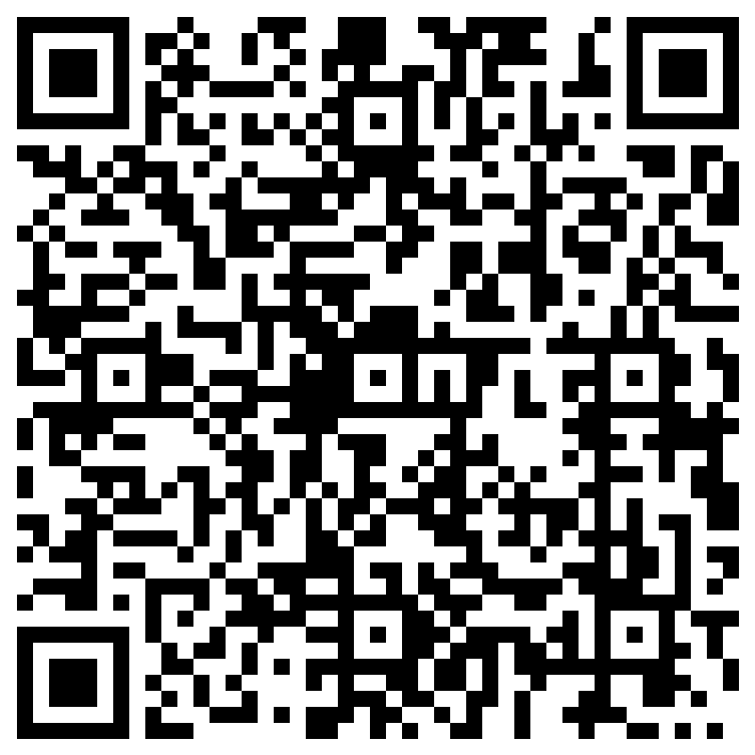
267 received so far!
Closing date of 31 May 2024
We will give detailed feedback in the summer forum
Some headlines so far
Delivering level 2 within in 5 days
Settings not updating level 2 every year
Use of the Essex Effective Support Document
No DDSL ( child minders?)
Keeping and transferring files
Recording incidents of physical restraint
Training and requests
On line safety/filtering and monitoring
Physical intervention (PRICE)
More frequent level 2 training (Train the Trainer)
Prevent (ECC/DfE)
Signposting to general training (ESCB)
Safer recruitment (Juniper or other providers)
Domestic abuse (SETDAB)
Safeguarding questionnaire
If you know any other settings/contacts
please do encourage them to complete the questionnaire.

Slide 30
Prevent training - online sessions
02.07.24 2.00pm - 4.00pm
HSB training (online)
25.03.24 2.00pm - 4.00pm
27.06.24 2.00pm - 4.00pm
Early Years Forums Summer term
03.07.24 - South
04.07.24 - West
09.07.24 - Mid
10.07.24 - NE
09.07.24 – online
Understanding difference – supporting schools to recognise and respond to hate incidents
14 March, online: 9.30am – 12.00pm
It could happen here – allegations in the work place
25 June Venue TBC 9.30am – 1pm
Train the Trainer Online
10.00am - 11.00am
28 March 2024
11 July 2024

Slide 31
This information is issued by: Essex County Council
Contact us: xxx@essex.gov.uk xxx
xxx Essex County Council County Hall, Chelmsford Essex, CM1 1QH
Essex_CC
facebook.com/essexcountycouncil
The information contained in this document can be translated, and/or made available in alternative formats, on request.
Published xxx

