Slide 1
Working Parents Funding Entitlements – April 2024
Provider Portal Process Overview

Slide 2
Agenda
1
5
Working Parents Funding Entitlement Offer
Temporary Codes
2
6
How to Apply
Contact Details
3
7
FEEE2 vs FEEE2W
Questions
4
How to Perform a Check in the Portal

Slide 3
Working Parents Funding Entitlement Offer
By September 2025, eligible working parents will be able to claim 30 hours of free childcare a week, over 38 weeks of the year, all the way through from the term after the child turns nine months old up to the child starting school.
This funding is being rolled out in stages to allow childcare providers and Local Authorities time to be able to implement the changes.
Phase 1
From April 2024, eligible working parents will be able to claim 15 funded hours per week, from the term after the child’s 2nd birthday
Phase 2
From September 2024, eligible working parents will be able to claim 15 funded hours per week, from the term after the child turns 9 months old
Phase 3
From September 2025, eligible working parents will be able to claim 30 funded hours per week, from the term after the child turns 9 months old

Slide 4
How to Apply
Parents can apply for their Working Parents Entitlement Code via Childcare Choices. They will be given an 11-digit-code beginning 50, or in some cases a temporary code beginning 114.
Important Information
Parents must renew their code every 3 months
Parents must be approved the term prior to claiming
Where parents remain eligible, the same code will remain with the child for renewal until they start school, and will be used for 30 hours funding the term after the child turns 3
Childcare Choices will prompt parents to renew however we ask that Childcare Providers also do this for existing children, using the Expiration Dashboard for guidance
Parents can use the following link to apply:
https://www.gov.uk/apply-free-childcare-if-youre-working?step-by-step-nav=f517cd57-3c18-4bb9-aa8b-1b907e279bf9

Slide 5
FEEE2 vs FEEE2W
With the introduction of 2-year-old funding for working parents (FEEE2W) it is important to remember that the existing 2-year-old funding for disadvantaged families (FEEE2) will remain unchanged.
There will be occasions when a family might meet the criteria for both entitlements however, they will still only be entitled to 15 hours funding per week. In this case, the parents should always opt for FEEE2.
 | FEEE2 | FEEE2W
Does the parent have to apply? | Yes – via the Essex Education Portal | Yes – via Childcare Choices
Does the parent have to renew? | No | Yes – every 3 months
Does the funding cease if the parents fall out of eligibility? | No – funding is not withdrawn if the family’s circumstances change | Yes – if the parent falls out of eligibility, they will not be able to claim past their Grace Period End Date
Is a Working Parent check required? | No | Yes
Is a Placement Notification required? | Yes | No
What is the Funding Rate | £8.00 per hour | £7.85 per hour
Can the funding be shared between 2 settings? | No | Yes
If the parent applies during the term, can they claim immediately? | Yes – from the application approval date (even if this is mid-term) | No – parents must be approved the term prior to claiming

Slide 6
How to Perform a Check in the Provider Portal
Once parents have received their code, they should add this to the Parent Agreement Form along with their National Insurance Number. Childcare Providers will then be required to complete a check to confirm the code is eligible for the term, before claiming the funded hours on the Headcount.
Parents must be approved the term before claiming. The below table advises of the latest applications can be approved each term.
IF PARENTS ARE NOT APPROVED BY THESE DEADLINE DATES, THEY CANNOT CLAIM THE FUNDING UNTIL THE FOLLOWING TERM AT THE EARLIEST!
Term Claiming | Date of Birth Range | Application Approval Deadline
Summer 2024 – FEEE2W | 01/04/2021 – 31/03/2022 | 31/03/2024
Autumn 2024 – FEEE2W | 01/09/2021 – 31/08/2022 | 31/08/2024
Spring 2024/25 – FEEE2W | 01/01/2022 – 31/12/2023 | 31/12/2024

Slide 7
How to Perform a Check in the Provider Portal
You can complete the check against a Working Parent Entitlement Code at any time. Please ensure the check is completed before agreeing a placement with the family as you will need to confirm the code is in date and valid for the term.
The reconfirmation date. Must be on or after the first day of the current term period.
Date the application was approved. Must be on or before the last day of the previous term period.
Only relevant if FEEE2W has been claimed in the previous term.

Slide 8
How to Perform a Check in the Provider Portal
The follow short video will demonstrate how to complete a check for Working Parent Entitlement codes and how to add these funded hours to the Headcount.
https://youtu.be/rbGzxcj7NfM

Slide 9
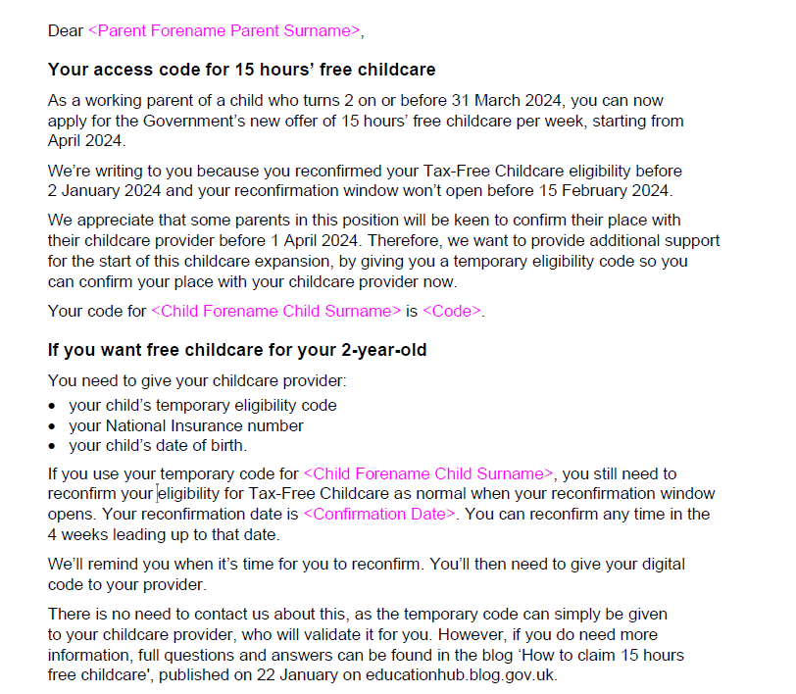
Temporary Codes
Some parents who have previously applied for Tax-Free Childcare have been advised that they will be unable to apply for the Working Parents Entitlement until their next reconfirmation window. Where the reconfirmation window is close to the deadline for the Summer term, parents have been issued a letter by Childcare Choices (see example) giving them a temporary code beginning 114.
Points to Note
Temporary Codes are checked in the same way as permanent codes that begin 50.
If a parent has both a temporary code and a permanent code, please always use the permanent code starting 50.
You will need to run a new check when a permanent code is issued.
Label

Slide 10
Contact Details
Headcount and general FEEE2W enquiries: earlyyearsdata@essex.gov.uk
FEEE2 enquiries, including Placement Notifications: twoyearold@essex.gov.uk
Childcare Choices: 0300 123 4097 / https://www.childcarechoices.gov.uk/
Childcare Reforms Updates from ECC: https://eycp.essex.gov.uk/funding/childcare-reforms-feee1w-feee2w-and-wraparound-childcare/

Slide 11
Questions
If you have any questions at all, please feel free to use the chat facility or unmute.

