Slide 1
Self Update Portal
Early Years
How to add or update your data in the Self Update section of the Provider Portal, as required for your annual sufficiency data return.

Slide 2
Provider Portal
Today we will cover:
Self Update – Service Details
Self Update – Consent
Self Update – Availability and Capacity
Self Update will also allow you to update:
Travel
Costs
Facilities
Full guidance notes for all sections of Self Update can be found here: https://eycp.essex.gov.uk/media/1971/self-update-portal-guidance-acceessible.pdf

Slide 3
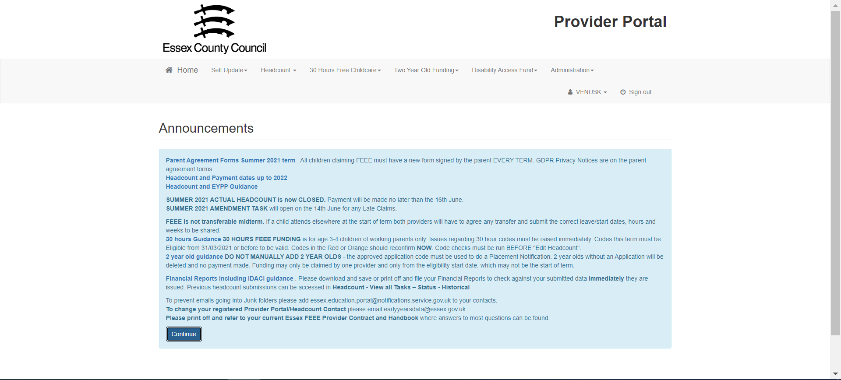
Provider Portal
Once logged in, you will be presented with an Announcement. This contains useful information, such as the next Headcount and payment dates, and links to various resources.
Click Continue to move onto the Home Screen.

Slide 4
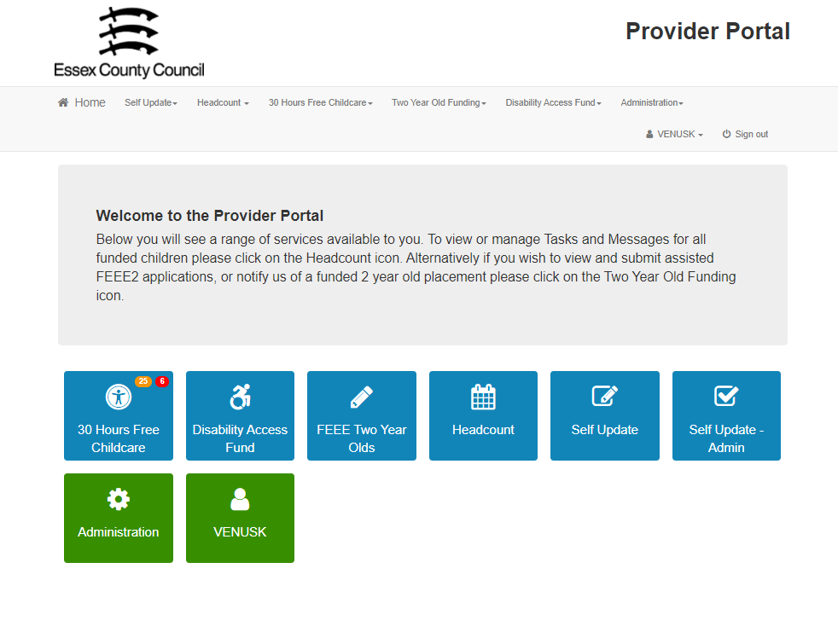
Provider Portal
You will only see the first 5 buttons shown below.
To submit your data, click on the Self Update button.

Slide 5
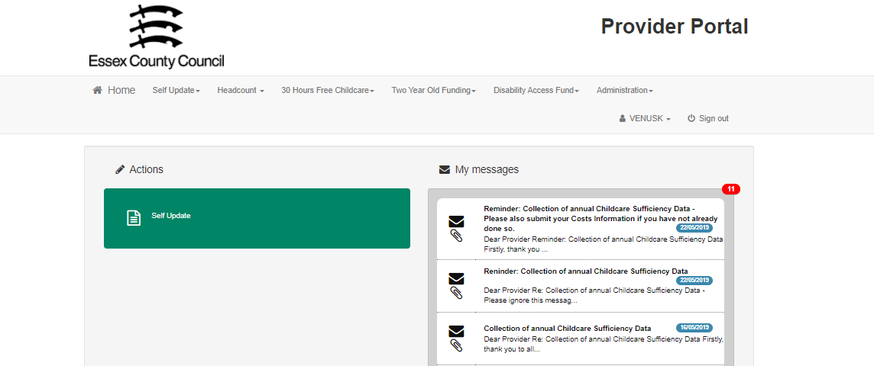
Provider Portal – Self Update
On the right-hand side, you will see any messages that have been sent regarding Self update.
On the left-hand side, you will see a green button for Self Update. Click this to proceed.

Slide 6
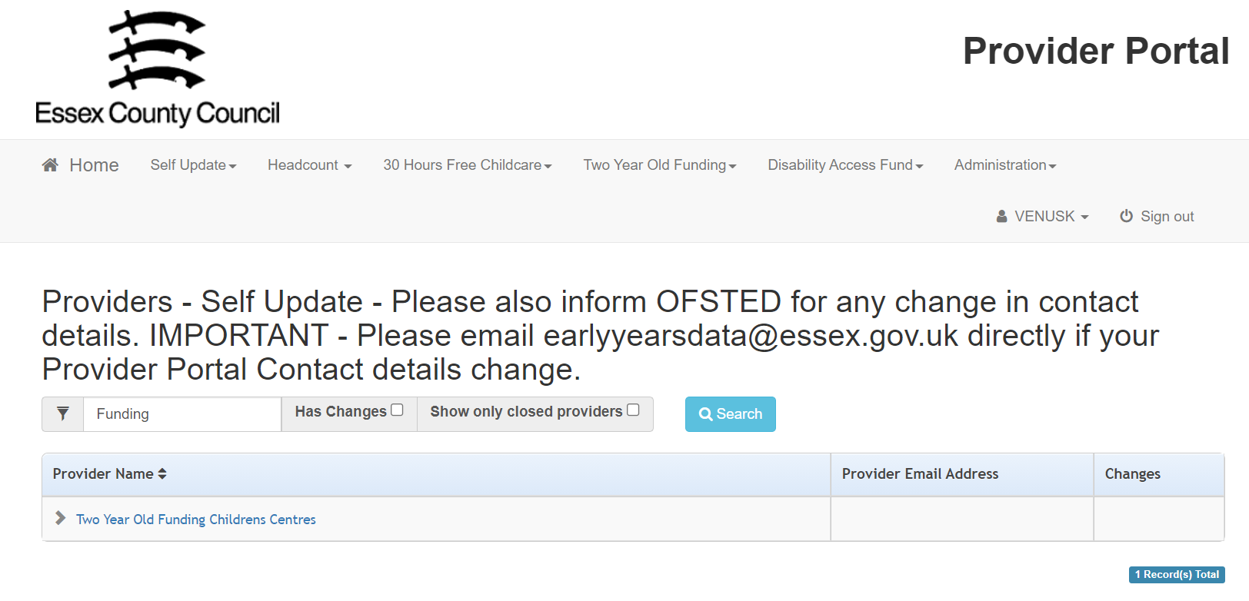
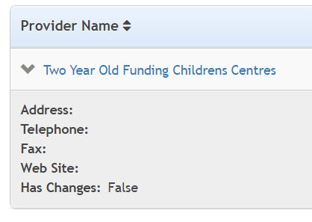
Provider Portal – Self Update
If you have more than one setting assigned to your login, they will all be listed here.
Use the arrow to see an overview of the Service Details if needed.
Click the name of the setting to begin the Self Update process.

Slide 7
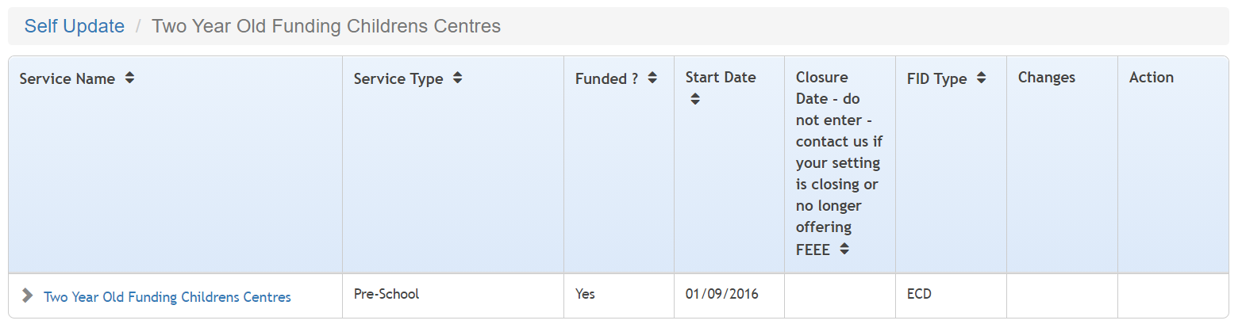
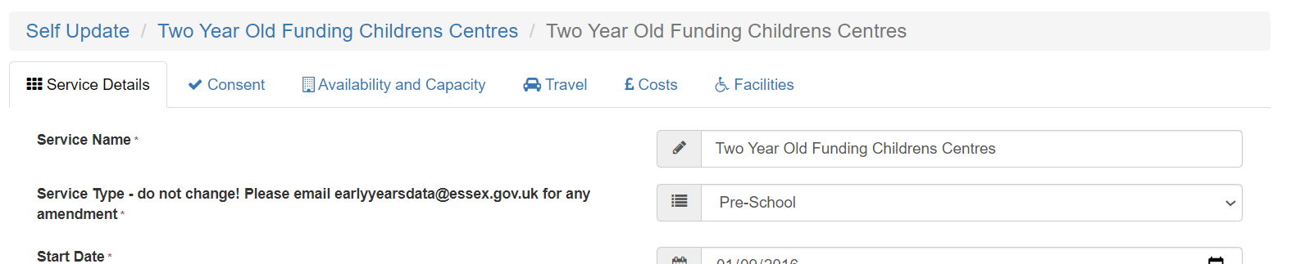
Provider Portal – Self Update
Click on the Service Name to take you into Self Update.
You will be presented with the Service Details page.

Slide 8
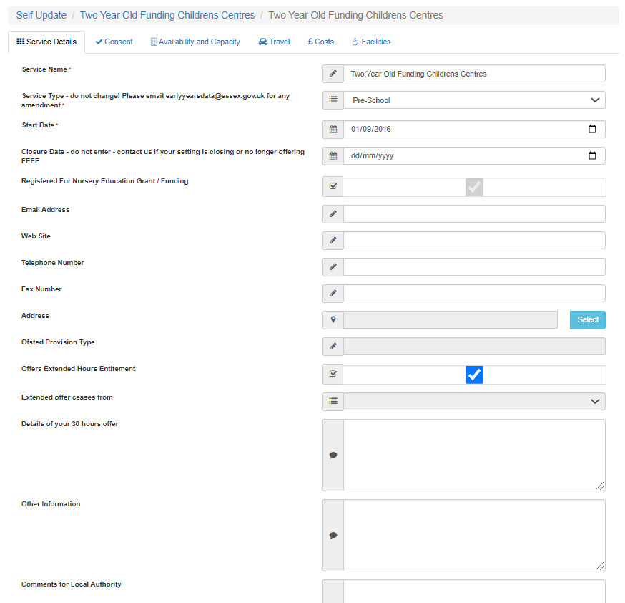
Provider Portal – Service Details
Please do not edit the following fields:
Service Name
Service Type
Start Date
Closure Date
If you need to edit or update the details in these fields, please email earlyyearsdata@essex.gov.uk
Once the details in the remaining fields have been updated, click the submit button at the bottom of the page.

Slide 9
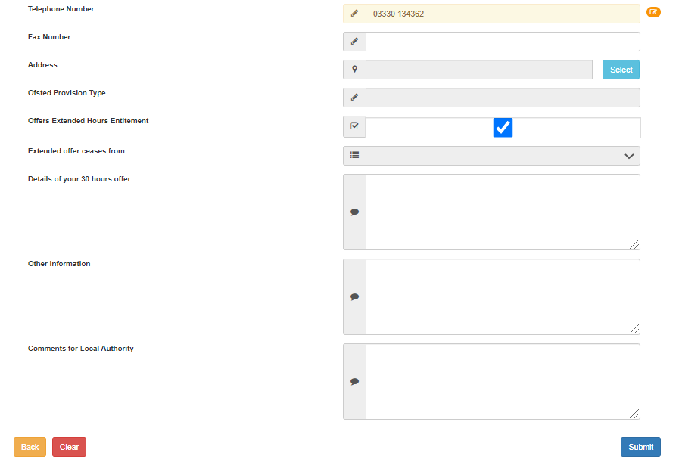
Provider Portal – Service Details
Once you have submitted any changes, they will be highlighted in amber.
You will see a Clear button at the bottom left-hand side of the page. This can be used should you wish to revert any changes.
This will be the same for any changes made throughout the Self update portal.

Slide 10
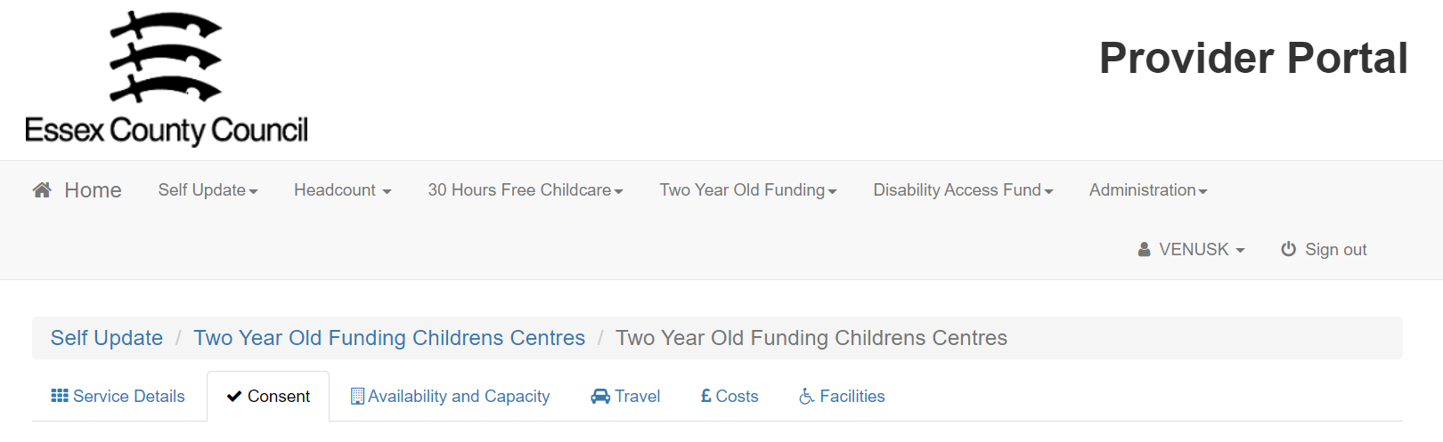
Provider Portal – Consent
Once you have completed the Service Details section, click on the Consent tab.

Slide 11
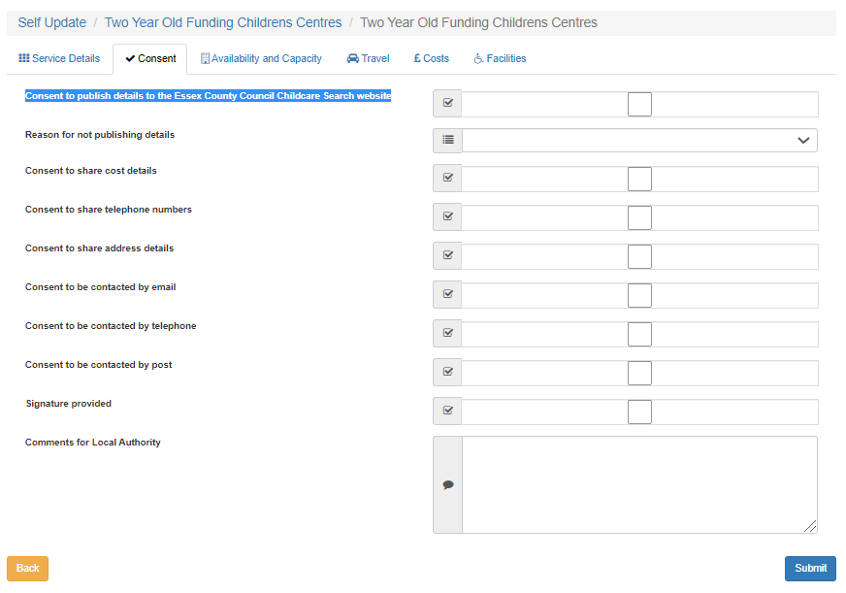
Provider Portal – Consent
The consent tab provides you the opportunity to give your consent to the local authority sharing your details, and your communication preferences.
IMPORTANT! Ticking the “Consent to publish details to the Essex County Council Childcare Search website” allows us to publish your details online to be review by the public.

Slide 12
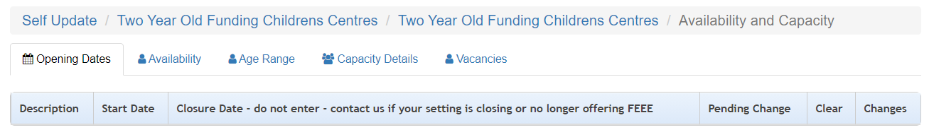
Provider Portal – Availability and Capacity
Select the Availability and Capacity tab.
This will display 5 further tabs to be completed.

Slide 13
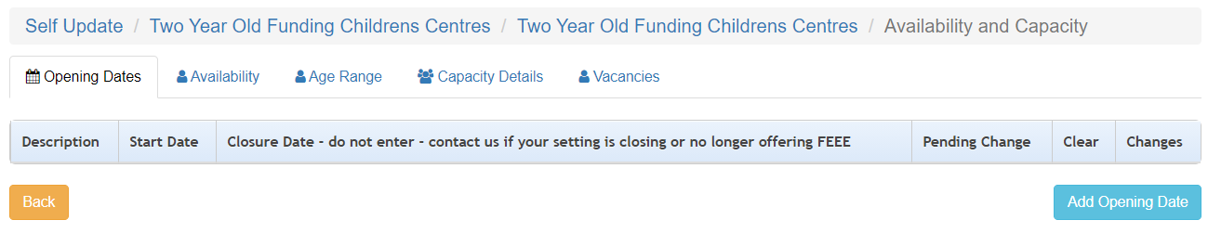
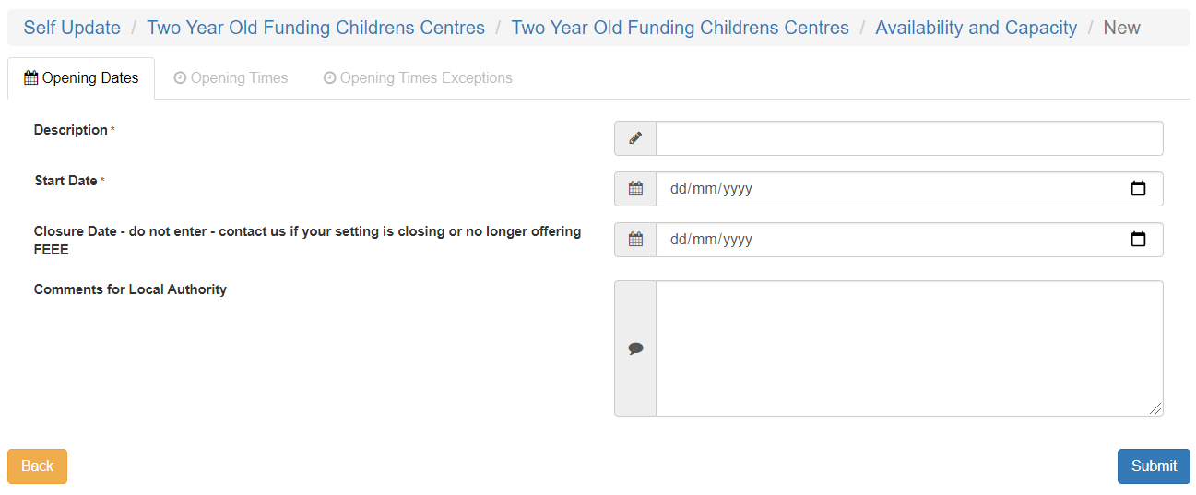
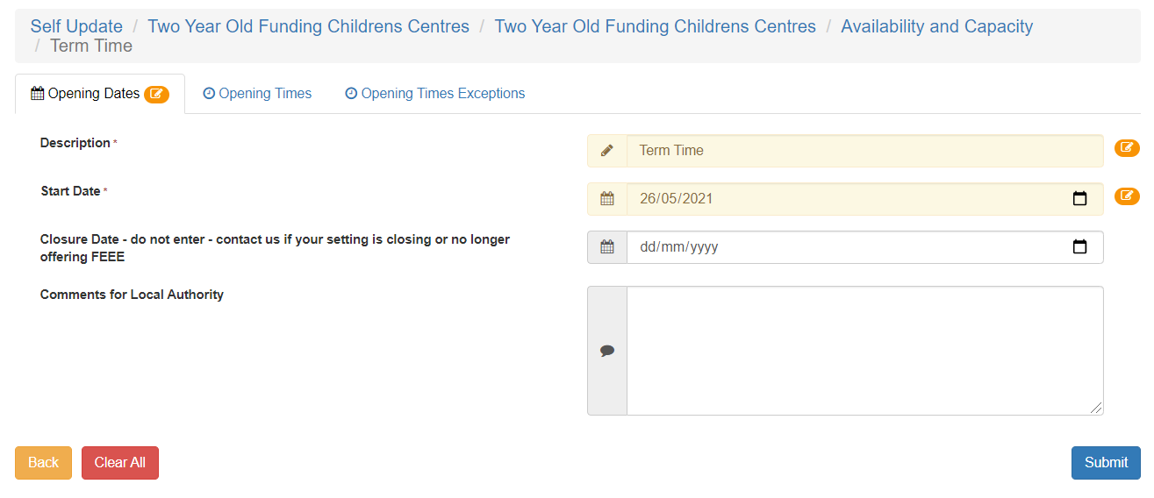
Provider Portal – Opening Dates

Slide 14
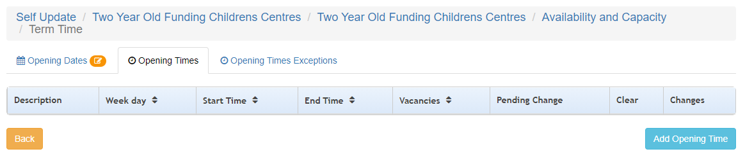
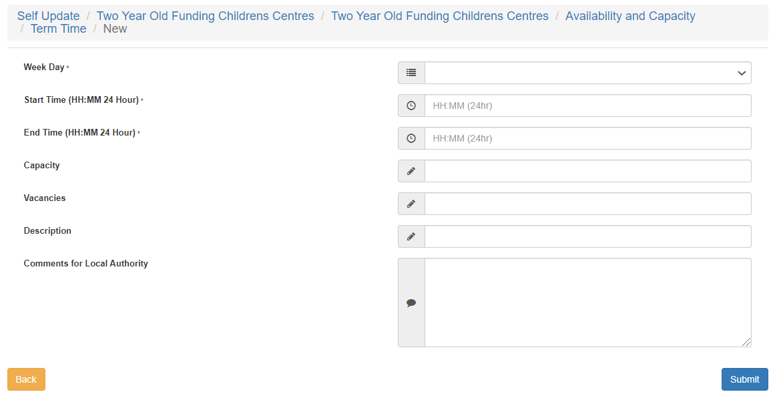
Provider Portal – Opening Times
Once you have added the details of your opening dates, click on the Opening Times tab.
You will need to add an Opening Time for each day of the week that you are open. Select the relevant day from the dropdown menu.
You can add more than one session per day if you wish, using the Description field to identify each time, such as “Monday AM”.
Submit once complete.

Slide 15
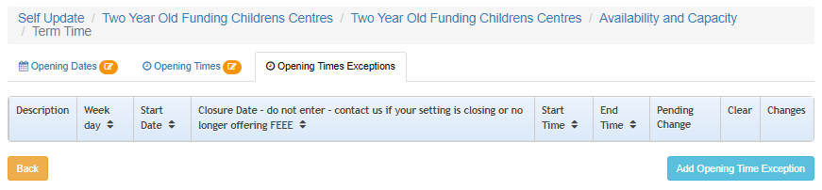
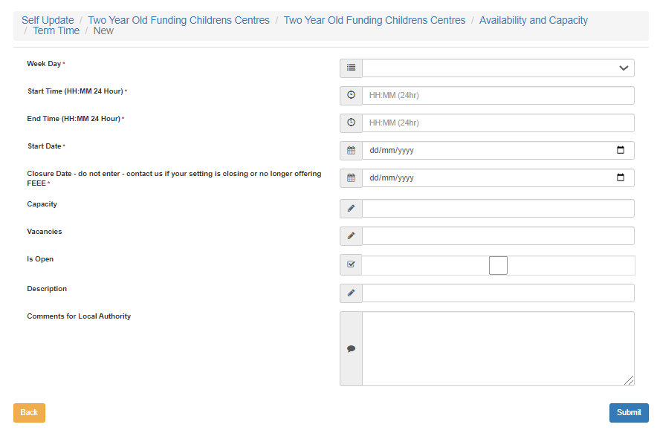
Provider Portal – Opening Times Exceptions
If there are exceptions to your Opening Times, Christmas Day for example, they can be recorded here.

Slide 16
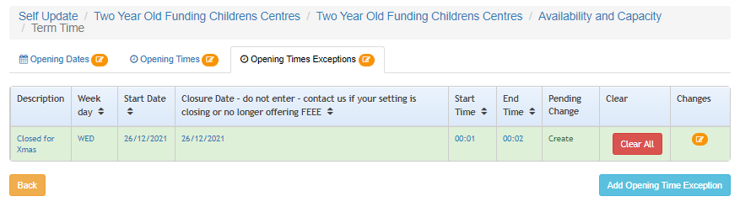
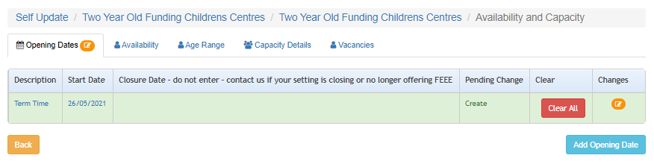
Provider Portal – Availability and Capacity
Once you have added Opening Dates, Opening Times and any Opening Times Exceptions click on the Availability and Capacity link to return.
From this page you can add any additional Opening Dates, such as Summer Holidays / Half Term if your opening times are different for these period.

Slide 17
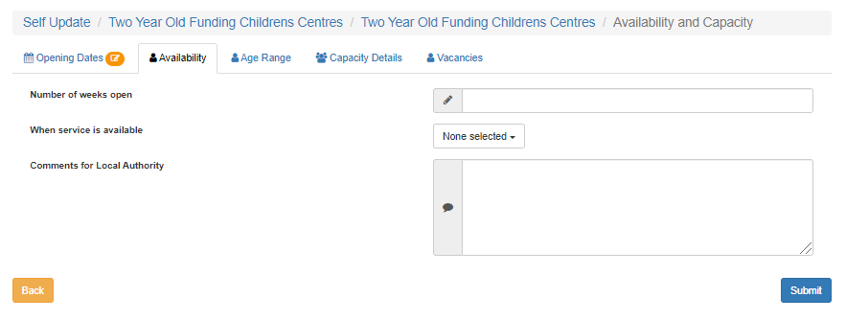
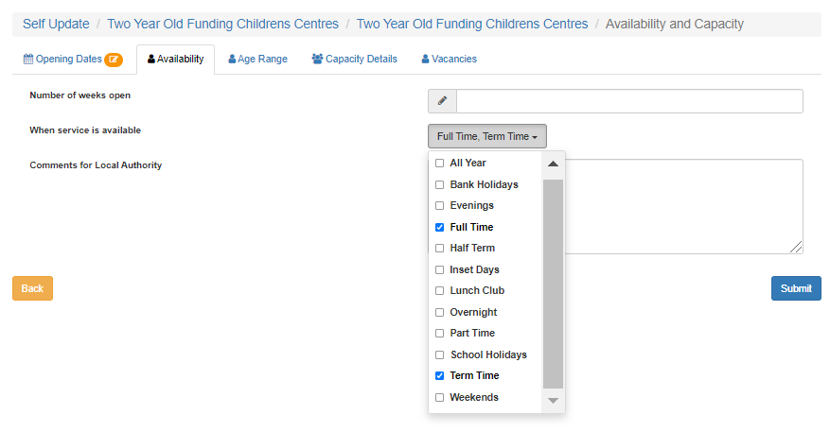
Provider Portal – Availability
Select the Availability tab.
Add the number of weeks per year that you are open.
Use the dropdown menu to select options for when the service is available. You can make multiple sections.
Click the Submit button once complete.

Slide 18
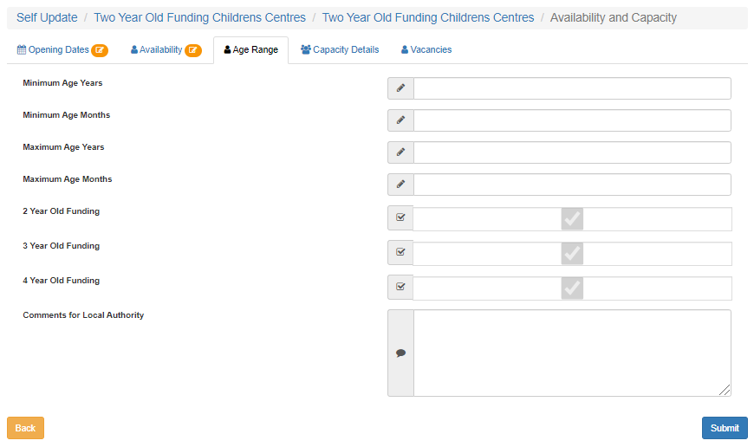
Provider Portal – Age Range
Select the Age Range tab.
Completed the Minimum and Maximum ages that you accept in your setting.
Please note the tick boxes highlighted below are prepopulated and you will be unable to amend these.

Slide 19
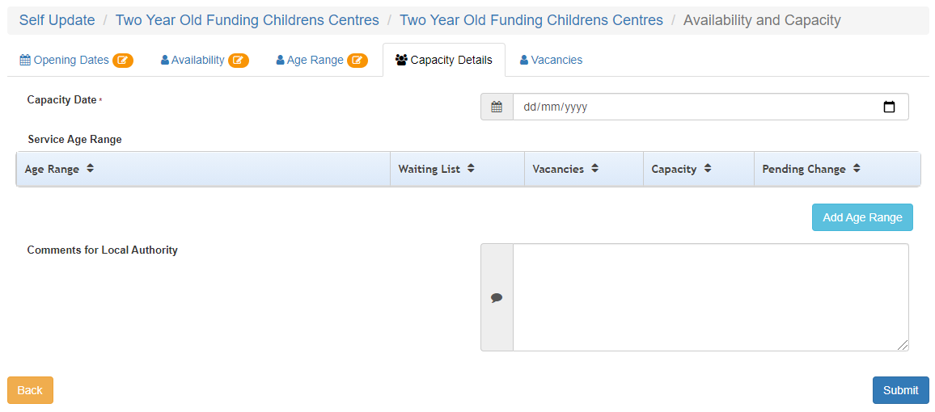
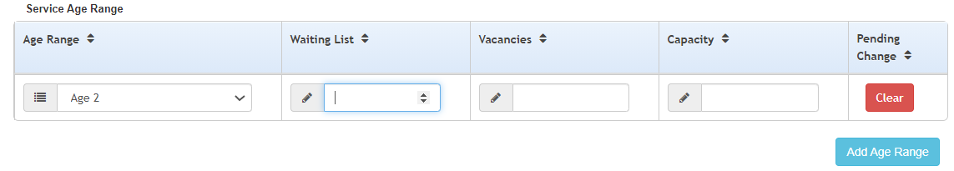
Provider Portal – Capacity Details
Select the Capacity Details tab and click the Add Age Range button.
IMPORTANT!
Please ensure the Capacity Date field is updated when submitting your data.
This should be the date of your submission.
Select an age range from the dropdown and add the required numbers to each field.
Use to Add Age Range button to add as many age ranges as needed.

Slide 20
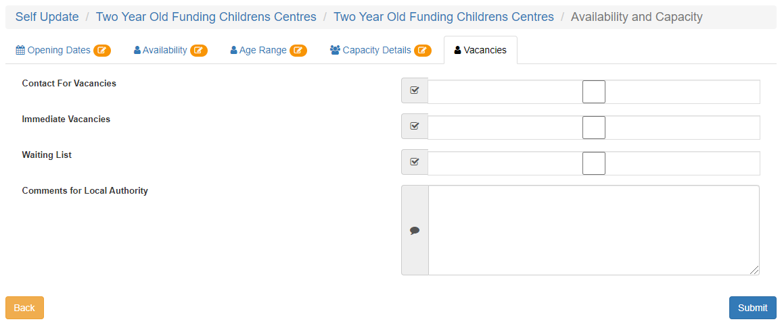
Provider Portal – Vacancies
Select the Vacancies tab.
Tick the boxes that are relevant to your current availability.
Click Submit once complete.

Slide 21
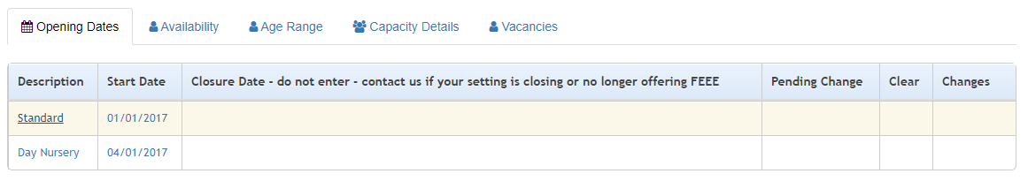

Provider Portal – Points to Note
Please ensure you click Submit in every section that you edit.
If you have pre-existing data, you can update these by simply clicking the item description you wish to update and over typing the data.
If none of your information has changed, please ensure you still update the Capacity Date on the Availability and Capacity: Capacity Details tab and click Submit.
Each edited section will have an amber Pending Changes icon next to it until we have approved and applied the changes.

