Slide 1

Keeping children safe in education :
Safeguarding Briefing for Early Years Settings
Autumn 2025
Essex Education Safeguarding Team
September 2025
Copyright © Essex County Council 2025
No part of this publication may be reproduced, stored in a retrieval system of any nature, downloaded, transmitted or distributed in any form or by any means including photocopying and recording, without the prior written permission of Essex County Council, the copyright owner

Slide 2
Agenda
1
Safeguarding Update
2
Essex Safeguarding Children Board
3
Private Fostering (if time)

Slide 3
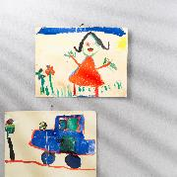
Keeping Children Safe in Education 2025
Updates – technical changes only
Future iterations will take into account the Children’s Well-being and Schools Bill, the Casey Audit on CSE and Abuse and Violence Against Women and Girls
Includes clarified advice on how settings should support children who are questioning their gender identity with links to new guidance
Gender questioning children: draft schools and college guidance
The role of the Virtual School Head to include children with a social worker and children in kinship care
Additional online safety risks outlined – misinformation, disinformation and conspiracy theories
Links to DfE guidance on Generative AI: product safety expectations
Generative AI: product safety expectations
Links to the revised guidance on Relationships, sex and Health Education
Relationships and sex education (RSE) and health education (DfE 2025)

Slide 4
Ofsted

Slide 5
Education Inspection Framework
Children Act 2006 (Section 49 and 50)
Operating guides for inspectors
Standards (with guidance on how they are applied) are in ‘toolkits’
Full Inspections
No children on roll inspections
Childcare Register compliance inspections
Childminder agencies

Slide 6
5-point grading scale:
Exceptional
Strong standard
Expected standard
Needs attention
Urgent improvement
Notes:
Low level concerns are part of a spectrum of behaviour. could include
Grabbing clothing and bags
Body blocking
Language and swearing
Acting outside of the behaviour management policy – does not mean this is an assault have they consulted with the behaviour policy and what the MOS should have done
Private Life – where a staff member may have issues with the parents of another child – relationships outside of work
When there is no evidence on CCTV that something has happened
inconsistent with the staff code of conduct, including inappropriate conduct outside of work
doesn’t meet the threshold of harm or is not considered serious enough for the school or college to refer to the local authority.
inadvertent or thoughtless behaviour
behaviour that might be considered inappropriate depending on the circumstances
behaviour which is intended to enable abuse could include:
being over friendly with children
having favourites
adults taking photographs of children on their mobile phone
engaging with a child on a one-to-one basis in a secluded area or behind a closed door
using inappropriate sexualised, intimidating or offensive language.

Slide 7
Evaluation areas for EY settings
Safeguarding
inclusion
curriculum and teaching
achievement
behaviour, attitudes and establishing routines
children’s welfare and well-being
leadership and Governance

Slide 8
The new framework – effective from November 2025
    New inspection report card:
      to highlight excellence and identify areas for improvement
      driving high and rising standards
      more nuance for parents and providers
      Combines ‘at-a-glance grades’ with narrative summaries of strengths and areas for improvement
      more accessible (for mobile devices)
    New ‘exceptional’ grade:
      to identify the very best provision in the country
      inspectors will evaluate ‘exceptional’ practice by applying the toolkit, subject to the usual quality assurance and consistency checking
    New ‘inclusion’ evaluation area:
      To help break down barriers to learning and wellbeing
      Inspectors will evaluate whether high-quality support is being provided (particularly for disadvantaged / SEND / children known to Social Care)
Notes:
Ineffective safeguarding will always mean that a school is placed in a formal category of concern.

Slide 9
Inspection findings to be grounded in a clear understanding of each provider’s unique circumstances - the new operating guides set out how leaders and inspectors will reflect on a provider’s context and priorities
    New inspection toolkit for grading:
      Definitions have been ‘tightened’ to clearly differentiate between them
      Standards ‘slimmed down’ for great clarity on evidence inspectors will assess
    New inspection methodology:
      Guides set out times inspectors arrive at and leave site, to ‘cap’ length’ of inspection days
    Evaluation of work to support and promote leader and staff wellbeing:
      To be considered under leadership and governance
    New online ‘insights platform’:
      Provides parents with key information about education and care services in their area
Notes:
Ineffective safeguarding will always mean that a school is placed in a formal category of concern.

Slide 10
Inspection findings to be grounded in a clear understanding of each provider’s unique circumstances - the new operating guides set out how leaders and inspectors will reflect on a provider’s context and priorities
    New system for monitoring settings where improvement is needed:
      Offer of reassurance to parents
      Allow providers to improve ‘needs attention’ grades
      Improvements to be recognised more quickly
    Will drive consistent and fair inspections:
      Inspections to be led by full-time HMI
      Professional relationship with leaders for a more collaborative experience
      Programme of work to assess consistency in inspections (senior inspector to shadow inspections – difference in opinions to ‘be analysed’)
Notes:
Ineffective safeguarding will always mean that a school is placed in a formal category of concern.

Slide 11

Ofsted Principles
Settings with identified areas for improvement to receive additional monitoring inspections, to ensure swift improvements are made
Nurseries and childminders to be inspected more frequently, to ensure all children receive the best start in life
Disadvantaged and vulnerable children at the heart of reforms, with a focus on ‘inclusion’ in every inspection
Increased focus on professionals’ well-being and workload through a more collaborative approach to inspection
Notes:
Working together is the multi-agency response to safeguarding.
SET procedures are your local procedures for managing safeguarding arrangements in Greater Essex

Slide 12
Planning timetable
Check paediatric first-aid arrangements
Arrange to meet with DSL
Arrange to meet with SENCO
Arrange to meet with leaders
Arrange to speak with parents
EYPP funding and rationale for how spent

Slide 13
The ‘nominee’
Not required in childminder settings / smaller settings
Not necessary for nominee to have attended training (make sure inspectors are aware)
Must be suitably placed to support inspection activity - should have a thorough knowledge of how setting operates on a day-to-day basis (inspectors will record in the evidence base the role of the person selected to be the nominee)
May join planning call, grading discussion and final feedback

Slide 14
Safeguarding will be graded as ‘met’ overall if all the individual safeguarding standards are ‘met’ and none of the ‘not met’ standards apply
If safeguarding needs minor
improvements:
Constructive discussion to allow opportunity to rectify before the end of the inspection
Inspectors will consider in context of previous non-compliance
safeguarding can still be graded as ‘met’ if necessary steps to resolve issues are already in place
minor improvements - should not have an immediate and/or significant impact on children’s safety if not resolved immediately

Slide 15
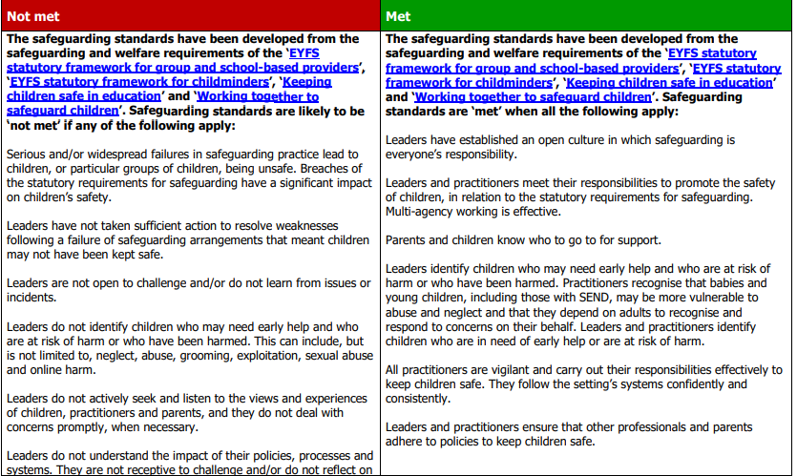
Safeguarding expectations

Slide 16
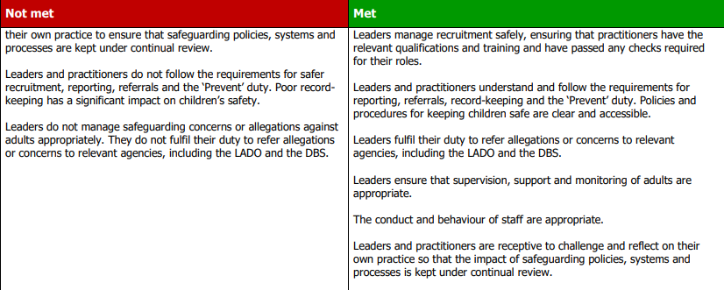
Safeguarding expectations

Slide 17
Report cards
  How well do children:
  Achieve
  Belong
  Thrive
Settings inspected approximately every 4 years
Safeguarding expectations are based on:
  Statutory frameworks
  Working together to safeguard children

Slide 18





Before the inspection, inspectors will consider
The correct registration details
Previous inspection reports
Check the accuracy of the information about individuals linked to the registration
Any published information, including monitoring letters and the settings website
The internet to identify any safeguarding concerns or related issues
All information held on the database
Details of concerns received
Any contextual information

Slide 19



Relevant documentation (safeguarding)
List of current staff and their qualifications
Safeguarding and child protection policies
Register showing the date of birth of all children on roll and routine staffing arrangements
Fire safety arrangements
A list of referrals made to the LADO with details of resolutions
List of children present on the day
Details of children who are open to social care and those who have a multiagency plan.
Log of all incidents of discrimination

Slide 20
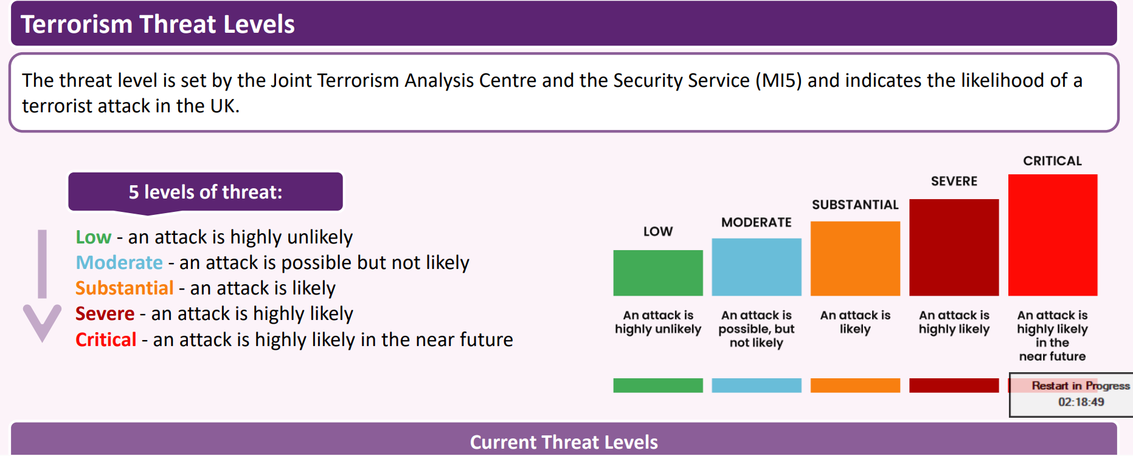
Current UK threat level remains at SUBSTANTIAL

Slide 21
Regional update
      Significant increase in referrals (80% on this time last year)
      Significant increase in:
        ERW
        ‘no ideology identified’ cases
        ‘fascination with extreme violence and mass casualty attacks’
        44% referrals from Education

Slide 22
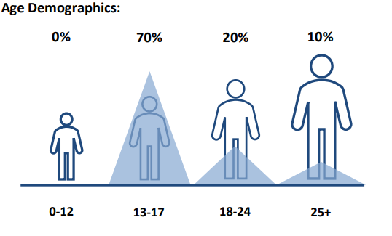
Regional age demographics
Essex data:
      Highest number of referrals from Education (33)
      Majority of referrals were ‘no ideology identified’

Slide 23

Curriculum and Assessment Review Final Report - GOV.UK
independent review for CYP (KS 1 – 4, plus 16-19) curriculum
Led over the past year by Professor Becky Francis CBE with a panel of experts
over 7,000 responses from the public

Slide 24
Leadership and staff wellbeing
Education Workforce Wellbeing Charter: Protecting the wellbeing and mental health of staff is:
        essential for improving morale and productivity
        critical to recruiting and retaining good staff
        a legal duty: employers are required by law to protect the health, safety and welfare of their employees
        taken account of as part of Ofsted inspections
Centre for Wellbeing’s guide on improving staff wellbeing in schools and colleges
Education Support’s staff wellbeing audit tool
DSL Supervision Programme: cipsli@essex.gov.uk
School leadership wellbeing advice and guidance
Wellbeing
This 20-minute training video explores how to reflect on and promote staff wellbeing in schools and settings.

Slide 25

Inclusion Strategy – wellbeing pillar
Education settings should be safe, happy environments for all within them. Research shows that pupil wellbeing is essential for learning and success. When children feel safe, supported, and emotionally healthy, they are more likely to engage in lessons, build positive relationships, and achieve better academic outcomes. It is also vital that staff feel supported, valued, and have good wellbeing, as they are then better equipped to create positive, engaging, and inclusive learning experiences for pupils and to better support the young people they work with.
Creating a culture of care, where wellbeing is prioritised and embedded in everyday practice, helps build resilient and sustainable communities. This guidance is aligned with the Inclusion Strategy wellbeing pillar and provides some useful resources for settings to support their work in strengthening wellbeing.

Slide 26
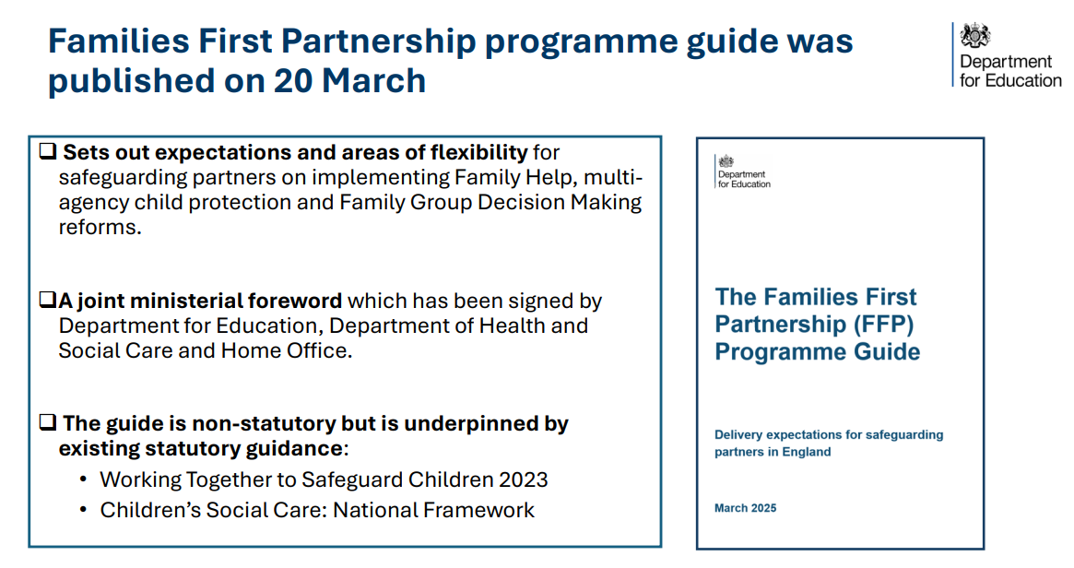
FFPP

Slide 27
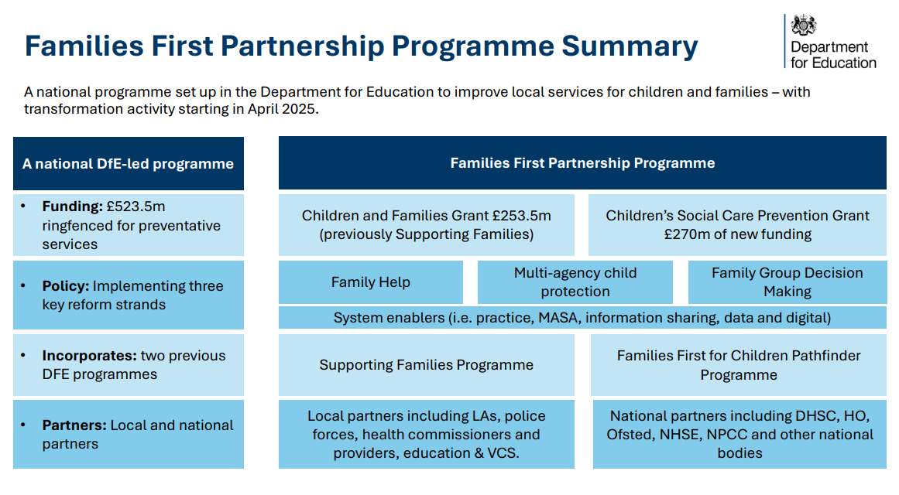
FF PP

Slide 28
Families First Pathfinder Programme
3) Family Networks
  Embed Family Group Decision Making across whole system
  Offer family group decision making at pre-proceedings stage
4) Revision of Multi-Agency Safeguarding
Arrangements
  Establish Lead Safeguarding Partners and Delegated Safeguarding Partners
  Identify partnership chair in place of independent chair
  Establish arrangements for independent scrutiny
  Create stronger role for education in strategic arrangements
Reform of Family Help Services:
  Targeted early help and section 17 support into single offer
  Family Help Lead Practitioner role
  Community based multi-disciplinary early help teams
  Integrated front door to services – central triage point for all referrals
  Single Family Help assessment and plan – merging current arrangements for targeted early help and section 17
Establishment of Multi-Agency Child Protection Teams
  Led by new Lead Child Protection Practitioner role
  Improve parental representation in child protection

Slide 29
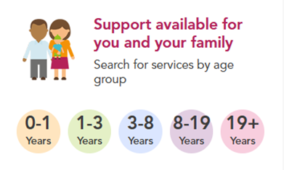
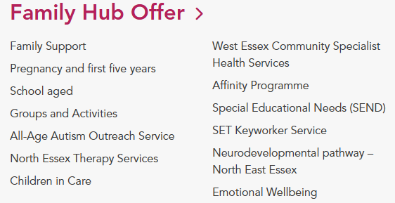
Essex child and family wellbeing service - Family Hubs (previously known as Children’s Centres)
Mid Essex: 0300 247 0014
North Essex: 0300 247 0015
South Essex: 0300 247 0013
West Essex: 0300 247 0122

Slide 30
Essex child and family wellbeing service - Family Hubs
Health visiting including pre-birth contact, helping parents, new baby review
Parenting support including breastfeeding / help choosing childcare
School nursing support for CYP and families
Family health advice (substance misuse / nutrition / maternal and infant mental health and wellbeing
Resilience and development work
Support for children aged 5 – 19 (including help with dental care / physical, emotional or developmental problems)
Support for CYP aged up to 25 with SEND

Slide 31
Essex Safeguarding Children Board
Karen Hammett, ESCB Board Manager
Liz Kirby, ESCB Practice Development Manager

Slide 32

Essex Safeguarding Children Board
Working Together 2023 introduced Lead Safeguarding Partners
Chief Executive of the Local Authority
Chief Officer of the Integrated Care Board
Chief Constable of Essex Police
Each Lead Safeguarding Partner has nominated a Delegated Safeguarding Partner who can take decisions on behalf of the LSP and hold their sectors to account
The Statutory Partners have a joint and equal duty to make arrangements to:
  Work together as a team to safeguard and promote the welfare of all children in a local area
  Include and develop the role of wider local organisations and agencies
Notes:
Mention changes to ICB landscape, from April there will be a single Essex ICB

Slide 33
Working Together 2023 states that all local education and childcare providers working with children up to the age of 18, including alternative provision, pupil referral units and further education are expected to be included as relevant agencies.
Education representation across the safeguarding partnership is strong and since December 2024 Education have been a formal member of the Delegated Safeguarding Partner meetings.
All education settings have been named as relevant agencies in the ESCB Multi-Agency Safeguarding Arrangements
Essex Safeguarding Children Board
Notes:
Education as a stat partner –guidance promotes the inclusion of education

Slide 34
ESCB Executive
Lead Safeguarding Partners
Delegated Safeguarding Partners
Stay Safe Group
North
Agency Chair: Suffolk & North East Essex ICB
Stay Safe Group
West
Agency Chair: ECC
Stay Safe Group
Mid
Agency Chair: Essex Police
Stay Safe Group
South
Agency Chair: Mid & South Essex ICB
Performance, Audit & Quality Assurance Sub-committee
Agency Chair: Herts and West Essex ICB
Essex Learning and Development Sub-committee
Agency Chair: ESCB Support Team
Neglect
Sub-committee
Agency Chair: Mid & South Essex ICB
Southend, Essex and Thurrock Learning and Development Sub-committee (children, adults and domestic abuse)
Agency Chair: ECC
Harm in our community Sub-committee
Agency Co-Chairs: ECC and HCRG Care Group
Child Safeguarding Practice Review Sub-committee
Agency Chair: ECC
SET Procedures
Working Group
Agency Chair: Thurrock Council
Links to other Essex Boards/Forums including:
Safeguarding Adults Board
Health & Well-Being Board
Children & Young People’s Strategic Partnership
Youth Justice Board
Health Executive Forum
Head Teacher Forums
Sexual Assault Strategic Partnership Board
Violence & Vulnerability Board
Safer Essex
Task & Finish Groups
(incl. Campaigns / ESCB policies & procedures)
SET Child Exploitation Strategic Group
SET Strategic Child Death Review Panel
SET Domestic Abuse Board
Notes:
LSP
Director of Education
Head of Safeguarding and Wellbeing
DSP
Director of Education
Head of Safeguarding and Wellbeing
Essex Safeguarding Children Board Executive
Attended by:
Director of Education
Head of Safeguarding and Wellbeing
Headteacher associations - Primary, secondary and special schools
The Statutory Partners in Essex moved to equal funding of the Board in April 2022
The ESCB Executive has a wide range of partners in attendance, these are referred to as ‘relevant agencies’ and includes Probation, Education, Community and Voluntary Sector reps

Slide 35


Effective Support for Children & Families in Essex
Save the link so that you always have the most up to date version
Effective support for Children and Families in Essex

Slide 36
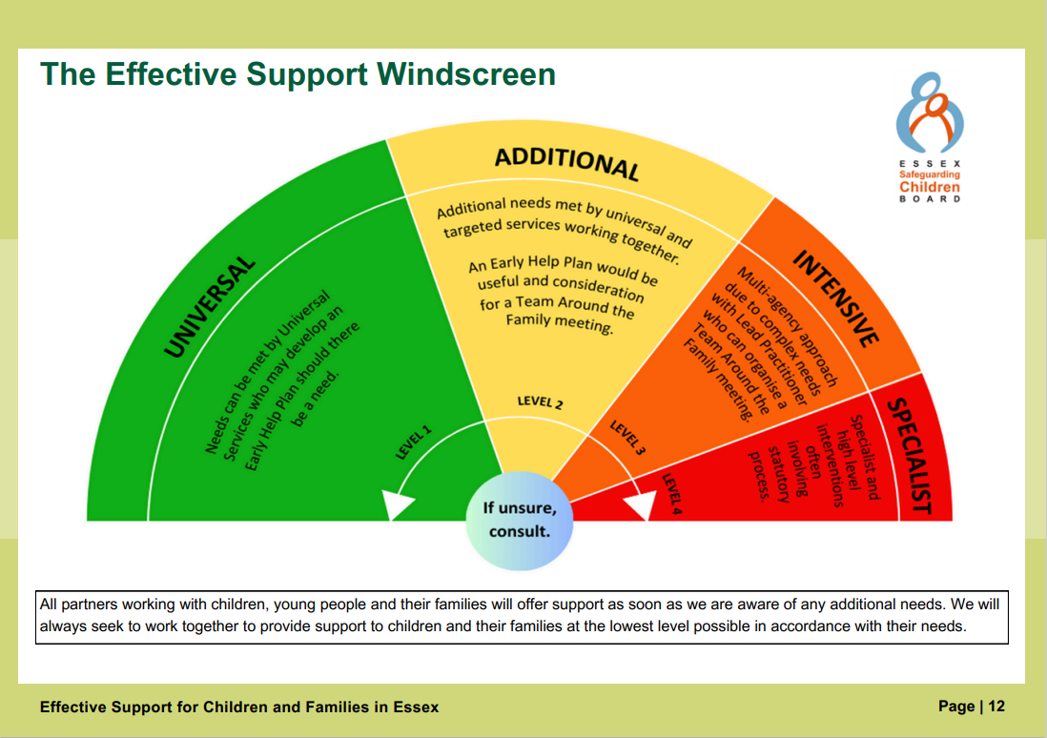
The Effective Support Windscreen

Slide 37
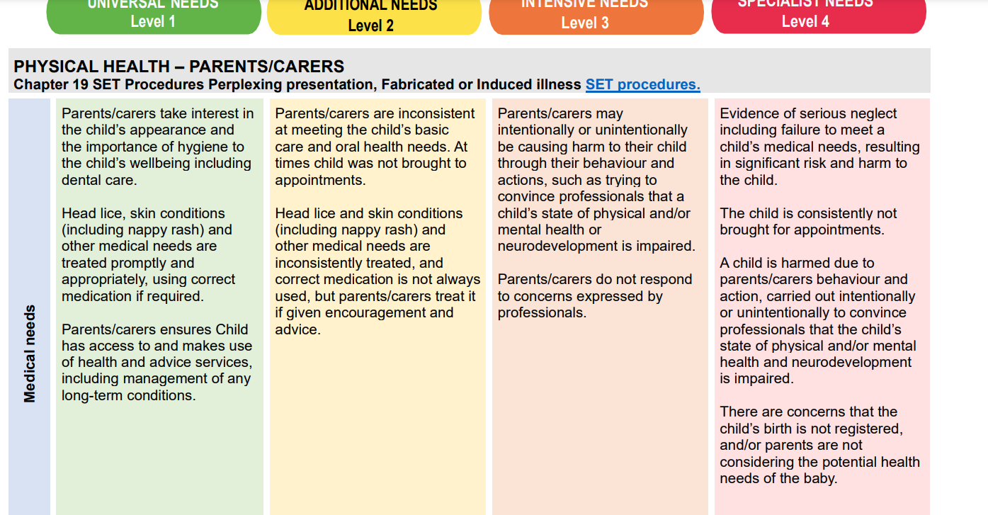

Indicators of Need

Slide 38
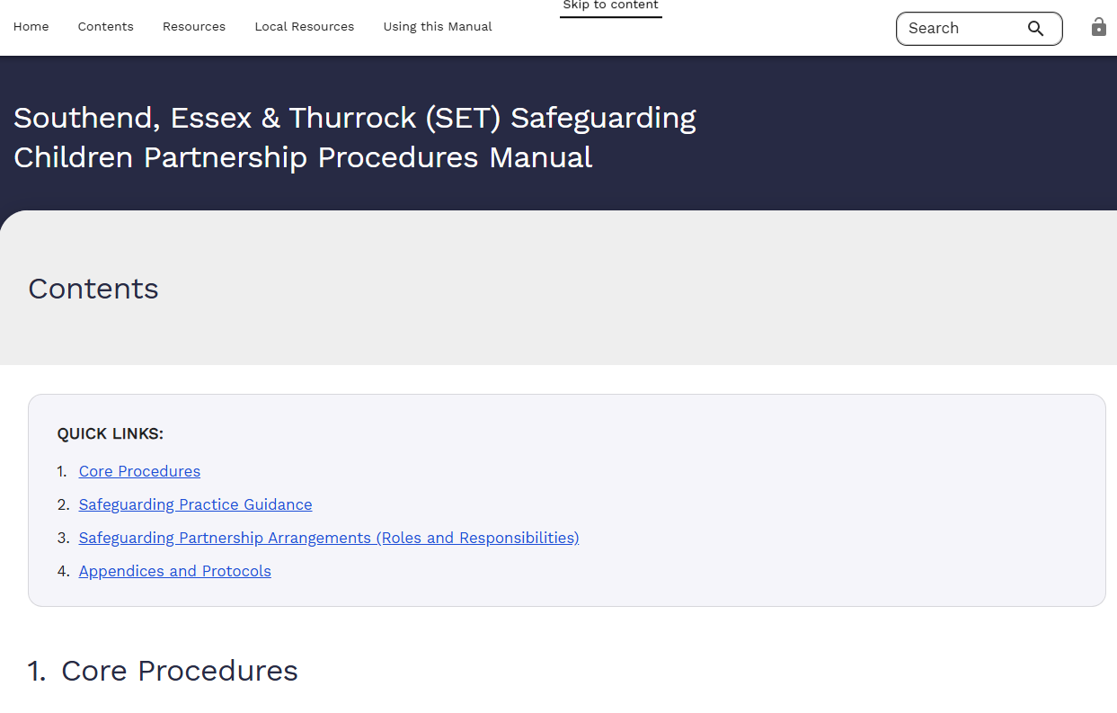
SET Procedures
Updated for 2025: ESCB polices and procedures
We are moving to Tri-x web enabled procedures next year

Slide 39
Child Safeguarding Practice Reviews (CSPRs)
Child Safeguarding Practice Reviews are conducted when a child dies or is seriously harmed, and abuse or neglect is known or suspected. The goal is not to assign blame, but to understand what happened and identify lessons that can improve safeguarding practices.
These reviews examine how different agencies worked together. They aim to highlight strengths in multi-agency safeguarding practice and areas for development.
The findings can influence local and national policy, learning and development and practice to better protect children in the future.
The National Child Safeguarding Practice Review Panel oversees national reviews and receives all local reviews, they disseminate learning that has broader
Notes:
Possibly helpful to point out that The length and process of a CSPR depends on the complexity of the case. Some are carried out over 2 – 3 days, some take several months, the process is much more flexible and less rigid than it was for Serious Case Reviews which means we can tailor the process appropriately to the case.
All reviews have a multi-agency panel who review the case and a lead reviewer who is either internal or external. The lead reviewer is responsible for compiling the report.
Family members and significant other key people are always invited to contribute to reviews, they may not always take up this offer but we always offer them the opportunity
Guidance says that all reviews need to be published
National panel-independent, has statutory powers and can make its own decisions.

Slide 40
ESCB Published reviews
Local learning review Child PP - Dec 2024 - This case relates to a 15-year-old that died in an accident in July 2022. The child and family had been known to Social Care and other partner agencies for some time. This review covered repeat referrals, whole family approach and trauma.
Local learning review Children KK - published July 2025 - This review concerned a group of siblings whose main themes of this review were Parental Substance Misuse & Mental Health, Cumulative Neglect & Emotional Harm and Escalation & Challenge.
CSPR Child GG - published March 2025 - The subject of this review was a 2-week-old baby who presented at hospital with non-accidental injuries (NAI). This review covered NAI, the impact of trauma, the Public Law Outline (PLO) procedure and professional challenge and escalation.
Local learning review Child LL – published Oct 2025 – This case relates to a 7-week-old baby that died in the care of their mother, cause of death was thought to be due to overlay. Mother had multiple vulnerabilities and had been known to Social Care for some time.
Local learning review Child TT – published Oct 2025 - This case relates to a 3-year-old who suffered severe neglect and was on a Child Protection plan when he was taken out of the country at the end of 2023.
https://www.escb.co.uk/reviews/local-learning/
Notes:
Possibly helpful to point out that The length and process of a CSPR depends on the complexity of the case. Some are carried out over 2 – 3 days, some take several months, the process is much more flexible and less rigid than it was for Serious Case Reviews which means we can tailor the process appropriately to the case.
All reviews have a multi-agency panel who review the case and a lead reviewer who is either internal or external. The lead reviewer is responsible for compiling the report.
Family members and significant other key people are always invited to contribute to reviews, they may not always take up this offer but we always offer them the opportunity
Guidance says that all reviews need to be published
National panel-independent, has statutory powers and can make its own decisions.

Slide 41
Children KK
Three siblings, referred to as Children KK, discovered their mother and her partner deceased in their home. Mother and her partner had sadly died following a drug related overdose.
The three children were 15, 12 and 10 at the time of their Mother’s death.
Mother’s alcohol and drug use and mental ill health were long-standing issues.
There was a history of multi-agency involvement both from universal and specialist services; the children have multiple needs relating to their health, educational, social and emotional wellbeing.
All three children were receiving significant support in school to meet their emotional, behavioural, social and educational needs.
Notes:
Much of mother’s alcohol us and substance misuse was self reported, therefore there was a lack of understanding of her use of substances including alcohol looked like and the impact it had on the children. It was seen as episodic and historic and this was routinely reported by mother. Mother was signposted to the Drugs and Alcohol (D&A) Service but for various reasons, including her denial of use at the time of contact, she did not benefit from the intervention of this service.
Children’s multiple needs -These have included concerns about the children’s unkempt appearance and their behaviour, the physical and mental wellbeing of all the children, poor school attendance, a chaotic volatile household, violence perpetrated by mother against household visitors, the presence of unknown men in the household, drug and alcohol misuse, missed medical appointments for the children, maternal mental ill health including suicidal thoughts and self harm witnessed by the children. The children frequently experienced verbal abuse by mother and on occasions, male friends at the property. They have been routinely involved in anti-social behaviour in the local neighbourhood ( Nov 2021: 27 incidents recorded by police) and have been in mother’s care on occasions when she has been drunk/very intoxicated.
Children are currently with a family member and reported to be doing well

Slide 42
Children KK
The children were intermittently the subject of child protection plans, Child in Need plans and Team Around the Family (TAF)
Over the children’s lives many services were provided to the children in school and offered to Mother, few of which were accessed.
There was a theme of many contacts/referrals to the Children and Families Hub and the lack of engagement or lack of maternal consent.
The long-term impact and cumulative harm experienced by the children was not fully grasped by statutory agencies.

Slide 43
Children KK
Key learning points:
Maternal Substance was long-standing but under-assessed due to reliance on self reporting-supporting people to access services
Mental Health issues were inconsistently addresses; children witnessed self harm and emotional instability
Cumulative Neglect & Emotional Harm – neglect was chronic and cyclical with short lived improvements
Professional concerns were raised by not often acted upon-the voice of schools require greater emphasis and weight
Escalation procedures existed but were seen as combative and ineffective-how can we support healthy, reflective dialogue?
Multi-agency chronologies are a critical tool in identifying cumulative neglect

Slide 44
ESCB Multi Agency Case Audits (MACAs)
Following the identification of a suitable case, agencies complete a bespoke audit tool for their agency’s involvement in the case.
Once all audits are completed a one day event is held. All the key agencies involved in the case come together to look at the effectiveness of multi-agency working, to share observations from their audit activity and to hear reflections of other agencies and to learn from each other.
Learning summaries from MACAs are published on the ESCB website (currently there are two-Honour Based Abuse and Domestic abuse).
Notes:
Some cases are referred to the multi-agency case audit process instead of CSPR

Slide 45
ESCB Multi Agency Audits
This year there have been 2 MACAs held on the subject of Child Sexual Abuse and another is planned. As soon as the learning has been finalised we will share it on the ESCB website.
Initial learning from these MACAs suggests there is still an overreliance on verbal disclosure for Child Sexual Abuse.
Research indicates that just one in three children who had been sexually abused by an adult told anyone.
The theme of the Multi-Agency Thematic Audit this year is also Child Sexual Abuse and it is also looking at the recommendations from the national Child Safeguarding Review Practice Panel report ‘I wanted them all to notice’
NSPCC summary of the report
Centre for expertise CSA has a signs and indicators toolkit
Notes:
Some cases are referred to the multi-agency case audit process instead of CSPR
Worth noting that Matt is the link for education settings for this work

Slide 46
Hearing the voice of the child in the safeguarding system
Reviews in Essex have highlighted that the child’s voice, wishes, thoughts and feelings are not evident in the records that organisations hold.
ESCB have produced some resources to support organisations to think about how they could improve this area of practice
ESCB have produced a video, power point and factsheets that you can share with colleagues and discuss in staff meetings. There are additional resources from other safeguarding partnerships
Voice of the child resources

Slide 47
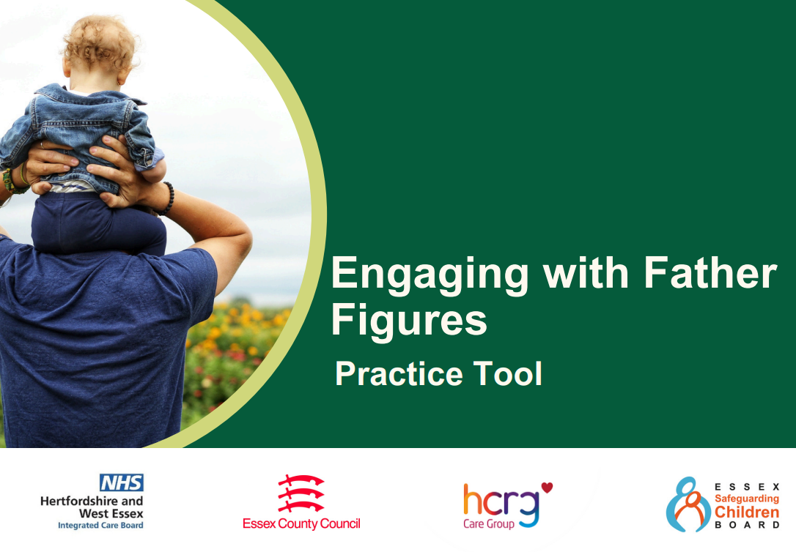


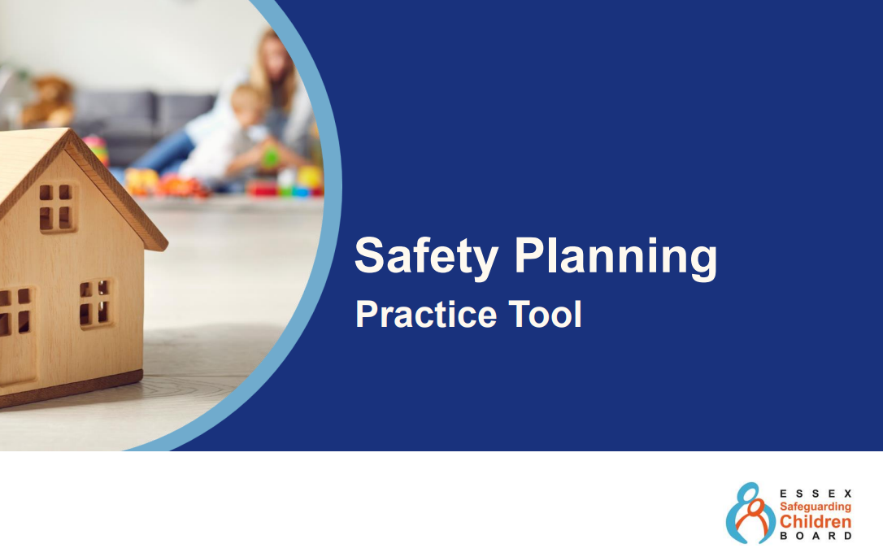
Practice Tools

Slide 48
Safer Sleep for Babies Practice Tool
Sudden Unexpected Death in Infancy (SUDI)
Recently there have been a number of SUDIs in Southend Essex and Thurrock, these recent cases will be included in the thematic review that is being undertaken but initial risk factor identified include
Parental smoking, Poor mental health, Co-sleeping and
Parental substance misuse (most frequent Cannabis and Cocaine)
A practice tool was developed so that all practitioners coming into contact with families can deliver those same safer sleeping messages and prompt curious conversations.
SUDI slides and video ESCB - Child Safety.

Slide 49

ESCB - Stay Safe Conferences
Conference dates & locations
South Essex – Wednesday 4 March 2026
North Essex – Tuesday 10 March 2026
Mid Essex – Thursday 19 March 2026
West Essex – Wednesday 25 March 2026

Slide 50
Essex Youth Vaping Toolkit
Concerns were raised by schools and colleges to the Stay Safe groups about vape use (nicotine and illicit substances)
A working group was set up to look at how police and schools could work with The Childrens Society to encourage educational sanctions.
Public Health and ESCB worked with a multi agency group (including schools and further education settings) to produce a toolkit giving guidance, resources and suggested communications for newsletters.
ESCB Youth vaping

Slide 51
ESCB Learning and Development opportunities –click here ESCB training
Getting to know your partners session-Gypsy, Roma and Traveller – Phoenix Futures 17th December 2025
Upcoming learning and development opportunities
Criminal exploitation – 4th December 2025
Early Help and TAF workshop – 13th January 2026
MAPPA awareness – 20th January 2026
Child protection conference training – 27th January 2026
Online safety week which includes a session from the 2 Johns on 11th of December 2025
Free e-learning – Exploitation, professional curiosity and non-accidental injury

Slide 52
Resources
Southend Essex and Thurrock Safeguarding and Child Protection Procedures
Resolving Professional Disagreements-Chapter 11 of the SET Procedures
Effective Support for Children and Families in Essex
Child Safeguarding Practice Reviews
To receive the ESCB newsletter please email escb@essex.gov.uk
Please follow us on LinkedIn Essex Safeguarding Children Board

Slide 53

Thank you for your time.
Any questions?
Liz.Kirby@essex.gov.uk
Karen.Hammett@essex.gov.uk

Slide 54
Private Fostering

Slide 55
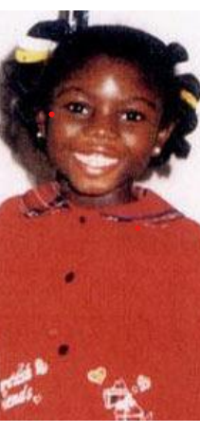
Origins of Private Fostering
In 2000, nine year old Victoria Climbie suffered chronic neglect and sustained multiple injuries which resulted in her death.
Victoria had been being cared for by her Great Aunt in what would now be considered a Private Fostering arrangement.
As a result of Victoria’s tragic death, there was a Government Inquiry which made recommendations to improve safeguarding and protect children in similar circumstances.

Slide 56


Definition of Private Fostering
A child is under 16 (18 with a disability)
Lives with someone who is not a close relative
Will be living together for more than 28 days
A close relative is :
  grandparent
  brother / sister
  uncle / aunt (this can be by marriage)
  step-parent
  Private Fostering Regulations 2005

Slide 57
Examples of Private Fostering
A child living with an extended family member –
  Great Aunt or Uncle, Great Grandparents or Cousin. This need to be confirmed they are actually related, not living with someone they refer to as ‘aunt’ or ‘Uncle’ etc.
A young person who is living with a boyfriend, girlfriend or friend’s family, perhaps as a result of parental separation or arguments at home.
A child whose parents are living or working abroad and they are living with another family in the UK.
A child who is part of an educational exchange programme and will be staying with a host family in the UK.
A child in the UK through Homes for Ukraine.

Slide 58
Outline of Private Fostering
Private foster carers are not Local Authority Foster Carers and the children within the arrangements are not Looked After Children.
Private Fostering is an arrangement made between the parent and the private foster carer.
It is a legal requirement for parents and private foster carers to notify the Local Authority when an arrangement is made.
Notification should happen at least 6 weeks before the arrangement is due to start, or if the child arrives suddenly, no more than 48 hours after child has arrived.
It is an offence not to notify the Local Authority about a private fostering arrangement under S.70 Childrens Act.

Slide 59
Outline of Private Fostering
There could have been previous, or current, Children’s Social Care involvement but the decision for the child to live with the family is NOT made by the Local Authority.
We undertake an initial visit to the Private Fostering arrangement, and see the carer and child, within 7 working days.
Safeguard checks and a Private Fostering assessment are completed within 42 working days.
Carers are not approved by the Local Authority.
The decision on suitability is taken by the Agency Decision Maker.
There is no financial support provided by the Local Authority for Private Fostering arrangements.
Visits are undertaken six-weekly at minimum, then 12-weekly after the arrangement has been ongoing for one year.

Slide 60
Responsibilities Towards the Child
The private foster carer becomes responsible for providing the day to day care for the child but the child’s parents/legal guardians remain legally responsible for the child, as they hold parental responsibility.
The Private Fostering Team ask parents and private foster carers to share information and agree practicalities. This includes:
- how long the arrangement will last
-who will keep in touch with the child’s school
- who can give consent for medical matters
- how the child will be provided for financially
- deciding how contact with family members will happen

Slide 61
How can you help us?
Professionals have a responsibility to notify us immediately if they become aware of any Private Fostering arrangement and believe the Local Authority have not/will not be notified. Be curious about who a child is living with and if they are directly related or not.
.
We may contact you and other involved agencies requesting information about the child and/or the private foster carers
Promote awareness and understanding of Private Fostering within your own teams and people you are working with.
Help with distribution of leaflets and posters as widely as possible.
Spread the word!
If at any time you become concerned about anything affecting the Private Fostering Arrangement, please contact us immediately.

Slide 62
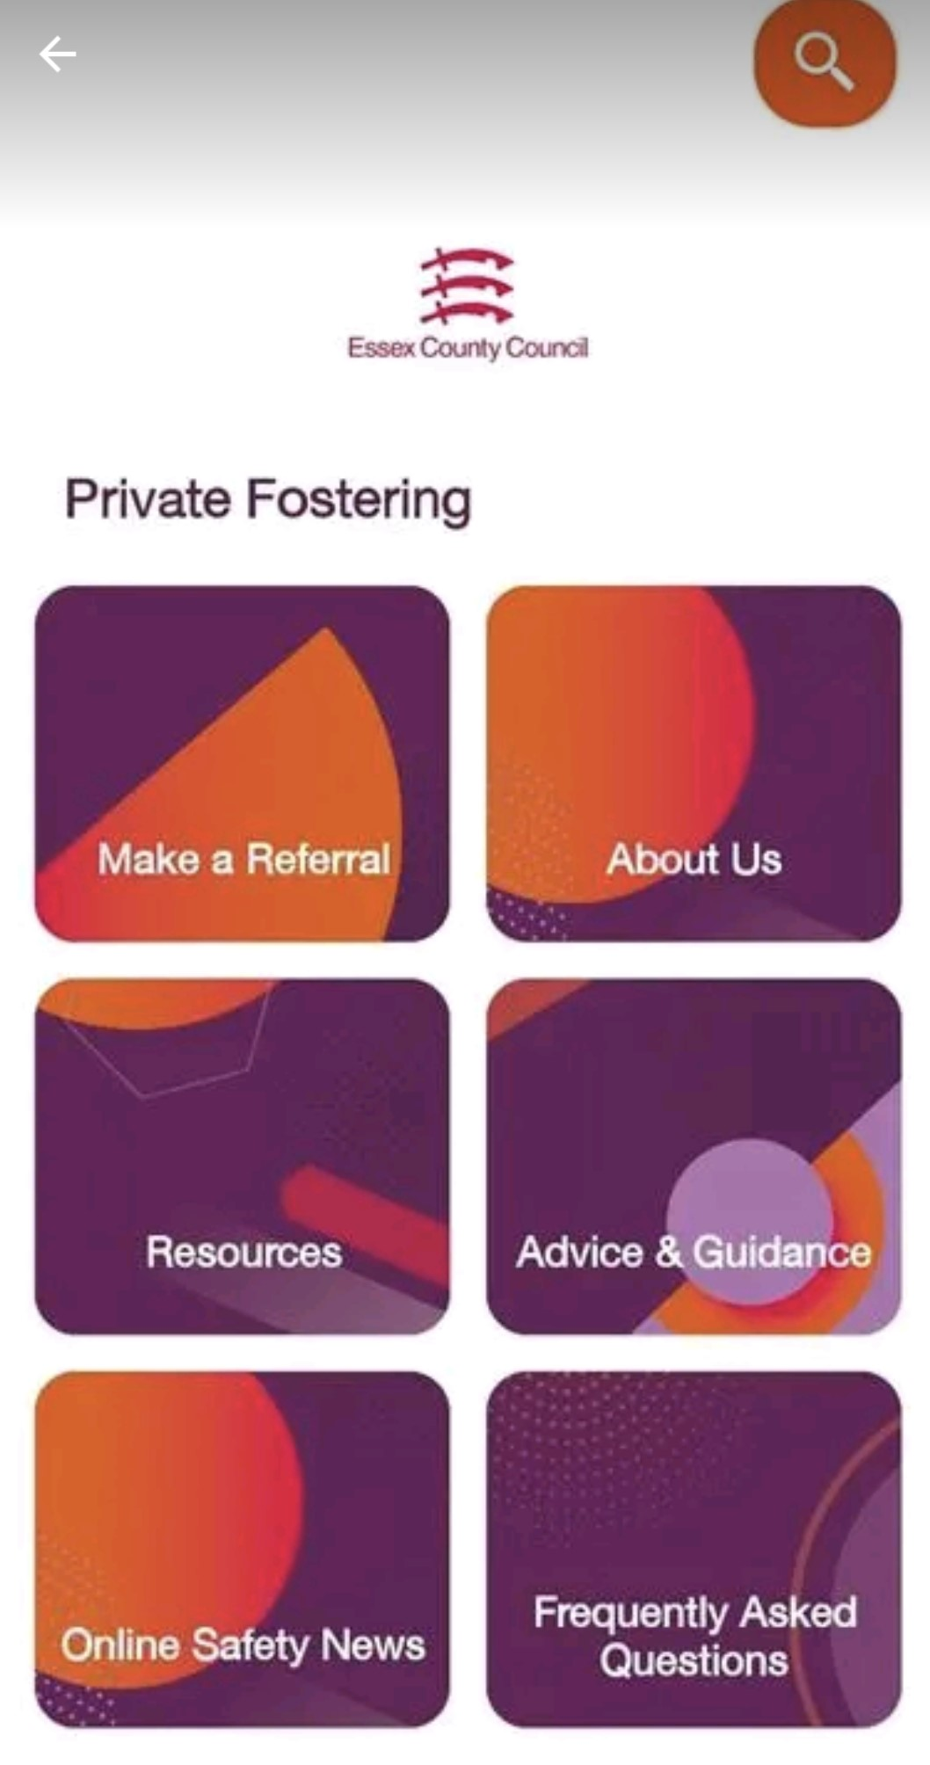
How do you find out more?
We have an app!

Slide 63
How do you make a referral?
Professionals can make an online referral to the Private Fostering team. Report a concern about a child: Information for professionals | Essex County Council Select the ‘Request for Support form’.
Professionals can call the Children and Families Hub for a consultation on 03456037627.
The public can contact the Children and Families Hub to make a referral on 03456037627.
Internal professionals are also welcome to call a Private Fostering team member for a consultation or email us on private.fostering@essex.gov.uk

Slide 64
Contact the Private Fostering Team for any questions
Adwoa Solomon – Team Manager
Win Escallier – Senior Practitioner
Michelle Joyner – Senior Practitioner
Lydia Johnson – Social worker
Gemma Boreham – Social worker

