Slide 1
Developing important writing skills before school
Emma Booker
(Referencing Alastair Bryce-Clegg and Julie Cigman)
This power point can be used as a presentation, staff meeting, discussion starter, or printed to use for display or information. Please view in “notes page”
Notes:
“From Mark Maker to Writer” – Alastair Bryce Clegg
“Supporting Boy’s Writing In the Early Years” – Julie Cigman

Slide 2
Plan for the the widest possible exploration of physical development
Display your own work
Celebrate efforts specifically e.g. “I like the way you worked carefully to cover the fence with water”
What is the role of the adult when supporting writing development ?
Observe and match provision to developmental stages
Give children the patterns of letters early on- imprint it in their heads
Mark make in all spaces
Notes:
Possible refection- do we cover all of these aspects in our setting?

Slide 3
Developmental stages in learning the transcriptional skills of writing:
Ascribes meaning to marks (30-50m)
Uses some letter-like shapes and identifiable letters to communicate meaning (30-50m)
Uses some clearly identifiable letters to communicate meaning, representing some sounds correctly (40-60m)
Uses phonic knowledge to write words in ways that match their spoken sound (ELG)
Writes some simple sentences which can be read by themselves and others (ELG)
Are we rushing towards formal writing too quickly?
Notes:
Possible discussion – in which band are the majority of children in our setting? If they are 22-36 or 30-50, do our expectations reflect this?

Slide 4
“In the early years, we must be wary of placing too much emphasis on transcriptional aspects of writing (handwriting, spelling and punctuation) too early as this can cause confusion and can create negative attitudes towards writing.” (Within the writing projects described in Julie Cigman’s book, focusing on the communicative aspects of writing freed children up to “have a go” as the purpose of the writing was to convey a message. )

Slide 5
Elements of early writing to think about
REAL -Raising Early Achievement in Literacy
- Environmental print
- Books
- Oral language
- Early writing
1. Upper body development
2. Fine motor development
3. Phonics
4. Stages of writing development
5. Talking for writing
Notes:
There are many elements that go into successful provision for early writing –are we planning opportunities for each of these elements?
We may refer to the REAL project at a later date. It also highlights the importance of environmental print, books and oral language to raise achievement in literacy. (At this point, we could use the ORIM framework, or another refection tool.)

Slide 6

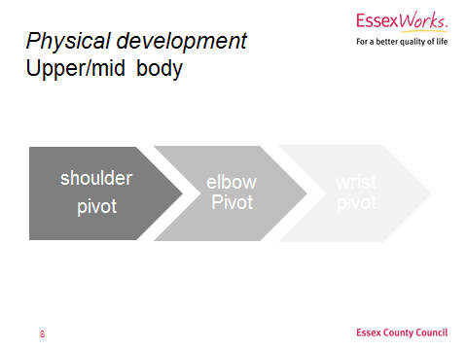
1. Upper body development
Notes:
“Strength in this area doesn’t happen by accident. We need to understand the small step stages of physical development and dexterity and how they link to mark making and then link this to what we can do on a daily basis to support and extend children in their progress…..Where are our children in their physical development in terms of upper body physical development ? Are they developing competence in their shoulder, elbow or wrist pivots?” Alastair Bryce-Clegg

Slide 7
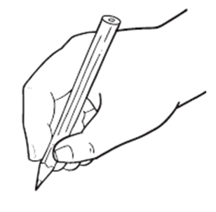
2. Fine motor development
Alastair Bryce-Clegg describes the 9 different hand skills that are needed to be able to hold a pencil effectively. (This skill is at the level of the Early Learning Goal!
He also talks about the many different stages of pencil grip that children may go through before gaining the tripod grip.
Children need lots of carefully considered fine motor activities!
Notes:
“End of the pivot journey is the fingers. Once the pivots have worked their way down to the wrist, the pivot journey continues to the smallest set of pivots, the fingers. The hand is complex and made up of different joint and muscle groups that work together to provide the maximum dexterity required for letter formation,” Alastair Bryce -Clegg

Slide 8
3. Phonics An early phonics focus lays the groundwork for systematic phonics that is taught in schools. “Letters and Sounds” is one programme that contains several elements and will support children, no matter which programme a school might use: Aspect 1: listening for sounds in the environment Aspect 2: playing with Instrumental sounds Aspect 3: making percussion noises with our bodies Aspect 4: playing with rhythm and rhyme Aspect 4: finding words beginning with the same sound (alliteration) Aspect 6: experimenting with voice sounds Aspect 7: starting to break words down into sounds and using sounds to make simple words (blending and segmenting) The Letters and Sounds programme can be downloaded from www.gov.uk/government/publications/letters-and-sounds
Reflection: are we concerned that we might do it wrong?
Notes:
Phase 1 recognises the central importance of developing speaking and listening skills as a priority in their own right and for paving the way to making a good start on reading and writing. Put simply, the more words children know and understand before they start on a systematic programme of phonic work the better equipped they are to succeed.
These activities are very largely adult led. However, they must be embedded within a language-rich educational programme that takes full account of children’s freely chosen activities and ability to learn through play.

Slide 9
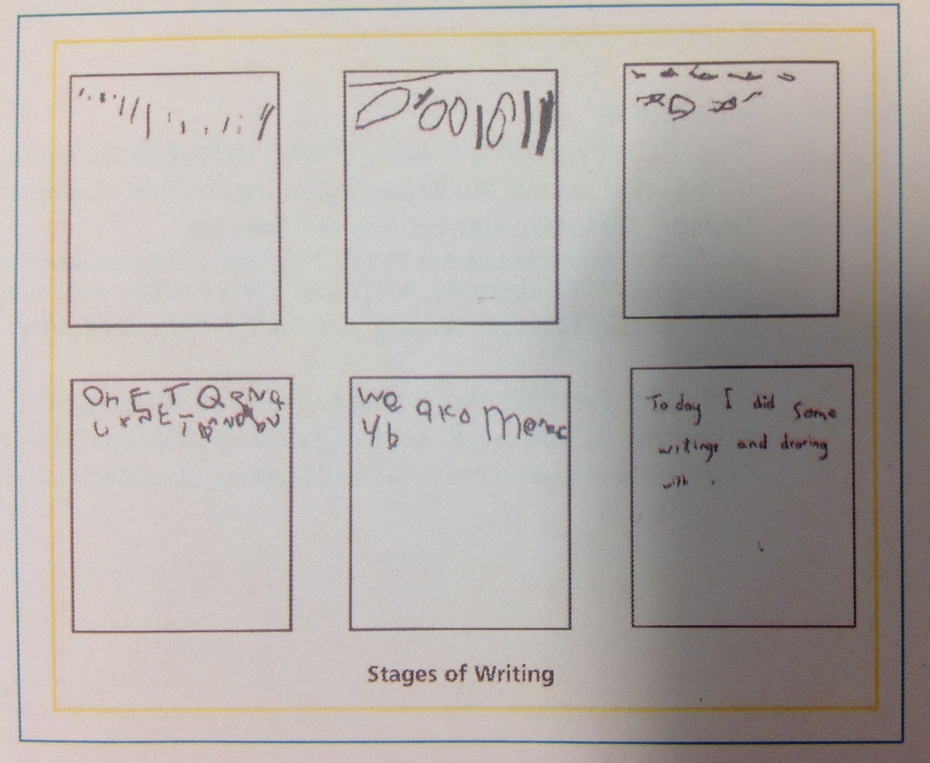
4. Stages of writing development
Do we recognise value and model children's efforts at every level?
Notes:
This is one version – others can be found online. Which stage(s) best describe the children that we are working with?

Slide 10
“In order to become a writer, children must develop transcriptional skills of handwriting, spelling and punctuation; and they must first develop compositional skills, by finding a creative and expressive voice of their own which they can communicate using the transcriptional skills of writing” Julie Cigman
5. Talking for writing
Do children have the chance to tell their stories and to develop strong and creative verbal skills?
Notes:
Reflection: do we listen for children’s voices in their play and model how to record their spoken stories?

Slide 11

Reflection: is there a place for copywriting (or overwriting?)
Think about:
Children get the message that writing is something YOU can do but they can’t
Children copywriting do not develop phonics skills essential to real independent writing
At the end of copywriting, children often have no idea WHAT they have written… this is very different in emergent writing where WE have no idea what they have written but THEY do.
Notes:
There may be a place for demonstrating writing, but this is in tandem with physical development, phonological awareness and lots of speaking and listening!
Possible reflection: Do we make judgements about boys’ writing abilities based only on their performance in adult-led activities? (This can damage boys’ self esteem and confidence in themselves as learners. )

Slide 12
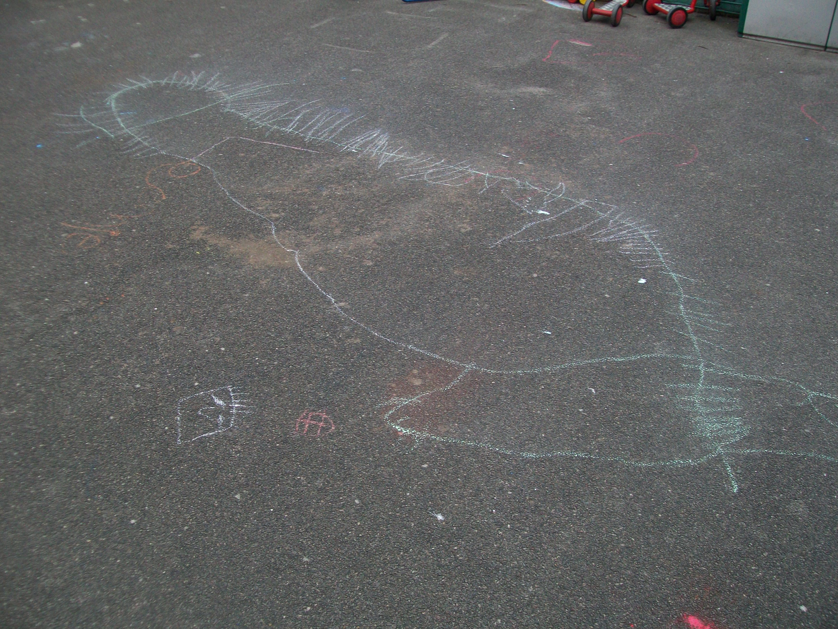
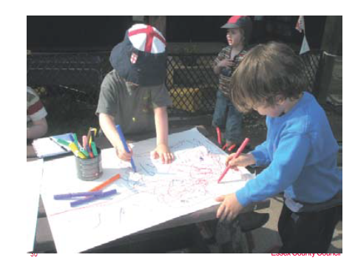
writing doesn’t need to be at a table…
…it should take place outside as well as inside
Reflection: Boys and writing
…it might take place with others…
…whiteboards appeal as the marks are not permanent
Photos 1,3,4 from “Mark Making Matters”

Slide 13
Displays?
Social media?
Parent workshops?
Staff CPD?
Liaison with schools
and Children's Centres ?
Newsletters?
Activities?
What works best for your setting and your parents?
Sharing the key messages
Reflection:
How you are involving other team members in the development of your environment?
How you are involving and informing parents?
Are there any challenges?

Slide 14
A motivated writer :
is tuned in
has a reason to write
sees writing as a useful part of everyday life
finds writing non- threatening
Notes:
What do you need to do next? Is there one element that you would like to think about more? Please talk to your EYFS Adviser, local schools, other settings and Children’s Centre
National Strategies:
Engaging Boys in the Early Years - The experiences of Three Islington settings
Building Futures: Believing in Children - A focus on provision for Black children in the EYFS
Confident, capable and creative: supporting boys’ achievements Guidance for practitioners in the EYFS
Children thinking mathematically: PSRN essential knowledge for Early Years practitioners
Finding and exploring young children’s fascinations - Strengthening the quality of gifted and talented provision in the early years
Mark Making Matters - Young children making meaning in all areas of learning and development
Learning, Playing and Interacting - Good practice in the EYFS
Books
Getting Ready to Write – Alistair Bryce Clegg
Get them Talking, Get them Writing – Alistair Bryce Clegg
Continuous Provision – Alistair Bryce Clegg
Young Boys and Their Writing – Sally Featherstone and Jenni Clarke
Supporting Boys’ Writing in the Early Years – Julie Cigman
Little Book of Props for Writing – Featherstone Education
Write Dance in the Early Years: A Pre-Writing Programme for Children 3 to 5 (Lucky Duck Books)- R. Oussoren
Raising Boys’ Achievement – Gary Wilson
Getting it Right from the Start – Linda Tallent with Gary Wilson

Slide 15
Power point will be available on the early years website on the resources section after half term
Upper body development
Talking for writing
Fine motor development
Action:
Think about how best to support your staff moving forwards
Choose one or more of the five areas to reflect on and develop
Stages of writing development
Phonics

