Slide 1


Keeping Children Safe in Education:
Prevent training for education settings
Copyright © Essex County Council 2026
No part of this publication may reproduced, stored in a retrieval system of any nature, downloaded, transmitted or distributed in any form or by any means including photocopying and recording, without the prior written permission of Essex County Council, the copyright owner
Notes:
This presentation can be used as part of ongoing training for staff.

Slide 2
Contents page:
1
What is Prevent?
5
Resources
Prevent in Essex
2
Prevent Duty guidance 2023
6
3
Definitions and key terms
4
Channel and prevent referrals

Slide 3
Set the scene
  When you think of Prevent, how does it make you feel?
  Take a couple of minutes – discuss together.
  Your thoughts please?
Notes:
You may wish to use this opportunity to invite comments from staff about Prevent. People may feel uneasy about it – thinking about extremism, radicalisation, and terrorism can make people uncomfortable. You can acknowledge any contributions, then move to the next slide and play the video.

Slide 4
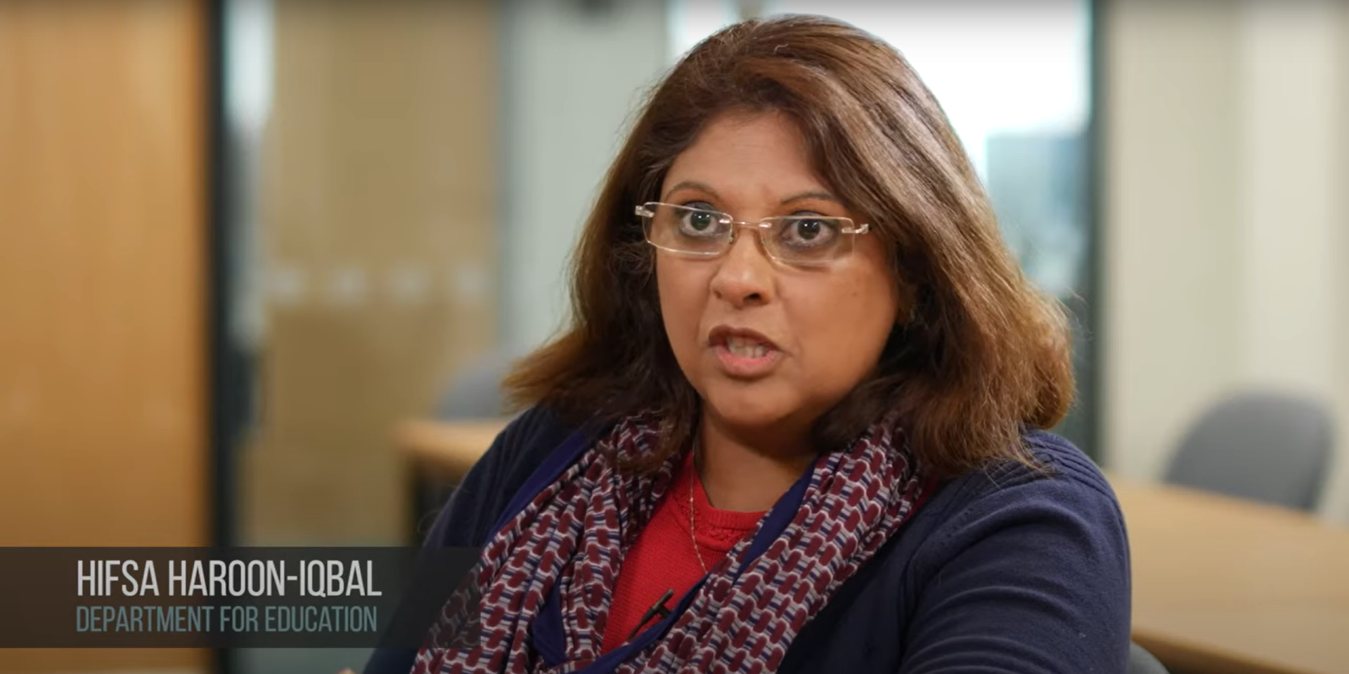
Video: What is Prevent:
Notes:
After the video, reassure people that Prevent is part of our safeguarding duties and responsibilities, like other types of abuse and neglect are. There is a legal and regulatory framework around Prevent, and support is available. Settings can discuss concerns with Prevent police, Social Care, and the Education Safeguarding Team. Try not to worry – think of it as problem-solving, like other safeguarding concerns.

Slide 5
PREVENT duty and strategy
The Counter-Terrorism and Security Act 2015 placed a new duty on schools and other providers of education and care, in the exercise of their functions to have ‘due regard to the need to prevent people from being drawn into terrorism’
Home Office produced guidance on what this means for schools and other providers: Prevent Duty Guidance - (updated 2023)
The Prevent strategy published by the government in 2011 is one of four elements in the Governments counter terrorism CONTEST strategy:
      Prevent people from becoming terrorists or supporting terrorism
      Pursue to stop terrorist attacks
      Protect to strengthen our protection against a terrorist attack
      Prepare to mitigate the impact of any attack
Notes:
The Prevent duty guidance states that settings should be safe spaces in which children and young people can understand and discuss sensitive topics, including terrorism and the extremist ideas that are part of terrorist ideology, and learn how to challenge these ideas.

Slide 6
Prevent duty guidance (2023)
Strategy
Education
Summary
Notes:
We will explore these documents in more detail on the next few slides

Slide 7
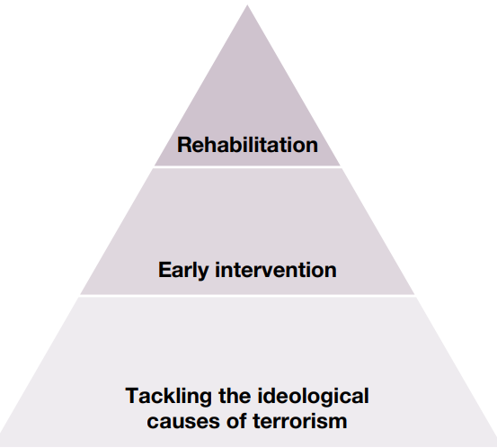
Prevent Duty guidance (2023) – Strategy
The 2023 Prevent Duty guidance has three specific strategic objectives:
To tackle the ideological causes of terrorism
To intervene early to support people susceptible to radicalisation
To enable people who have already engaged in terrorism to disengage and rehabilitate
Notes:
The Prevent model (right) shows how the strategy tackles the ideological causes that lead to radicalisation. Then, it intervenes to support those susceptible to radicalisation, and seeks to rehabilitates those engaged with terrorism.

Slide 8
Prevent duty guidance (2023) – education
Schools should:
Actively promote the fundamental British values of democracy, the rule of law, individual liberty, and mutual respect and tolerance of those with different faiths and beliefs to support learners to have the knowledge, skills and values that will prepare them to be citizens in modern Britian
Be spaces in which children / young people can understand and discuss sensitive topics, including, where appropriate, terrorism and the extremist ideas that are part of terrorist ideology, and learn how to challenge these ideas
Be mindful of their existing duties on political impartiality and to ensure the balanced presentation of political issues

Slide 9
Prevent Duty guidance (2023) summary
  The Prevent duty is part of schools’ wider safeguarding and welfare responsibilities. Settings should not only be alert to violent extremism but also non-violent extremism, including certain divisive or intolerant narratives which can reasonably be linked to terrorism
  Children continue to make up a significant proportion of Channel cases (Channel information is on Slide 21). Settings are often in a unique position, through interacting with children on a regular basis, to be able to identify concerning behaviour changes that may indicate they are susceptible to radicalisation
Children’s resilience to extremist ideology can be strengthened by settings providing a safe environment for debating controversial issues and helping them to understand how they can influence and participate in decision making
The internet continues to make it simpler for individuals and groups to promote and to consume radicalising content. Research has demonstrated that the internet has become the ‘preferred’ avenue for those searching for terrorist propaganda or contacts
Notes:
For discussion: What does our setting do to prevent radicalisation?
Children from all kinds of different backgrounds can become radicalised
You need to be aware of the factors that make your pupils more vulnerable to radicalisation. The following is a guide only, and you need to use your professional judgment to assess their vulnerability.
Young people often struggle with their sense of identity, and this can make them vulnerable to extremist influence. Some may feel distant from their cultural or religious heritage, or isolated from the prevailing British culture, which may lead them to question their place in British society.
Personal circumstances, such as tensions in the family or having experienced a traumatic event, can also increase vulnerability. Extremists prey on low self-esteem, perceptions of injustice and feelings of failure combined with a sense of grievance, often triggered by firsthand experience of racism or discrimination. If your pupils have special educational needs, or find it difficult to interact socially, empathise or understand the consequences of their actions, they may be more vulnerable to radicalisation.
External factors, such as tensions in the local community, events affecting their country or region of origin, having friends or family who have joined extremist groups, and exposure to narrow points of view, are also a factor.

Slide 10


Whole school approach
Permissive environments
Push and pull factors
Example risk indicators
Susceptibility and vulnerability
Radicalisation
Notes:
We will explore these things in more detail on the next few slides

Slide 11
Reducing permissive environments – introduced in 2023 guidance
Radicalisers create and take advantage of permissive environments to promote or condone violence and to spread ideologies that
undermine values and society
This strand of Prevent is about limiting exposure to radicalising narratives online and offline, and creating an environment where radicalising ideologies are challenged and are not permitted to flourish
Established terrorist narratives exhibit common themes such as antisemitism, misogyny, anti-establishment, anti-LGBT grievances and religious or ethnic superiority
Encouragement of terrorism, including glorifying the commission or preparation of acts of terrorism, fundraising for the purposes of terrorism, and inviting support for a proscribed terrorist organisation, are all criminal offences
Settings can help to address this through working to reduce the potential for this to exist:
promote safe, open dialogue that challenges harmful narratives
through robust IT policies and systems – this is also about filtering and monitoring
using appropriate classroom resources (for example, Educate Against Hate resources)
carefully considering and checking external speakers before they speak at setting events
Notes:
Recognise, challenge, manage
Glossary of terms - GOV.UK (2024) – relevant to the Prevent duty guidance 2023.

Slide 12


Risk: push factors
Push factors may include a child / young person feeling:
isolated
they do not belong
they have no purpose
low self-esteem
their aspirations are unmet
anger or frustration
a sense of injustice
confused about life or the world
real or perceived personal grievances
This Photo by Unknown Author is licensed under CC BY-SA-NC
Notes:
All staff should be aware of the push and pull factors that may increase a child’s vulnerability to being radicalised. Radicalisation is a process similar to the grooming process in other abuses, and staff should be vigilant about indicators
Push factors: something that makes a person want to leave a place or escape from a particular situation – moving to something else

Slide 13

Risk: pull factors
Pull factors could include an extremist or terrorist group, organisation or individual:
offering a sense of community and a support network
promising fulfilment or excitement
making the learner feel special and part of a wider mission
offering a very narrow, manipulated version of an identity that often supports stereotypical gender norms
offering inaccurate answers or falsehoods to grievances
encouraging conspiracy theories
promoting an ‘us vs. them’ mentality
blaming specific communities for grievances
encouraging the use of hatred and violent actions to get justice
encouraging ideas of supremacy
This Photo by Unknown Author is licensed under CC BY-NC-ND
Notes:
Pull factors: something that attracts people to a place or an activity
Falsehoods: lies / stretching the truth
Stereotypical gender norms: girls should be polite, nurturing, feminine – boys should be strong, aggressive and bold
Conspiracy theories: a belief that some secret but influential organisation or entity is responsible for an event or phenomenon

Slide 14
The Prevent duty: example risk indicators
Low risk signs:
Holding strong non-violent or non-extremist values
Criticising government policies
Taking interest in international affairs
Adopting visible signs
Being active on social media
Supporting non-violent causes
Showing new interest in political ideology or religion
Adoption of icons or symbolism, bonding to a certain group
Medium risk signs:
Legitimising the use of violence to defend an ideology or cause
Accessing extremist or terrorist websites, forums or publications
Expressing dehumanising views
Expressing interest to travel to a conflict zone
Being in contact with online groups or individuals known to support extremist ideology
Expressing persistent intolerance towards groups of people perceived as ‘other’.
Showing a fixation on weaponry or explosives
Being obsessed with massacre or mass violence or past terrorist activity.
High risk signs:
Verbally or physically attacking someone due to their race, religion or sexuality
Committing violent acts guided by a violent extremist group or ideology
Producing or sharing terrorist material in person or online
Recruiting others to a proscribed terrorist group or organisation
Having a ‘kill list’ or plan to carry out mass violence
Notes:
There is no single way of identifying whether a child is likely to be susceptible to an extremist ideology. Background factors combined with specific influences such as family and friends may contribute to a child’s vulnerability. Similarly, radicalisation can occur through many different methods (such as social media or the internet) and settings (such as within the home). However, it is possible to protect vulnerable people from extremist ideology and intervene to prevent those at risk of radicalisation being radicalised. As with other safeguarding risks, staff should be alert to changes in children’s behaviour, which could indicate that they may be in need of help or protection.

Slide 15
Susceptibility and vulnerability
  Children from all kinds of different backgrounds may be susceptible to radicalisation
  Susceptibility is complex and unique to a person's circumstances
  Susceptibility can be closely connected to emotions – a person may feel insignificant, marginalised or invisible
  A person can be vulnerable if they need special care, support or protection because of age, disability, risk of abuse or neglect
  Not all individuals susceptible to radicalisation will be vulnerable
  There may be other circumstances, needs, or other underlying factors that may make a person susceptible to radicalisation
  As with all safeguarding concerns, each case should be
  considered on its merits
Notes:
Susceptibility: someone or something who / that can easily be influenced, harmed, or infected
Vulnerability: being vulnerable / at risk of something – able to be easily hurt, influenced, or attacked – specific things can also be vulnerable, e.g., old buildings

Slide 16
Radicalisation
  Radicalisation is the process of a person legitimising support for, or use of, terrorist violence
  A person might be susceptible to radicalisation due to a variety of circumstances, needs or other underlying factors
  There is no single model of someone's radicalisation journey or single profile of a radicalised person
  Methods of radicalisation:
    Grooming using online platforms (innocent looking social media sites)
    Public displays of hate and division (graffiti)
    Promoting ideologies through leaflets or otherwise

Slide 17
Definitions and key terms
Extremism, Radicalisation and Terrorism
Extreme Right-wing Ideology
Islamist Extremism
Left-wing, Anarchist and Single-Issue Extremism
Involuntary celibates (Incel ideology)
Fascination with extreme violence or mass casualty attacks
Notes:
We will explore these definitions in the next few slides

Slide 18
Definitions and key terms
EXTREMISM IS:
The promotion or advancement of an ideology based on violence, hatred or intolerance which aims to:
Negate or destroy the fundamental rights and freedoms of others
Undermine, overturn or replace the UK’s system of liberal parliamentary democracy and democratic rights
Intentionally create a permissive environment for others to achieve results in either of the above.
RADICALISATION IS:
The term commonly used to describe the processes by which a person adopts extremist views or practices
to the point of legitimising the use of violence.
TERRORISM IS:
An action or threat designed to influence the government or intimidate the public. Its purpose is to advance a political, religious or ideological cause.

Slide 19

Extreme Right Wing Ideology
This covers sub-ideologies including Cultural Nationalism, White Nationalism and White Supremacism - often spans a range of extreme beliefs such as antisemitism, anti-Islam, neo-Nazism, ethno-nationalism or anti-establishment
This Photo by Unknown Author is licensed under CC BY-SA
Notes:
Picture: Mein Kampf by Adolf Hitler. Outlines many of Hitler's political beliefs, his political ideology, and his future plans for Germany and the world. Some right-wing extremists will refer to the book, possibly in reverential terms.

Slide 20
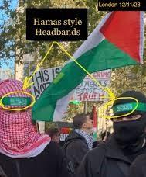

Islamist extremist ideology
Islamist extremist acts of terrorism are perpetrated or inspired by political or religiously motivated groups, or individuals who support the use of violence as a means through which to establish their interpretation of an Islamic society

Slide 21
Left-wing, Anarchist and Single-Issue Extremism
Extreme Left-Wing
Anarchist Extremism
Single Issue Extremism
Extremists who believe in using violence and serious criminality to abolish existing systems of government and replacing them with anarchist, socialist or communist systems
Extremists who believe in using violence to replace current systems of government and law enforcement with a system that prioritises complete liberty and individual freedom
Extremists who endorse violence and serious criminality focused on a specific topic, such as animal rights

Slide 22

Involuntary celibates (Incel) ideology
individuals or communities that largely exist online
characterised by extreme misogyny and notions of male superiority – in some cases racial hatred too;
belief that although men are entitled to sex, attractiveness is determined by predetermined genetic factors which women choose in a partner. This is why they are unable to form relationships or have sexual experiences;
this is the fault of the social and political structures which privilege women, for example the feminist movement.
Attacks where there appears to have been an Incel link:
    2021 Plymouth shooting
    2024 Sydney Westfield shopping centre attack
Notes:
Educate Against Hate – the terms red pill and blue pill refer to a choice between the willingness to learn a potentially unsettling or life-changing truth by taking the red pill, or remaining in contented ignorance with the blue pill
Red pill: means ‘waking up’ to the real world, where women have an advantage and female oppression is a myth
Blue pill: means remaining ignorant to the ‘real world’ experienced by Incels
Black pill: means that they adhere to ideas behind the ‘Red Pill’, but don’t believe that society will change or that Incels lives can be improved
Although not always the case, those subscribing to the 'Black Pill’ may be more inclined to self-harm, whilst those subscribed to the 'Red Pill' may be more inclined to take extreme action against others
Manosphere: websites and blogs where men express opinions about issues concerning contemporary masculinity and male relationships with women, especially those associated with views that are hostile to feminism and women's rights

Slide 23

Fascination with extreme violence or mass casualty attacks
This has been a Prevent category since April 2024, despite having no recognised ideological basis – risk indicators:
Fixation on massacres: persistent interest in overseas school shootings, historical mass killings, or genocide
Idolisation of attackers: glorifying previous mass murderers or drawing inspiration from battle sites and extremist symbols
Extreme online behaviour: unsupervised, excessive viewing of gore, violent subcultures, or instructional material on weapons
Justifying violence: expressing a desire for revenge or asserting that violence is an acceptable solution to personal grievances
Social isolation: drastic changes in daily routine, increasing secrecy, or sudden withdrawal from family and friends
Notes:
You can acknowledge that this concept is difficult to consider, but is important in the context of Prevent – it is within the framework for this work
Extracts from government response (Home Sec.) to Prevent Learning Review, and Phase One of the Southport Inquiry:
The Home Office published the Key Principles of Prevent on GOV.UK in February 2026 which states that ‘while ideology is an important consideration, a clear identifiable ideology is not mandatory to make or adopt a Prevent referral’. The Home Office will embed the Key Principles through new and updated policy and guidance such as the forthcoming revised ‘Notice, Check, Share’ document (which provides guidance on making referrals), and the upcoming revision of the guidance for Channel panel members and partners.
I have created a taskforce in the Home Office to consider the Southport Inquiry recommendations, coordinate the Government’s response, and develop a new approach to managing the risk from individuals fascinated with violence. The taskforce will start to develop a coordinated approach to identifying and tackling the risk posed by violence‑fixated individuals, alongside the work of Phase 2 of the Southport Inquiry.

Slide 24
Radicalisation using technology
Online radicalisation:
The internet (including the ‘Dark Web’) has become a mechanism that groups and individuals with extreme views and ideologies use to find those with similar views, and to groom / radicalise vulnerable children and adults
Apps like WhatsApp, Telegram and Discord provide the opportunity for groups and individuals to meet and befriend individuals in order to radicalise them - End-to-end encryption offered by offered by these apps enables the discussions to remain hidden
Online gaming:
The world of online gaming provides a space for extremists to lure vulnerable individuals into spaces where they can be radicalised
In-game functions such as ‘team-speak’ facilitate this as it enables individuals to vocally communicate with others in-game without being ‘friends’ with them
The connectivity of online gaming provides extremists with the opportunity to befriend vulnerable people, luring them into groups who (under the pretext of gaming) can seek to radicalise them

Slide 25
Channel Panel:
Voluntary support programme to provide support at early stage to people identified as vulnerable to being drawn into terrorism
Multi-agency panel (Head of Education Safeguarding and Wellbeing sits on panel for Education)
Education setting invited to join meeting to contribute information and be involved in planning (where an individual is linked to the setting)
Young person could refuse to consent, but that may constitute a child protection concern in itself (if not willing to work with agencies)
If adopted to Channel, appropriate intervention and support will be identified to address concerns, educate the individual and provide a counter-narrative
Notes:
Each local authority has a Channel Panel – this meets monthly in Essex and all agencies are represented.

Slide 26
Prevent in Essex
Notes:
We will explore these documents in more detail on the next few slides

Slide 27
Prevent in Essex - summary
Jo Barclay Head of Education Safeguarding and Wellbeing – is the Prevent Lead for Education in Essex
There is a Prevent Strategic Board to oversee arrangements in Essex and implement Essex Prevent Strategy (Prevent Lead sits on this)
There is also a Prevent Police Team that works across the Eastern region
The Counter Terrorism Local Profile (CTLP) is a national document shared with Prevent Leads
Elements of the CTLP are shared with education safeguarding leads to explain national and regional data and trends
Settings should use this information to inform their Prevent risk assessments
Practitioners should report any concerns to their DSL or Lead Practitioner
The DSL should share concerns with an appropriate agency, and may make a Prevent referral
The ECC Education Prevent Lead sits on the Channel Panel which meets monthly to discuss cases.
This brings together all key agencies to agree a plan of support if needed
An education setting may be invited to the meeting to contribute
Channel is a voluntary support programme
Notes:
Settings should have Prevent a risk assessment, which is informed by the CTLP, to assess risk of children being drawn into terrorism, including support for extremist ideas that are part of terrorist ideology
Staff should be aware of the latest trends and risks
Geography is not as much of a concern due to the online risks of radicalisation that can happen anywhere
There is a separate presentation on PREVENT which you may which to use with this (or at a later date to develop learning)
Protecting children from risk of radicalisation should be seen as part of settings’ wider safeguarding duties – similar to protecting children from other forms of harm and abuse
The DSL (and any deputies) should be aware of local procedures for making a Prevent referral

Slide 28
Responding to Prevent concerns
If settings have Prevent-related concerns and feel a child is at of radicalisation or harm the DSL can:
contact the Education Safeguarding Team (Jo Barclay or Matt Lewis) for advice
consult with the Children and Families Hub at Social Care
contact the Eastern Region Counter-Terrorism Policing Team – the team will provide advice and guidance including about whether the setting should make a Prevent referral
Telephone: 01245 452 196 / Email: prevent@essex.police.uk
Any setting considering a referral to Prevent should at the same time submit a Request for Support to the Children and Families Hub
Any setting submitting a referral to Prevent should at the same time submit a Request for Support to the Children and Families Hub
PREVENT response section on Essex Schools Infolink

Slide 29
Prevent: government resources
  Prevent duty guidance
  The Prevent duty: safeguarding learners vulnerable to radicalisation - GOV.UK (www.gov.uk)
  How to complete a risk assessment to assess the risk of people becoming terrorists or supporting terrorism - GOV.UK (www.gov.uk)
  Understanding and identifying radicalisation risk in your education setting - GOV.UK
  Managing risk of radicalisation in your education setting - GOV.UK
  Making a referral to Prevent - GOV.UK
  Case studies - GOV.UK

Slide 30
Prevent resources
  ACT Early | Prevent radicalisation (Action Counters Terrorism – a website to engage the community in reporting concerns about people who may be involved in extremism / radicalisation
Child Net / Trust me - a resource which could start conversations around extremism and extreme online content
Counter Terrorism Policing | Home
Counter Extremism – Preventing Radicalisation in Schools - developed by the London Grid for Learning (LGfL)
Educate Against Hate - Prevent Radicalisation & Extremism - government advice and trusted resources for schools to safeguard students.
  Educate Against Hate blog: advice for schools on discussion and approach to difficult issues with children, including ongoing conflicts, in a way that will allow them to consider the classroom as a place where they can voice their opinions and feelings on things that are happening around the world. Blog also signposts to quality-assured resources to help sensitive discussions

Slide 31
This information is issued by: Essex County Council
Contact us:
educationsafeguarding@essex.gov.uk
Education Safeguarding Team
Essex County Council
County Hall, Chelmsford
Essex, CM1 1QH
Essex_CC
facebook.com/essexcountycouncil
Published August Autumn 2026

