Slide 1
Safeguarding forum for Early Years Settings
Summer 2024

Slide 2
Agenda
1. Safeguarding update
2. Training
3. Early Years Questionnaire
4. Effective Support
5. Thematic audit – Neglect (Professional Standards and Audit Service)

Slide 3
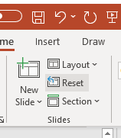

Safeguarding update
To change image:
Delete existing image and insert new by clicking on icon
or
Right-click, change picture
If new picture causes placeholder to resize or rotate
Click on ‘Reset’ under ‘Slides’ tab on Ribbon
To resize or reposition image within placeholder:
Picture Format> Crop
Resize using white circles at corners
Move by click+hold on grey area of image then drag to position

Slide 4
Keeping Children Safe in Education (2024)
PART ONE – safeguarding information for all staff
Definition of ‘safeguarding and promoting the welfare of children’ – amended to reflect the updated ‘Working together to safeguard children 2023’
(Para 18) ‘Early help’ – amended to reflect revised ‘Working Together’ guidance
(Para 19) All staff should be aware of the indicators of abuse, neglect and exploitation
(Para 24) This can be particularly relevant, for example, in relation to the impact on children of all forms of domestic abuse, including where they see, hear or experience its effects
(Para 29) All staff should have an awareness of safeguarding issues that can put children at risk of harm. Behaviours linked to issues such as drug taking and/or alcohol misuse, unexplainable and/or persistent absences from education (instead of ‘deliberately missing education’)

Slide 5
Keeping Children Safe in Education (2024)
PART TWO – the management of safeguarding
(Para 93) In addition, see the DfE Data Protection guidance for schools, which will help school staff, governors and trustees understand how to comply with data protection law, develop their data policies and processes, know what staff and pupil data to keep and follow good practices for preventing personal data breaches.
(Para 171) Where a school places a pupil with an alternative provision provider, it continues to be responsible for the safeguarding of that pupil and should be satisfied that the placement meets the pupil’s needs.
(Para 204) Links added to NSPCC advice on protecting children with SEN; and deaf/disabled children and young people
(Para 205 - 209) ‘Children who are lesbian, gay, bisexual, or questioning their gender’ – disclaimer added, and additional text includes further clarification to comply with gender questioning children guidance terminology
Notes:
Children who are lesbian, gay, bisexual, or gender questioning
N.B. This section remains under review, pending the outcome of the gender
questioning children guidance consultation, and final gender questioning
guidance documents being published.
205. A child or young person being lesbian, gay, or bisexual is not in itself an
inherent risk factor for harm, however, they can sometimes be targeted by other
children. In some cases, a child who is perceived by other children to be lesbian,
gay, or bisexual (whether they are or not) can be just as vulnerable as children who
are.
206. However, the Cass review identified that caution is necessary for children
questioning their gender as there remain many unknowns about the impact of
social transition and children may well have wider vulnerabilities, including having
complex mental health and psychosocial needs, and in some cases additional
diagnoses of autism spectrum disorder and/or attention deficit hyperactivity
disorder.
207. It recommended that when families/carers are making decisions about
support for gender questioning children, they should be encouraged to seek clinical
help and advice. When parents are supporting pre-pubertal children, clinical
services should ensure that they can be seen as early as possible by a clinical
professional with relevant experience.
208. As such, when supporting a gender questioning child, schools should take a
cautious approach and consider the broad range of their individual needs, in
partnership with the child’s parents (other than in the exceptionally rare
circumstances where involving parents would constitute a significant risk of harm to
the child), including any clinical advice that is available and how to address wider
vulnerabilities such as the risk of bullying. Schools should refer to our Guidance for
Schools and Colleges in relation to Gender Questioning Children, when deciding
how to proceed.
209. Risks can be compounded where children lack trusted adults with whom
they can be open. It is therefore vital that staff endeavour to reduce the additional
barriers faced and create a culture where they can speak out or share their
concerns with members of staff.

Slide 6
Keeping children safe in education (KCSIE) is designed to help schools and colleges identify concerns early, develop the right relationships with other professionals, and support them to put appropriate processes and procedures in place
Keeping children safe in education consultation (for 2025)
Deliberately broad
New risks emerging
seeks to reflect areas and issues that have been shared by school and college safeguarding professionals
wider systemic changes (including findings of Ofsted's ‘Big Listen’) provide opportunity to better align safeguarding policy

Slide 7
Keeping children safe in education consultation (for 2025):
1
Role of the DSL
5
Quality assuring safeguarding arrangements
2
6
Recording, retaining, and sharing child safeguarding information
Child-on-child sexual violence and sexual harassment
Safer recruitment
7
3
Other safeguarding issues (own devices on site and AI)
4
Filtering and monitoring systems and safeguarding children online

Slide 8
Prevent: update
UK threat level remains as SUBSTANTIAL (meaning an attack is considered likely)
The primary threat both regionally and nationally is from Islamist Extremist Groups, whilst an attack from individuals with an Extreme Far Right mindset/ideology remains a realistic possibility
Slight increase in Islamist extremist referrals
Slight decrease in ERW and MUU referrals
84% closed before case management as ‘vulnerability present, but no CT ideology or risk identified’
54% Channel Panel case are for under 18 year-olds / 18% for 18-24 year-olds
28 Prevent referrals across the region in the last reported quarter
Majority continue to be from Education (15)
Majority deemed vulnerability present, but no CT ideology or risk

Slide 9
Prevent on EY website
Prevent guidance and support
Key Prevent definitions
Prevent in Essex
Respond to concerns
Responding to concerns:
if settings have concerns about extremism or radicalisation, they may seek advice from the Police Prevent Team
if settings feel a child is at risk of (or subject to) harm because of these issues, settings should follow the advice and guidance on the Report a concern about a child web page
Prevent referral form

Slide 10
Safeguarding resources for 2024-25
Model CP policy (separate one for settings and childminders)
Level 2 training presentations
Keeping children safe in early years (Powerpoint, 1MB)
Female genital mutilation - early years (Powerpoint, 654KB)
PREVENT - early years (Powerpoint, 407KB)
Understanding the Children and Families hub - an overview of the Children & Families hub in Essex (Powerpoint, 2MB)
Template to sign for key safeguarding documents
Templates for CP file records
Visitor to site information
Risk assessments

Slide 11
Transfer of Child Protection Files

Slide 12
Child Protection Files
Essex Early Years and Childcare Website
Guidance for Essex schools and education settings
Storage systems
File access requests
Format
Accurate recording of concerns and responses
Reviewing of files
Transferring of files
Retention of files
Appendices including templates for front sheet, case chronology, concern reports, body maps, contact forms, review forms and file transfer record and receipt forms.
Child Protection Files

Slide 13
Transfer of Child Protection records
Keeping Children Safe in Education (DfE 2023)
Annex C
Record transfer falls under the role of the DSL
The responsibility lies jointly with both the original and new setting
This should happen within 5 days (mid-year or from the start of the new term)
Only Child protection information should be shared in a CP file.

Slide 14
Best Practice
Ensure files are up-to-date, complete, in chronological order and tidy (e.g. remove duplicates)
Ensure names of other children are redacted or use initials
Paper copies only - make a copy of the file before sending - the original should go to the new setting.
DSLs from the two settings should organise transfer electronically, by post or by hand
DSL from current setting to consider what is appropriate for sharing prior to the child starting at the new setting. Consider inviting staff from new setting to any relevant meetings
Preparation prior to sending the file

Slide 15
Best Practice
Confirm the child has started at the new setting. Files should not be sent in advance.
File should go directly to the DSL at the new setting
File must be sent securely whether electronically or by post.
If by post call the original setting should notify the new setting that the file has been sent. It should be by recorded delivery FAO of the DSL and should be marked ‘Strictly Confidential’. A ‘record of transfer form’ should be included with the file.
Transferring the file

Slide 16
Best Practice
New setting should send confirmation of receipt to the original setting (either electronically or paper). ‘File Transfer, Record and Receipt’ can be found on the Essex Early Years and Childcare website
Once confirmation of receipt has been obtained the original setting can securely destroy their copy
Confirming receipt of the file

Slide 17
Training
Safeguarding forums Autumn Term 2024
Venues to be confirmed
19 November
20 November
25 November
28 November -
Train the Trainer level 2
11.07.24 online: 10.00am – 11.00am
Briefing for new Head Teachers and DSL’s
04.09.24 online: 1.00pm - 2.00pm
Cyber Choices Training
19.09.24 online: 9.30am - 10.30am
Harmful Sexual Behaviour Training
11.12.24 online: 2.00pm – 4.00pm

Slide 18
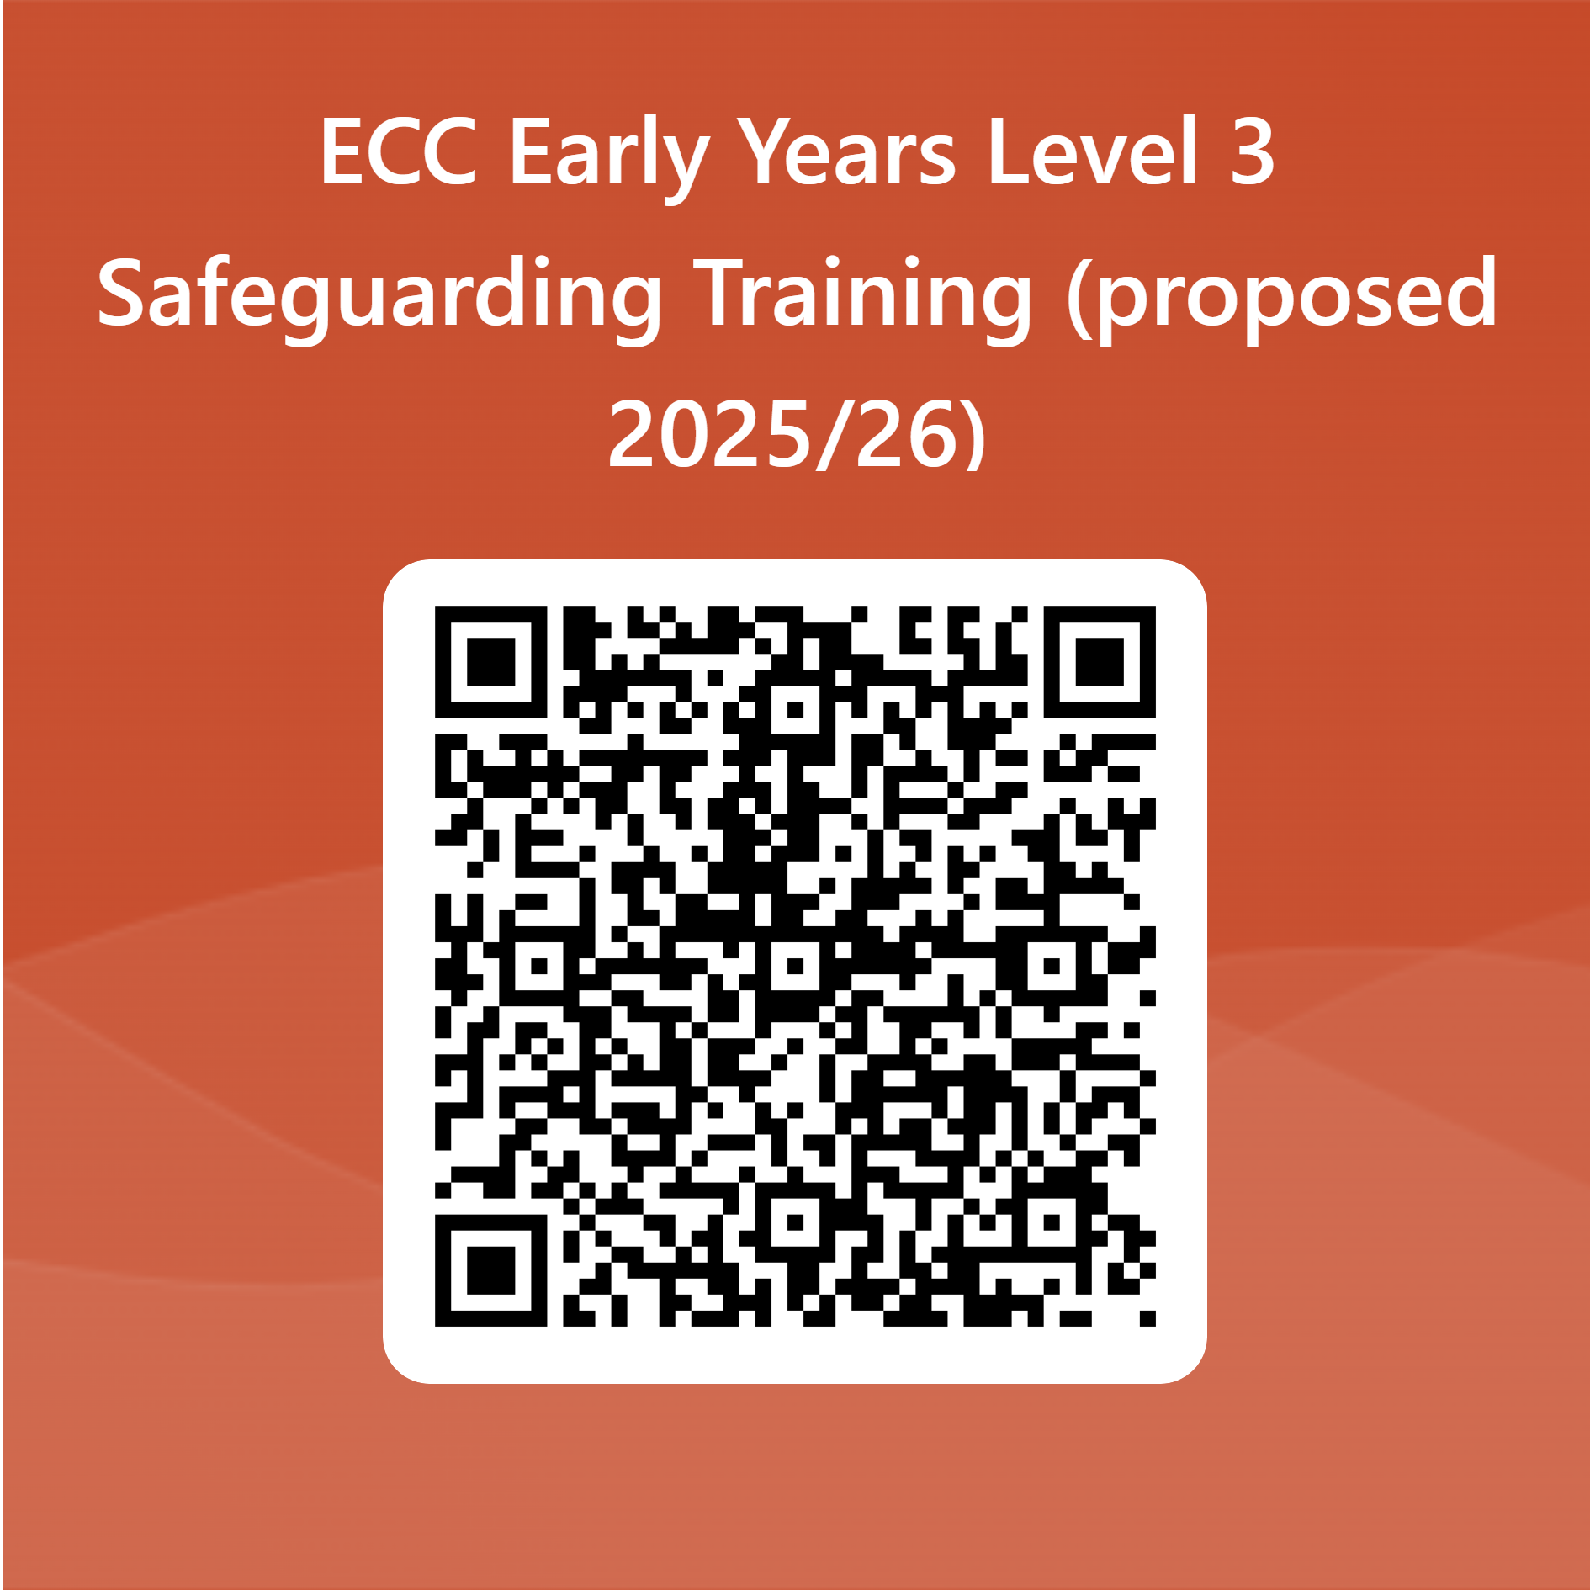
Level 3 training:
Expressions of interest
Level 3 training

Slide 19
Safeguarding questionnaire
336 - the total received
Thank you!
Areas of strength include:
All settings (bar 1) had a Child Protection policy in line with the SET procedures
Most settings report they know how to use the Effective support document, how to make a referral to the Children and Families Hub, how to report to the LADO and other statutory agencies
Most settings have Lead Practitioners / DSL and DDSL’s trained to level 3
Most settings have up to date Prevent training
Over half of settings deliver level 2 themselves
Child protection files are held securely (bar 1)
Every setting reports having safer recruitment processes in place.
Areas for development include:
The ability of settings to provide level 2 training within 5 days of a new member of staff starting.
There are still a number of settings who have not accessed/delivered level 2 training and/or do not renew this annually.
Understanding of systems and processes for transferring files and for regular reviews of the files.
Recording of and reporting on physical intervention

Slide 20
Comfort Break

Slide 21
Working Together to Improve School Attendance
Applies: 19th August 2024

Slide 22






Overview of changes for next academic year
The New DfE attendance guidance will be statutory for all schools from 19th August 2024
Attendance and admissions processes in schools have been modernised to improve consistency and accuracy of recording data
The role schools and LA’s play in managing and supporting attendance have been made clearer
Introduction of a new national framework for penalty notices
Build strong relationships with families – a support first approach
Share information and work with other schools in your area as well as the Local Authority
Working together to improve school attendance (applies from 19 August 2024)
Summary table of responsibilities for school attendance (applies from 19 August 2024)

Slide 23
‘Attendance is everyone’s business’ The Children’s Commissioner
Set out your expectations with parents. Expect them to phone if a child is unwell or not attending. If they do not contact you, contact them
Record attendance and keep records on a daily basis
Be vigilant to early indicators of attendance difficulties and alert the DSL/Lead Practitioner to any concerns
Be curious as to the nature of or reasons for a child’s absence and look for any patterns
Record any conversations you have with parents about attendance
Manager/owner oversight - include absence in your half termly reviews of safeguarding

Slide 24

Effective Support for Children and Families in Essex (ESCB, 2021)
Review 2024
The document should assist professional judgements in determining the next actions needed to meet needs and help everyone to:
understand the child in the context of their family and wider community; and
develop ideas and solutions with children and their families, so that timely support is provided, by the right person/service, which empowers families to make decisions and changes to their lives

Slide 25
Effective Support Review – 2024
The new guidance will refer to children rather than children and young people – which applies to anyone under 18 years
The guidance should be used alongside statutory guidance
The Essex Effective Support windscreen will remain the same with the four levels of need: universal, additional, intensive and specialist
The indicators of need will now be detailed across the page to allow users to view all levels simultaneously – this layout means that users can look more easily at any relevant section and descriptors, and see which level of need is appropriate
The subject headers are based on the triangle of need from Working together to safeguard children (DfE, 2023) and fall into three main categories: Child developmental needs, Parenting capacity, and Family and environmental factors
Consultation – coming soon to all education settings – please tell us what you think!

Slide 26
Supporting Families and Early Help Support
Notes:
Rita or LfP

Slide 27

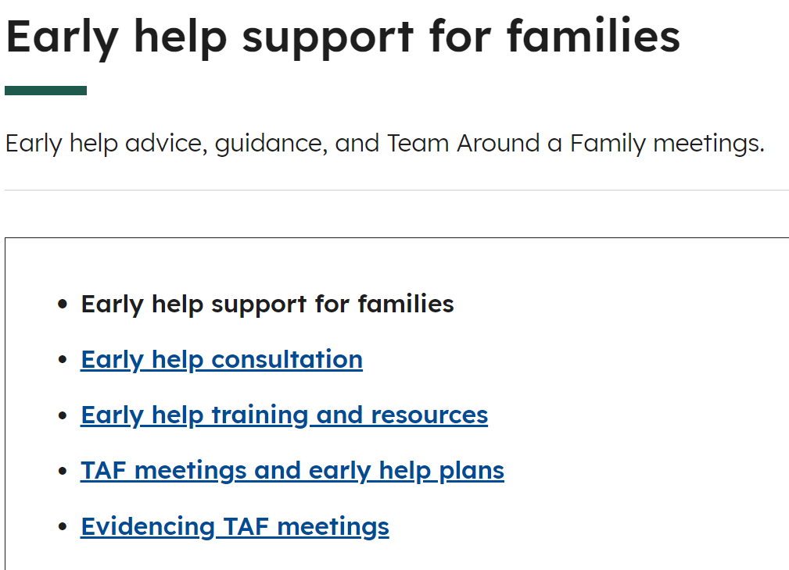
Essex Schools InfoLink now includes a page on Early Help support, which is under Pupil Support and Wellbeing: Early help support for families: Early help support for families | Essex Schools Infolink There is also a link from the Safeguarding landing page. You will find information on accessing Early Help consultations, training, resources and more. For support with creating an Early Help Plan or holding a Team Around the Family meeting, please email TAFSO@essex.gov.uk
Essex Schools InfoLink- Early Help Page

Slide 28
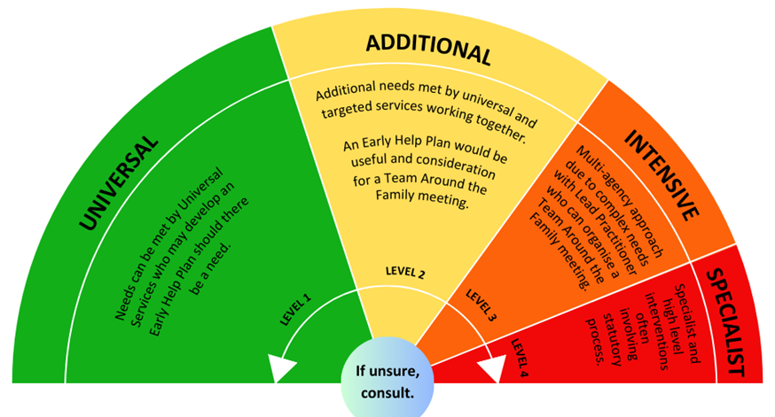
Effective Support Windscreen
Level 2 – more specialist voluntary, community and commissioned support across the county
TAFSO team
Essex Child & Family Wellbeing Service
0-19 service that includes School Nurses, Health Visitors, Midwives and support for children up to age 19 and families including support with parenting
Level 3 and 4 – Family Solutions and statutory Children’s Social Care Teams – Accessed via the Children and Families Hub
Education and GPs

Slide 29



Increased Early Help Support at Level 2
Team Around the Family Support Officers TAFSOs
TAFSOs can write Early Help Plans for families
As a 12-month pilot from April, Family Solutions will be writing Early Help Plans (EHPs) and offering up to 6 weeks of level 2 intervention for families referred to them by the C&Fs Hub or CSC (for families with complex needs but not meeting threshold for Family Solutions)
The TAFSO team will be working closely with the C&F Hub to write EHPs and offer support for referring partners and families who have complex L2 needs but do not meet threshold for Family Solutions L3 or CSC L4 support. You can also email them directly at TAFSO@essex.gov.uk
New - These plans will be followed up at 3 months and 6 months to discuss progress for the family.
Facilitate Early Help Training Workshops
Attend/ chair tricky TAFs
- Join an Early Help consultation for specific and localised advice and signposting
- Email them directly at TAFSO@essex.gov.uk for more information
- To book on an Early Help training workshop click here
Notes:
Alison D

Slide 30
Key Benefits:
6
1
Further support for families
Allows Social Care to collate evidence of early help support for DfE and schools of a “support first” approach
2
Further support for partners
7
Helps to re-balance the system
3
Prevents needs escalating
8
Evidences support already provided at Level 2, if there is a need to escalate concerns
4
Reduction in pressure on the C&F Hub
9
Encourages a Think Family approach- one shared family plan
5
10
Promotes use of the Early Help Plan
More opportunities to listen to the voices of families

Slide 31
Early Help Drop In
Team Around the Family Support Officer (TAFSO), Inclusion Partners, Essex Family Support Service, Engagement Facilitators, SENDIASS, Attendance Specialists, Essex Youth Service, Peabody Outreach, Essex Child & Family Wellbeing Service, DWP and others
North Essex drop-in session - Tues 15:30-16:30pm Click here to join the meeting
Email Rita Jenner Partnership Lead (North) rita.jenner@essex.gov.uk
South Essex drop-in session - Wed 12:30-13:30pm Click Here to Join﻿
Email Sarah Pattison Partnership Lead (South) sarah.pattison@essex.gov.uk
West Essex drop-in session - Thurs 12:00-13:00pm Click here to join the meeting
Email Fiona Cuthbertson Partnership Lead (West) fiona.cuthbertson@essex.gov.uk
Mid Essex drop-in session - Wed 12:00-13:05pm Click here to join the meeting
Email Lyn Pipe TAFSO (Mid) lyn.pipe@essex.gov.uk
Please Note that the Mid Essex drop in HAS an online booking system, where you can pre-book a slot to present a case. Click here to book a case discussion. Colleagues are still welcome to join the session without booking, but you won't be guaranteed a time to discuss your case.
PLEASE NOTE: You can attend any Early Help Drop-In across the county.
Notes:
LfPD

Slide 32
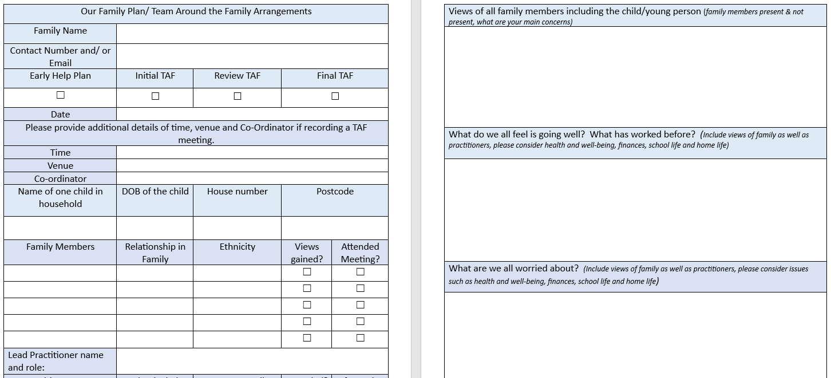
Early Help Plan
Resources for practitioners: Early help resources | Essex County Council

Slide 33
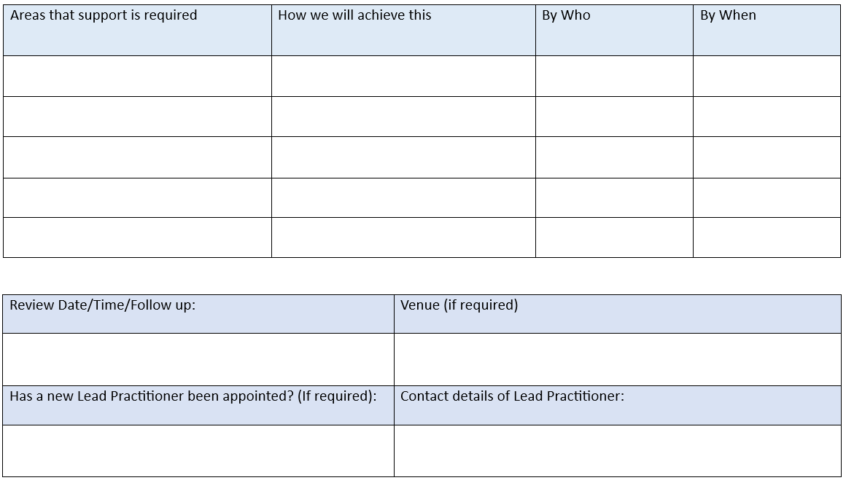
Clear plan of support- bespoke to the family
Notes:
See embedded document for full plan…..
We will encourage this plan to be used by the Lead Professional and Team Around the Family, as we exit, to share “one family plan”. It can also be used for TAF meeting notes. This template is also promoted for professionals to use for all their family plans and TAF meetings opposed to referring to the Hub.

Slide 34


Supporting Families Programme (2022- 2025)
Supporting Families has four key principles:
Early intervention
Whole family working with one key worker and one plan
Strong partnership working across the local area
Measuring outcomes through data transformation and data sharing
The Supporting Families programme aims to ensure families with multiple needs receive support for the whole family through one assessment, one plan, and that the support needed to address all the needs is co-ordinated.
Family Solutions and TAFSOs work under the programme, but the aim is to embed this way of working for all families needing help by everyone.
The programme requires LAs to report on the number of families achieving sustained and significant progress against all the needs identified for those where there are needs covering 3 or more of the 10 headline outcomes in the Supporting Families national outcomes framework.

Slide 35
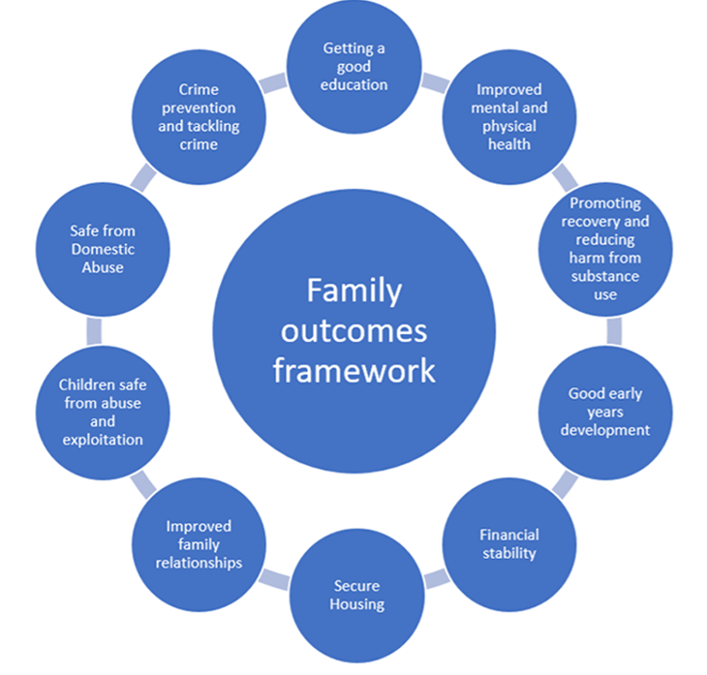
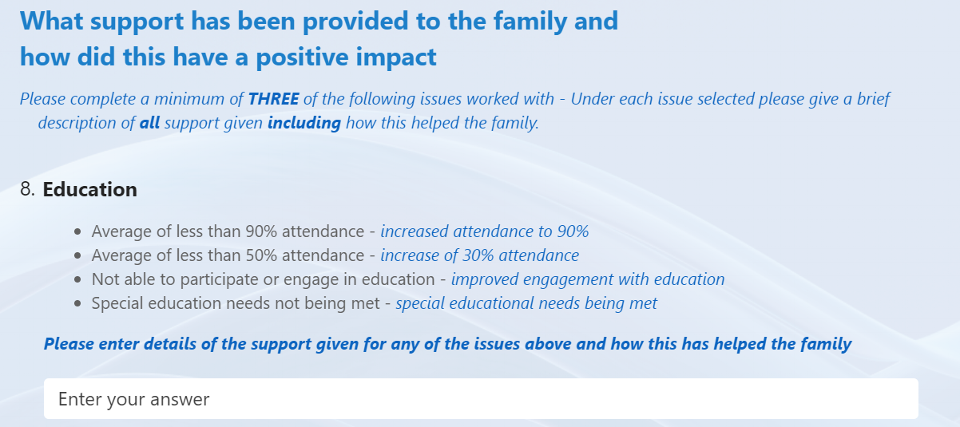
Evidencing Early Help in Essex
The Key aim of Programme is to see vulnerable families thrive, building their resilience by providing effective, whole family support to help prevent escalation into statutory services. Evidencing this is happening across the County helps to drive more funding into early help.
We have produced a secure online form to capture the Team Around the Family meetings/ activity and whole family support that is happening across the County. The form is built to match the criteria set by the Department for Education (DfE):
https://forms.office.com/e/uqR42YQXT4
Settings receive an email copy of their submission for safeguarding records and evidence of a collaborative and inclusive approach to supporting children.

Slide 36
Evidencing the impact of (TAF) meetings / Early Help Drop-Ins
Please do note – there is no requirement for settings to submit evidence!
But…
doing so may be useful to settings as evidence of Early Help approach for Ofsted inspection, Inclusion Review, or other purpose
evidence from education settings will also help ECC to build an evidence base to secure further funding for TAFSO and Family Solutions services
And finally, settings are now actively encouraged to attend any of the four Early Help Drop-Ins across the four quadrants. Each Drop-In will remain quadrant-based and welcome attendees from other areas
In addition, after each Drop-In, attendees will receive an anonymised Early Help Plan for each family summarising the issues raised, and the suggestions made by the panel
Early Help Drop-Ins

Slide 37
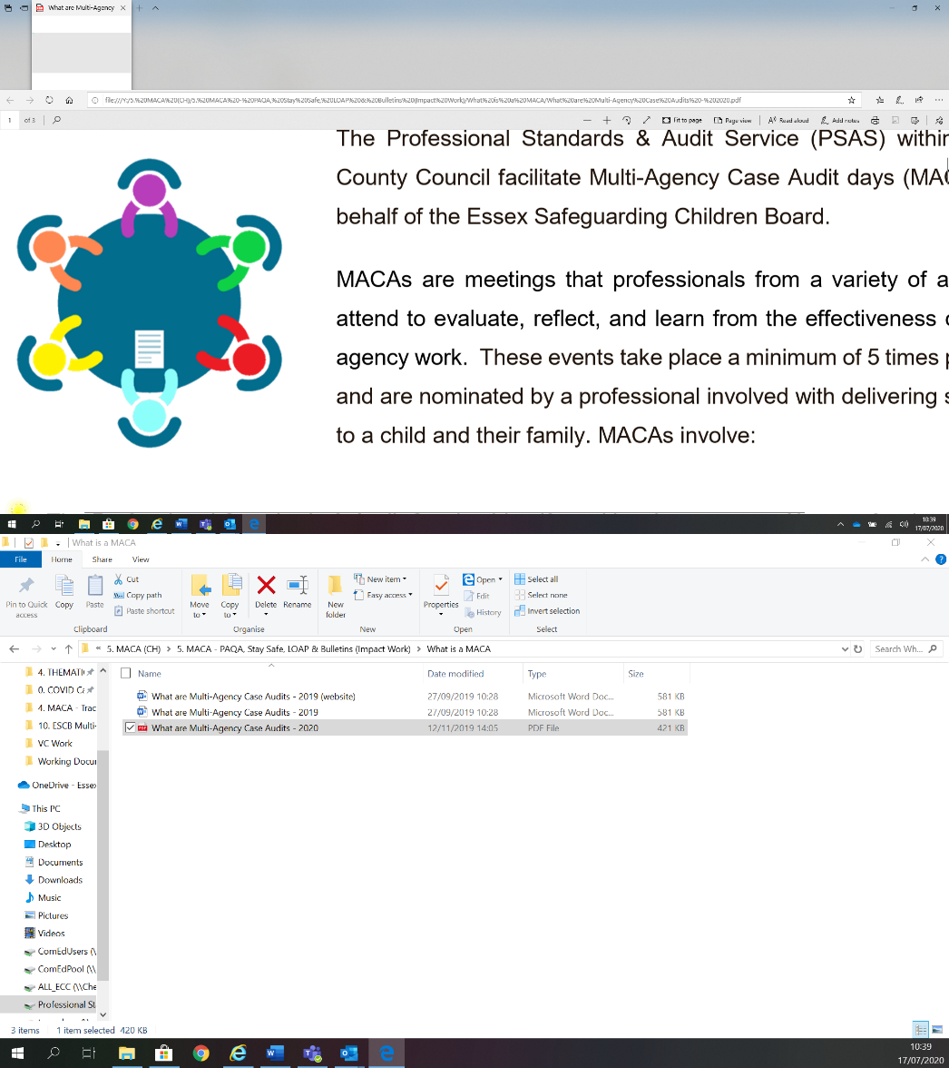

Multi Agency Thematic Audit (MATA)
Working with Neglect
Co-ordinated by the Professional Standards & Audit Service (PSAS)
Notes:
The purpose of this presentation is to set out the findings of a Multi-Agency Audit that focused on Working with Neglect. The decision to undertake this audit was to respond to one of the ESCB business priorities which was motivated by a number of factors:
1- Neglect is the largest practice feature of Essex Children and Families work
2 – Learning from a variety of reviews was highlighting Neglect as a significant contributory feature causing challenges to multi-agency working
This MATA was an opportunity to understand in more depth these challenges, and to create an evidence base to inform how we might want to strengthen practice I this area going forwards
We are bringing this summary to you to ensure that you are cited on the learning that was generated through this piece of multi-agency evaluation work and to invite your thoughts/reflection about how we might utilise the learning.

Slide 38
Background to Neglect MATA
2022-2023, the Professional Standards & Audit Service (PSAS) worked with MATA Co-ordinators, to deliver this MATA – Responds to a ESCB Business Plan Priority
To inform the MATA findings, the following activity was undertaken:
Focus Groups and Questionnaires to secure views of Practitioners/Frontline Staff.
13 Individual Agencies participated in the facilitation
All MATA Co-ordinators all shaped and agreed the practice themes identified in the final report

Slide 39
Multi-Agency Aspirations
1. Refresh of the definition of Neglect
2. Develop a Multi-Agency Risk Assessment Framework to support Practitioners working with Neglect
3. Develop further a ‘whole system approach’ to working with Neglect -
Not just for Childrens Social Care
4. Develop our suite of Direct Work Tools, Approaches & CPD offer for working with Neglect – and ensure its inclusivity
5. To develop flagging and information mapping methods within and across multi-agency systems, that improve opportunities to recognise cumulative Neglect & its impact
6. To provide the opportunity for professionals to come together and hold reflective discussions where significant multi-agency practice dilemmas present
7. Increase understanding of Police Thresholds for Criminal Neglect, and implications for Multi-Agency working, particularly risk is understood by families in light of differing thresholds
Notes:
The learning from the MATA activity has been aggregated by PSAS and considered by the MATA Co-Ordinators, which has informed the following 7 thematic practice areas that the evidence indicates would benefit from Multi-Agency practice development ordered as they were prioritised.

Slide 40
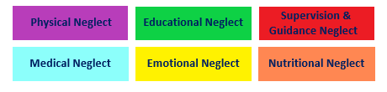
1. Defining Neglect
WhWhat were the motivations for these areas of focus?
at were the motivations for these areas of focus?
Notes:
The term ‘Neglect’ has become a ‘catch all’ term. The unintended consequence has been a loss in the clarity and practice confidence of traditional understanding of Neglect as set out in the tiles below. Sometimes, practitioners across agencies use the term neglect, but what do we really mean? Neglect can mean so many different things, how do we get across and portray the harm we are seeing?
Families can often struggle with the association of Neglect, and additionally when it is used as a ‘catch all’ term for example in situations where it is used as a Child Protection categorisation where Domestic Abuse is the primary feature it loses its impact, detail and direct link to harm of the children.
Revisiting and refreshing the definition of Neglect would enhance practitioner understanding, focus and confidence. The use of the visual tiles was hugely helpful as part of this MATA and invited a request that this should be incorporated into future definition and practice frameworks.
Learning from this MATA highlighted the importance of obesity, oral health, social media, chronic childhood illness and not being brought to appointments being incorporated within the definition categorisations.
Whilst there is a recognition that all professionals/agencies have a role in identifying and responding to neglect these can vary differently dependant on role and level of contact and opportunities for observations of family members. For example, a GP vs Social Worker. Helping to shape a greater clarity of how specific agencies/professionals can be effective and impactful within their respective roles would support with roles and responsibilities.

Slide 41
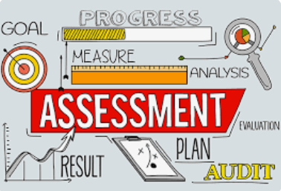
2. A Multi-Agency Risk Assessment for Neglect
Multi agency risk assessment
Support an assessment framework – increase in confidence in identifying neglect
Benefits to the multi-agency group and children and families
Notes:
Many practitioners within the focus groups reported positive experience of using the Graded Care Profile which is a paper based screening/ assessment tool which grades level of neglect, because it provided a common understanding of risk and language. There is a desire to introduce something similar across the Multi Agency network to aid practice which has been talked about for a number of years and prior to this MATA.
The perceived benefits would be that Multi-Agency practice would be supported by an Assessment Framework that would increase practitioner confidence with identifying and evidencing Neglect and its impact for a child/ren including:
Increased multi-agency confidence particularly outside of Children Social Care, preventing escalation?
Enable practitioners to work with and explain to families with more confidence and evidence of neglect and its impact, this being a tool for discussion and learning
Provide greater cohesion around risk where Neglect is a significant feature
Create greater clarity on ‘Baselines’ i.e. what we all agree on as unacceptable for any child(ren), this would help us better articulate what is ‘good enough’
Improving descriptions of observed Neglect and its short and long term impact both verbally and written.
HCRG have introduced their own agency risk assessment for Neglect which has been well received by staff and is improving their practices when working with Neglect and it may be helpful to use learning from this to guide this work moving forward.

Slide 42
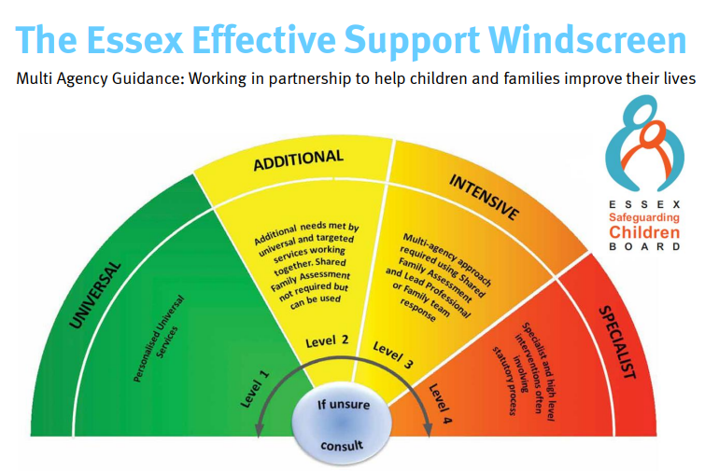
3. Whole System Approach to Neglect
How do we help the families that may always need help
Early intervention – are there opportunities to strengthen the offer?
Child Protection Medicals
Notes:
The MATA recognised that some families will always need ‘outreach’ support from agencies to prevent Neglectful patterns falling below ‘good enough’. I am sure we have all seen examples of families doing well, closing to services and then for a range of reasons they are unable to sustain the level of care and are referred back to services. This can happen multiple times.
How well do services at tiers 2 & 3 accommodate these families given that most are time limited? How does this contribute to the escalation of risk and need for Childrens Social Care intervention? Do we miss opportunities for earlier intervention?
Reviewing who works with ‘Neglect’ through the tiers of service (the windscreen), might provide opportunities to strengthen outreach and in reach offers of support to vulnerable children and families at risk of Neglect– Can the TAFSO role support this?
The Family Group Conferencing service could be extended to be accessible at Tier 2 to enhance the early intervention approach – providing opportunities for robust family led plan to help build resilience in families to support and sustain changes. Does this tie in with the Stable Home Built on Love Agenda and aspirations?
When we think of child protection medicals, we don’t always associate this to neglect. The value and purpose of Child Protection Medicals are often overlooked when working with long standing Neglect. Examples of children with headlice resulting in critical/life threatening medical needs shared, demonstrated how tolerated and normalised neglectful patterns can result in critical situations that have not been noted/recognised by professionals.

Slide 43

4. Suite of Practice Tools, ensuring inclusivity
Neglect Guidance and Common Assessment framework
Multi agency training
Accepted approach / language and understanding
Direct work tools
They are developed with the following in mind: Ethnicity, Learning Needs, The Psychology of Intergenerational patterns, Mental Health, SEND
Notes:
As discussed in the previous slide, there is a desire for a refreshed multi-agency and agency specific Neglect Guidance and Common Assessment framework which would underpin our suite of direct tools, CPD and Training.
Agencies want a programme of Multi-Agency Neglect specific training. We welcome the opportunity to come together across partnerships to learn and develop our shared approaches and build relationships.
We would have a more accepted approach to talking about Neglect that would enhance the engagement opportunities with children and families who may feel dissociation/offence with the term Neglect.
Our Direct Work Tools, CPD and Training offer will reflect and consider diversity and socio-economic factors to ensure our approaches are diverse enough to be inclusive and effective for all families. To take account of:
Racial Identity, Ethnicity, Religion, and Culture of Families
Being able to identify intergenerational patterns of Neglectful behaviours, and seeing the psychology.
The impact of poor mental health of parents and carers on children and how to articulate this
Working with children/parents/carer with learning needs and learning disabilities, given the association that we see with neglect
Assessing and working effectively with Neglect where there are large sibling groups and chaotic environments
The impact of a child receiving a diagnosis for behavioural/emotional difficulties on professional curiosity where there are neglect concerns – i.e. is the behaviour linked to the social environment? And how diagnosis impacts upon how we assess and understand risk

Slide 44

5. Developing recording system approaches
‘Flagging’ high risk families across services and agencies
Importance of genograms and chronologies
Notes:
All agencies shared their struggles with respective agency systems and approaches in being able to notice and flag effectively where neglect may be an emerging theme. There is a desire to improve these systems for example being able to flag the most high-risk families where Neglect is a key feature .
Flagging systems would invite the development of chronologies as a method to understanding family patterns and be developed across sibling groups and across episodes of social care involvement over time.
All agencies saw the value of strengthened chronology work and use of genograms within practice as a way of understanding family dynamics and blended families to include partners who aren’t the child/rens parent. Also, to note intergenerational patterns that link to Neglect. This would also result in better quality referrals which demonstrate a cumulative picture of neglect and is able to evidence the impact on the child.

Slide 45

6. Professional Multi-Agency Reflective Discussions – Dilemma resolution
Reflective practice, learning space – systemic model
How do we come together to think about professional dilemmas for practice that impact our approach with families?
Sometimes these differences cannot be aired in front of families – MACA’s are an example of this
Notes:
Working with neglect can be difficult, there is often a level of frustration from some agencies where they are referring to social care and decision is NFA or close. Social Workers, can feel stuck on what to do next to sustain change, feeling they have tried ‘everything’. Over the last 4 years there have been a number of calls from agencies via MACA and MATA activity for reflective space for professionals to unpick ‘dilemma’s’ for practice and multi-agency working. These would be supported by a suitable framework i.e. such a systemic model. Coming together, to think together as a group of professionals was discussed in detail as being beneficial.
Examples might be where multiple referrals have been received over a short period of time, how we stop, pause and reflect

Slide 46

7. Understanding of Criminal Thresholds vs Social Care Thresholds
Beyond reasonable doubt vs balance of probability
Clarity and confidence
Refreshed practice guidance
Co-ordinated approaches
Helping families understand risk in the context of difference of thresholds. No Prosecution or NFA does not = No Risk
Notes:
This is a really difficult area. Agencies and Practitioners lacked clarity and confidence in understanding the interface between social care and criminal thresholds. Agencies desire to a clearer understanding of Criminal Thresholds for Neglect, when they should be applied and the interface with Social Care hence strengthening how we work together and how this is explained to families. How do we support families in understanding different thresholds and one doesn’t ‘trump’ the other? As Social Care, we have a different role, how do we ensure we are not swayed by a Police decision.
Our Refreshed Practice Guidance would incorporate practice principals that enhance the way in which we think about Criminal Neglect and prosecutions, and when they do and so not effectively support interventions with children families.
Children and Families and co-ordinated practice approaches would benefit from this joined up understanding.

Slide 47
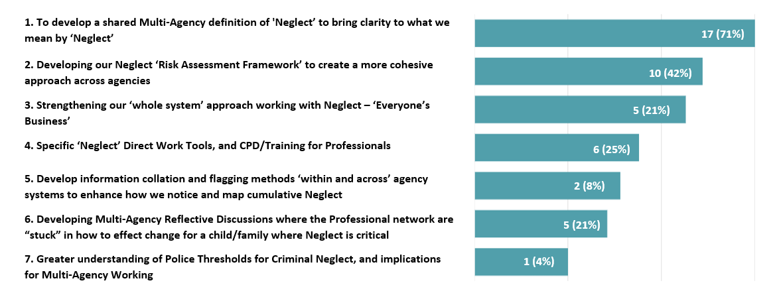
Prioritisation – Where is the need?
Notes:
The MATA co-ordinators steering group recognise that the aspirations are far reaching and broad and were invited to offer a view about the prioritisation of the practice improvement areas. The below chart on this slide set out their views are what they felt should be prioritised,

Slide 48
Education Safeguarding Team
Head of Education Safeguarding:
Jo Barclay
3 x Education Safeguarding Advisers:
Alex Darvill
Matthew Lewis
Derai Lewis-Jones
1 x Education Safeguarding Officer:
Gemma Harris (MARAC)
educationsafeguarding@essex.gov.uk
EYCP / Safeguarding (essex.gov.uk)

Slide 49


This information is issued by: Essex County Council
Contact us: xxx@essex.gov.uk xxx
xxx Essex County Council County Hall, Chelmsford Essex, CM1 1QH
Essex_CC
facebook.com/essexcountycouncil
The information contained in this document can be translated, and/or made available in alternative formats, on request.
Published xxx

