Slide 1


Safeguarding training activities
These activities and case studies are for you to use and adapt as you wish
2026 -2027
Copyright © Essex County Council 2026
No part of this publication may be reproduced, stored in a retrieval system of any nature, downloaded, transmitted or distributed in any form or by any means including photocopying and recording, without the prior written permission of Essex County Council, the copyright owner

Slide 2

Activity ideas
Post it wall
Acronyms
Quiz
Stand up sit down
Knowledge check
Bingo
Safeguarding speed discussion

Slide 3

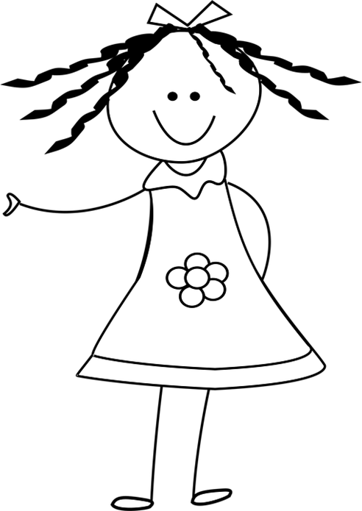
ACTIVITY
The children are at the centre of everything we do.
In your groups (or as a staff) using post it notes, create a safeguarding wall of everything you do to safeguard children
Notes:
Think about this in the widest context –
1. Policies and Procedures
Safeguarding and Child Protection Policy (updated annually)
Staff Code of Conduct
Whistleblowing Policy
Online Safety Policy
Anti-Bullying Policy
Behaviour Policy
Attendance and Missing Child Procedures
2. Designated Safeguarding Lead (DSL)
Appointed DSL and deputies
DSL responsible for managing referrals, training, and safeguarding records
Availability during school hours and for out-of-hours concerns
3. Staff Training
All staff must complete safeguarding training at induction
Regular updates and refresher training (at least annually)
Specific training for DSLs and senior leaders
4. Safer Recruitment
Enhanced DBS checks for all staff and volunteers
Verification of identity, qualifications, and employment history
References and prohibition checks
Ongoing vigilance post-appointment
5. Child-on-Child Abuse Prevention
Clear procedures for reporting and responding to incidents
Education on respectful relationships and consent
Support for victims and appropriate sanctions for perpetrators
6. Online Safety
Filtering and monitoring systems
Education on digital resilience and safe online behaviour
Staff training on online risks and reporting mechanisms
7. Curriculum Integration
PSHE and RSHE lessons covering:
Healthy relationships
Consent
Mental health
Online safety
Recognising abuse and seeking help
8. Early Help and Multi-Agency Working
Identification of children who may benefit from early help
Referrals to external agencies (e.g., social care, CAMHS)
Participation in multi-agency safeguarding meetings
9. Safeguarding Allegations Against Staff
Clear procedures for managing concerns or allegations
Reporting to the Local Authority Designated Officer (LADO)
Support for both the child and the staff member involved
10. Site Security and Supervision
Controlled access to school premises
Visitor sign-in and ID checks
Supervision during break times and transitions
11. Record Keeping and Information Sharing
Secure storage of safeguarding records
Timely and appropriate sharing of information with relevant agencies
Transfer of safeguarding files when pupils move schools
12. Listening to Children
Encouraging pupil voice and feedback
Safe spaces and trusted adults
Anonymous reporting mechanisms
13. Support for Vulnerable Groups
Tailored support for:
Children with SEND
Looked-after children
Children with mental health needs
Children at risk of exploitation or radicalisation

Slide 4

Acronym check
ESCB
SETDAB
CSPR
TAFSO
HBA
CTLP
SCR
RCPC
MARAC
LADO
EOTAS
IDVA
Notes:
ESCB – Essex Safeguarding Children Board – the local Board that oversees multi agency safeguarding arrangements in ESSEX
SCR – Single Central Record
SETDAB – Southend Essex and Thurrock Domestic Abuse Board – the gateway into Domestic abuse support services in Essex
RCPC – Review Child Protection Conference
CSPR – Child safeguarding Practise review – where a child has been significantly harmed or died as a result of abuse – this is a learning process (not a blame game)
MARAC – Multi Agency Risk Assessment Conference – police led multiagency meeting to risk assess a Highrisk domestic abuse situation. It is a process about the adults involved but =where there are children involved the school will be contacted
TAFSO – Team Around the Family Support Officer
LADO – Local Authority Designated Officer
HBA – Honour Based Abuse
EOTAS – Educated Other Than At School
CTLP – Counter Terrorism Local Profile 0- information shared with agency Prevent leads about counter terrorism risk – published 6 monthly
IDVA – Independent Domestic Violence Advisor

Slide 5
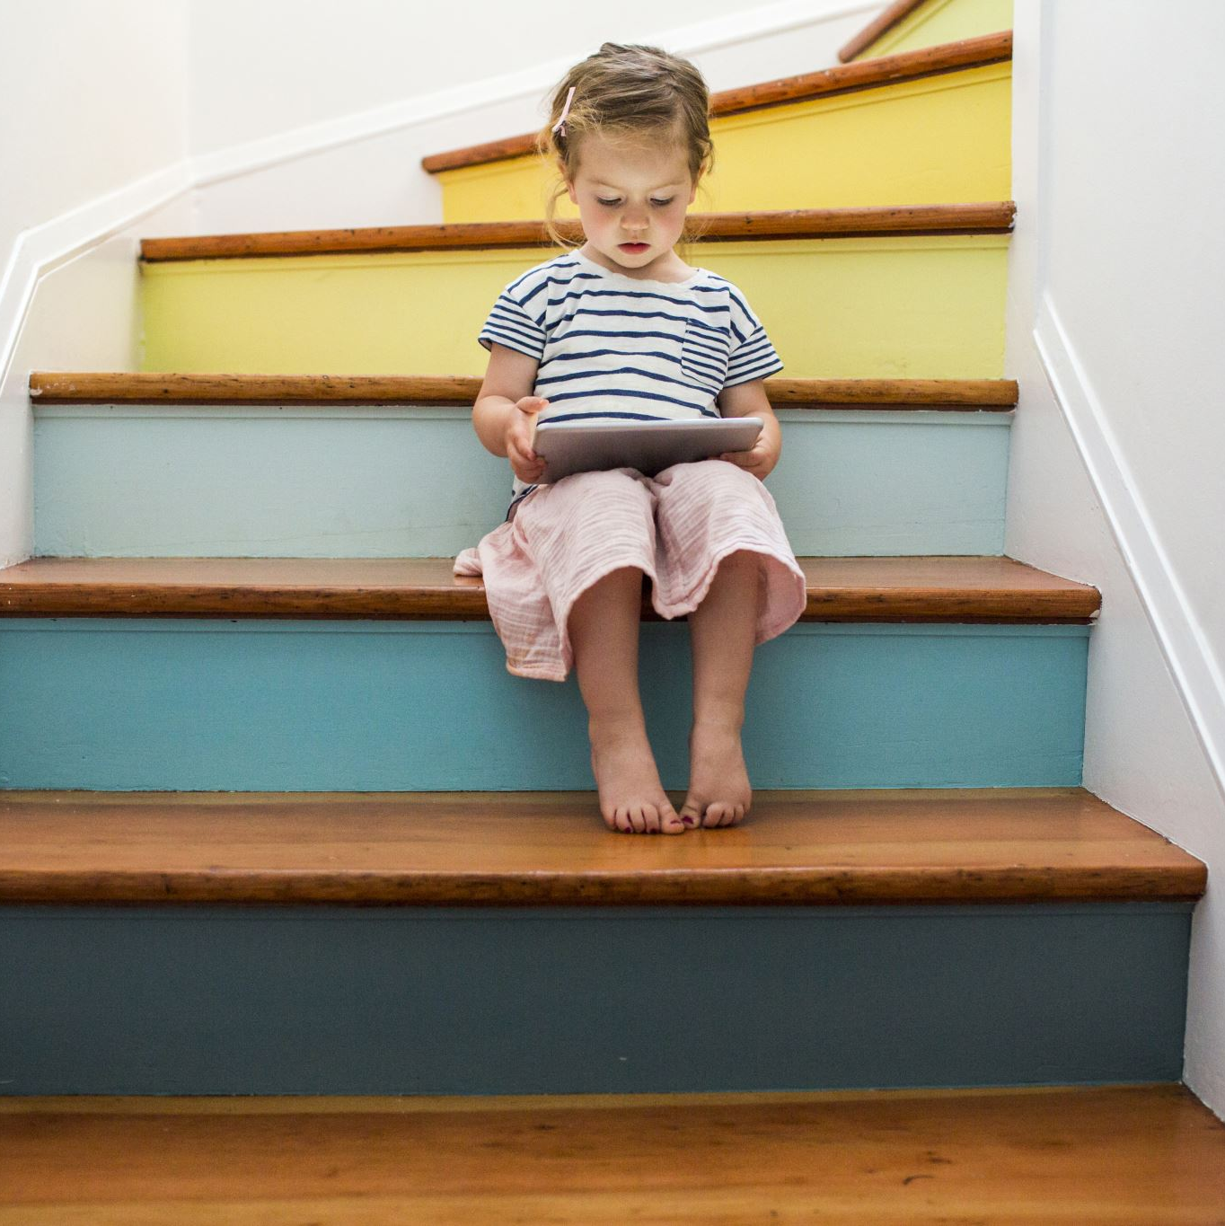





QUIZ
Children always disclose abuse directly.
A child who appears happy and is successful will not experience abuse
Attendance can be a safeguarding indicator.
If a member of staff has been at the setting a long time their behaviour around children cannot be challenged
Poor information sharing is a common theme of Child Safeguarding Practice Reviews
Is AI an emerging risk for children?
Notes:
Children always disclose abuse directly. No, particularly children who are experiencing sexual abuse – they may not understand they are being abused or may believe what is happening to them is normal as they know no different
Attendance can be a safeguarding indicator. If a child is not in school where are they and are they safe? Is a parent hiding DA, substance mis-use or physical harm of eh children
Poor information sharing is a common theme of Child safeguarding practice reviews Yes – often information is not shared at all or too little and too late. GDPR should not prevent the sharing of information to keep children safe.
A child who appears happy and is successful will not experience abuse. No any child can be the subject of abuse
If a member of staff has been at the setting a long time their behaviour around children cannot be challenged. No – any staff member should expect to have their behaviour challenged. Every member of staff should have an attitude of ‘It could happen here’
Is AI an emerging risk for children? yes

Slide 6
Stand up sit down (easy)
Stand up if it is true, sit down if it is false!
You should only report concerns if you have evidence
Safeguarding is everyone's responsibility
Children always disclose abuse directly
Attendance can be a safeguarding indicator
Professional curiosity is an important safeguarding skill
Notes:
You should only report concerns if you have evidence. (False)​
• Safeguarding is everyone's responsibility. (True)​
• Children always disclose abuse directly. (False)​
• Attendance can be a safeguarding indicator. (True)​
• Professional curiosity is an important safeguarding skill. (True)​

Slide 7
Stand up sit down
Stand up if it is true, sit down if it is false!
No safeguarding concern is too small to record.​
Most serious cases begin with low-level concerns.​
Children's behaviour is communication.​
Information sharing prevents harm.​
Notes:
You should only report concerns if you have evidence. (False)​
• Safeguarding is everyone's responsibility. (True)​
• Children always disclose abuse directly. (False)​
• Attendance can be a safeguarding indicator. (True)​
• Professional curiosity is an important safeguarding skill. (True)​
These statements are more ambiguous and may need clarifying
No safeguarding concern is too small to record.​
Most serious cases begin with low-level concerns.​
• Children's behaviour is communication.​
• Information sharing prevents harm.​

Slide 8



KNOWLEGDE
CHECK
Is it just room leaders that report concerns to the DSL?
What is the name of the local multiagency safeguarding guidance you should be aware of?
Is there child on child abuse in your setting ?
Is education a statutory safeguarding partner?
Who should you go to if you have a concern about the conduct of a member of a staff?
What is the most common form of abuse?
Do you know these acronyms?
HBA
NEET
TAF
Who is responsible for safeguarding ?
What is filtering and monitoring?
Notes:
Is it just teachers that report concerns to the DSL? No – everyone is responsible for safeguarding – if you have a concern report it.
Is there child on child abuse in your school? Yes – there will be bullying or child on child of some sort – the question you need to ask if you think there is none, is why are the children not reporting. How do you collect pupil voice – do you know the views of your children on their safety. Do they report online abuse to you?
Who should you go to if you have a concern about the conduct of a member of a staff? You should report to the HT and is it is about the HT the governors or trust and you can report to NSPCC whistleblowing
Is education a statutory safeguarding partner? No not currently, they are a relevant agency In Essex we are treated as a statutory partner as education is represented an all-relevant boards at the ESCB. The partners are – health, police and children’s social care
What is filtering and monitoring? Filtering of online systems at school and the monitoring of the access to the systems
What is the name of the local multiagency safeguarding guidance you should be aware of? The SET procedures – Southend, Essex and Thurrock safeguarding procedures
What is the most common form of abuse? Neglect
Do you know these acronyms? HBA – Honour or Faith based Based Abuse NEET – Not in education, employment or training TAF – Team around the family
Who is responsible for safeguarding ? EVERYONE’S

Slide 9
BINGO
DSL | Children and Family’s Hub | Neglect | Prevent Duty | Report a concern
Emotional abuse | Child-on-child abuse | CPOMS/My Concern | Confidentiality | Risk assessment
Early help | Radicalisation | FGM | Facts | It could happen here
Risk in the community | Windscreen of need | Local Authority Designated Officer | Safe | Bruising
Notes:
First person to complete by hearing each of these terms wins….!

Slide 10

Safeguarding speed discussions
(you can alter the topics to meet need)
Facilitator
Put the staff into groups with post it notes or large paper.
On each table put one of the following with prompts (on the next slide )
Risk in the community (contextual safeguarding )
Domestic abuse
Online harm
Mental health
Child on child abuse
Neglect
Notes:
Risk in the community (contextual safeguarding )
What do we mean by RIC
When are children most at risk (consider where in the local community, times of the day)
Domestic abuse
Online harm
Mental health
Child on child abuse
Neglect

Slide 11
Safeguarding speed discussions
General prompts
(more specific prompts in the notes)
What indicators may you see?
How might the children present?
How might children be affected?
What are the risks of harm?
How might you respond?
Which children may be at increased risk?
What factors may increase risk?

Slide 12
In groups – consider each of these areas for 3 – 5 minutes, jot down your thoughts and then move on.
Come together and discuss
Safeguarding speed discussions
Notes:
Facilitator

Slide 13
CASE STUDIES
Explore your thinking
Adapt as you wish

Slide 14

During outdoor play, a practitioner notices finger-shaped bruising on the upper arms of a 3-year-old child.
The child initially says that a parent was angry but later gives a different explanation.
Staff also recall previous unexplained marks.
Notes:
Discussion Point​
• What are the indicators of risk? What should be recorded? What should be shared with the DSL?​
The DSL will phone the CFH consultation line to get advice

Slide 15
A child repeatedly acts out adults shouting and a child being locked in a room.

Slide 16
Case Study
  Liam frequently wears the same clothes, which are visibly unwashed. His hair appears greasy, and he often smells strongly.
  He regularly arrives without breakfast. Staff notice he asks / take food from other children
  Liam is increasingly withdrawn, fatigued, and disengaged in his play.
Notes:
Ask your staff to discuss and think about things such as - what would you do immediately? Would you record any of this, and if so, where? What actions would you take in the longer term? If you felt that you needed to take further advice, who would you speak to?

Slide 17
Case Study
Henry is three. His attendance has always been sporadic; parents are not always forthcoming in the reasons why.
Last week the manager spoke to Henry’s Dad about recent concerns that the school has logged, these include, that he often smells unclean, does not wear appropriate clothing and often complains of being hungry.
Following this conversation Henry has not returned to the setting and his parents have not been in touch.
Notes:
Ask your staff to discuss and think about things such as - what would you do immediately? Would you record any of this, and if so, where? What actions would you take in the longer term? If you felt that you needed to take further advice, who would you speak to?
Try and contact the parents to enquire why Henry is not attending and when he is due back. If he is not coming back, can you find out the name of his new setting.
Log all contact that is attempted/made. Phone calls, e mails and so on. If he is still registered with your setting and you cannot get in touch think about carrying out a door knock (in twos).
If no contact can be made and there are concerns for Henry’s health, safety, and well-being – contact the Children and Families Hub; and if deemed necessary, make a request for support. The police will not do a welfare check unless there is an immediate risk to safety. They are not attendance officers.
In general - make sure all parents have clear information about the settings attendance policy when they start in your setting, set high expectations that if a parent does not contact you to tell you why their child is absent, you will contact them. Keep a record and use this as part of your safeguarding reviews. Are there links between attendance or neglect? Do families need help early to get into good habits?

Slide 18
Case Study
Sarah is known for being a generally outgoing and bubbly child
Recently there has been a complete change in her behaviour – she is quiet and withdrawn and keeping herself to herself.
You also notice that although she usually wears summer dresses, she is now wearing clothes that cover her whole body even though the weather is really hot.
Notes:
Ask your staff to discuss and think about things such as - what would you do immediately?
Would you record any of this, and if so, where?
What actions would you take in the longer term?
If you felt that you needed to take further advice, who would you speak to?
There is no evidence that Sarah is at risk of harm. However, you know the child well.
The change in behaviour and clothing are both concerning
Her different clothing is also making her stand out so you may also be concerned about other children being unkind
Would you put any support in? pastoral support? School nurse?

Slide 19
Case Study
Ellie lives with her mother and older brother
She joined the setting recently and her attendance pattern has been poor
She devours snack at playtime and often asks for more
She shows reluctance to go home
Ellie’s mother avoids conversations with staff, being standoffish and when she does engage, she is very defensive
During a carpet time Ellie discloses she doesn't like her brother, and they often argue
She can be quite jumpy in her responses and flinches easily
Notes:
Ask your staff to discuss and think about things such as - what would you do immediately?
Would you record any of this, and if so, where?
What actions would you take in the longer term?
If you felt that you needed to take further advice, who would you speak to?

Slide 20
Case Study
Noah lives with his mother and two siblings – his father is not present in the family home
Previous concerns about housing instability and financial hardship
Noah arrives with dirty clothes, his shoes are too small and give him blisters
Noah is unkempt
His attendance is poor and when he does attend he is often late or appears very tired
His packed lunch is of poor quality, if he has one
Notes:
Ask your staff to discuss and think about things such as - what would you do immediately?
Would you record any of this, and if so, where?
What actions would you take in the longer term?
If you felt that you needed to take further advice, who would you speak to?

Slide 21
Record of Concern
What are your views on this record of concern?
Sam told me, last week, something bad happened at home. She said her dad shouted at her. I told her not to worry, gave her a hug and that everything would be okay. I asked her a few more questions to find out what happened and who else was there. I think her dad has done this before. I tole her to tell him to stop shouting when he did that. I’ll keep an eye on her and let you know if she says anything else.
Notes:
Issues
This has not been reported immediately
Promise that everything would be ok
Leading questions
Opinion not fact

Slide 22
This information is issued by: Essex County Council
Contact us:
educationsafeguarding@essex.gov.uk
Education Safeguarding Team
Essex County Council
County Hall, Chelmsford
Essex, CM1 1QH
Essex_CC
facebook.com/essexcountycouncil
Published August Autumn 2026

