Slide 1


Keeping Children Safe in Education
(DfE 2026)
What all staff need to know
Level 2 training for Early Years settings
2026-2027
Copyright © Essex County Council 2026
No part of this publication may be reproduced, stored in a retrieval system of any nature, downloaded, transmitted or distributed in any form or by any means including photocopying and recording, without the prior written permission of Essex County Council, the copyright owner
Notes:
This presentation can be used as an induction for new staff or as the annual level 2 update

Slide 2
Level 2 training for all staff in Early Years settings
This presentation can be used at induction, as an annual update for all staff or as a refresher
It can be used alongside any of the other presentations in our level 2 suite of training materials. These include Prevent, HSB, DA and Honour or faith-based abuse (including female genital mutilation and forced marriage)
To enhance training we have included a presentation with a selection of practical activities to use and adapt as you wish
Copyright © Essex County Council 2026
No part of this publication may be reproduced, stored in a retrieval system of any nature, downloaded, transmitted or distributed in any form or by any means including photocopying and recording, without the prior written permission of Essex County Council, the copyright owner

Slide 3
educationsafeguarding@essex.gov.uk
EY website: safeguarding
Welcome to the Essex Safeguarding Childre Essex Safeguarding Children Board
Head of Education Safeguarding and Wellbeing:
Jo Barclay
Senior Education Safeguarding Adviser (Strategic Support and Review)
Matthew Lewis
Senior Education Safeguarding Adviser (Strategic Support and Training and Development Lead)
Alex Darvill
Education Safeguarding Advisers (Quadrants):
Derai Lewis-Jones (Northeast)
Samantha Stevens (Mid)
Emma Roles (South)
Jo Sullivan (West)
Education Safeguarding Officer (Domestic Abuse)
Gemma Harris
Notes:
The team structure
You can point out the adviser relevant to your quadrant.

Slide 4
Contents
1
5
Some other aspects of safeguarding
What is Safeguarding?
2
Key documents
6
PREVENT
3
What is Abuse?
7
The LADO / whistleblowing
4
What staff should do – reporting and recording
8
Essex Effective Support
Notes:
Acknowledge that this is a sensitive matter and that some aspects of this presentation may be upsetting, either due to their personal circumstances or history, or because they may recognise abuse in children they have worked with in the past and have not previously done so – provide attendees with the opportunity to discuss any concerns
You can then go through the agenda of what will be covered.

Slide 5

What is Safeguarding?
DISCUSS
Safeguarding is a broad concept that includes all the proactive work that settings do in preventing children / young people from being harmed – it is what we do for all children (and adults).
Everything we do in settings should be considered through a safeguarding lens.
So, with that in mind what do you think safeguarding includes in your setting – what are you doing to safeguard children?
Notes:
You may want to ask staff to discuss what safeguarding means to them / in your setting. You could use post it notes, mini white boards, discussion or other means of making this interactive.
Talk about the distinction between safeguarding, and child protection.
Safeguarding is wider than child protection – school leadership has to have oversight of all these areas of work and ensure all statutory requirements are met – huge area of work. Safeguarding is much broader concept (than child protection) based around preventing children / young people from being harmed – focus upon promoting the child / young person’s welfare
Safeguarding is proactive and about developing a culture within your setting that has an open and positive culture where children and adults feel safe.

Slide 6

What is child protection?
Child protection refers to activity undertaken to protect specific children identified as either suffering or at risk of suffering significant harm as a result of abuse or neglect
What specific activities do you carry out that keep children safe from harm?
Notes:
You may want to ask staff to discuss what Child protection means to them / in your setting. You could use post it notes, mini white boards, discussion or other means of making this interactive.
Talk about the distinction between safeguarding, and child protection.

Slide 7
Key documents for schools and other settings, including Early Years
Notes:
We will explore these documents in more detail on the next few slides

Slide 8
Statutory Documents
Working Together to Safeguard Children
(HMG 2026)
Keeping Children Safe in Education
(DfE 2026)
EYFS Statutory Frameworks
(DfE 2026)
Southend Essex Thurrock (SET) procedures
2026
(Essex Safeguarding Children Board)
The Prevent Duty
(Home Office 2016)
Notes:
The next few slides go on to explain each of these.

Slide 9

Working Together to Safeguard Children (HMG 2026)
Defines safeguarding and sets the statutory (legal) framework by which the three legal Safeguarding Partners make arrangements to work together to safeguard and promote the welfare of children.
There are 5 chapters
Multi-agency safeguarding arrangements
Providing help, support and protection
Organisational responsibilities
Learning from serious child safeguarding incidents
A shared responsibility

Slide 10
The three statutory safeguarding partners are:
The local authority (Children’s social care)
The Integrated Care Board (ICB)
The Police
  Education is defined as a relevant agency.

Slide 11

The Essex Safeguarding Children Board (ESCB)
  The ESCB works with the Local Safeguarding Children Boards in Southend and Thurrock to produce the SET (Southend, Essex and Thurrock) Procedures
  The Southend, Essex and Thurrock (SET) Procedures is a document that sets out how agencies and individuals should work together locally to safeguard and promote the welfare of children and young people. They are underpinned by Working Together to Safeguard Children
  In Essex is fully involved in safeguarding arrangements at all levels of the ESCB
  Welcome to the Essex Safeguarding Children Board - Essex Safeguarding Children Board
Notes:
Staff should be aware of the Essex Safeguarding Children Board and how it works with the statutory partners (Social Care, Health and Police) – the Board also works closely with Education in Essex. There are many committees at different levels and the Education Safeguarding team filters the issues raised by education settings to the statutory partners.
All staff should be aware of the SET procedures – Ofsted may ask staff if they are aware of their local procedures / arrangements and the staff should be able to reference the SET procedures

Slide 12
Children learn best when they are healthy, safe and secure, when their individual needs are met, and when they have positive relationships with the adults caring for them’
Statutory Frameworks
Safeguarding and welfare requirements
September 2026
Early Years Foundation Stage
Statutory Framework – for group and school-based providers
Early Years Foundation Stage
Statutory Framework for Childminders
In both documents the safeguarding and welfare requirements are laid out in section 3

Slide 13

Safeguarding and welfare requirements for settings and childminders
They must:
Take all steps necessary to keep
children safe and well
Safeguard children
Ensure that the people who have
contact with children are suitable
Promote good health
Support and understand behaviour
Maintain records, policies
and procedures
Notes:
This section of the framework sets out the safeguarding and welfare requirements providers must meet. They are designed to help providers create a high-quality, welcoming, and safe setting where children can enjoy learning and grow in confidence.

Slide 14

Safeguarding and welfare requirements:
Policies and procedures
Have you read and understood your settings Child protection policy?
Designated safeguarding lead (DSL) will
take lead responsibility for safeguarding
children and liaising with local statutory partners
Policies should be recorded in writing and should cover EYFS requirements
Policy must include actions to be taken when a concern is raised, in the event of an allegation against staff and how mobile phones and electronic devices will be used and procedures to check the suitability of new recruits
Details of how safeguarding training is delivered

Slide 15
Safeguarding and welfare requirements:
Concerns about children’s safety and welfare
Key CHANGE
Immediately notify relevant
agencies in line with local reporting arrangements
Providers must inform Ofsted (or CMA) of any allegations of harm or abuse of anyone living, working or looking after children on the premises
The word serious has been removed
Notes:
The 2026 framework version has removed the word ‘serious’ from the harm descriptor. Dropping ‘serious’ from the reporting requirement means providers must now notify Ofsted of any allegation of harm or abuse, not just serious ones.
3.10
Registered providers must inform Ofsted, or the CMA with which a provider of CoDP is
registered, of any allegations of harm (instead of serious harm) or abuse by anyone living, working, or looking after
children at the premises.
This must happen whether the allegations of harm or abuse are
alleged to have been committed on the premises or elsewhere, for example, on a visit.
Registered providers must also notify Ofsted/their CMA of the action they have taken in
response to the allegations.
Ofsted/the CMA must be notified as soon as is reasonably
practicable, but in any event within 14 days of the allegations being made. A registered
provider who, without a reasonable excuse, fails to do this, commits an offence.

Slide 16

Updates to Statutory Frameworks September 2026
  Safer sleep guidance is now Statutory
  Practitioners must read NHS advice on Sudden infant death syndrome (SIDS) - NHS. More information on safer sleep guidance is available from The Lullaby Trust
Detail of how safeguarding training is delivered and how practitioners are supported to put this into practice.
Everyone working or volunteering with children needs an enhanced DBS and barred list check, completed before they start.
Staff and prospective staff must now disclose arrests and charges, not just convictions and cautions, and this duty explicitly extends to people who haven’t yet started at the setting .
Providers must put appropriate whistleblowing procedures in place for all staff (including students and volunteers) to raise concerns about poor or unsafe practice in the setting’s provision.

Slide 17
Updates to Statutory Frameworks September 2026
  Providers must have regard to the formal guidance on children’s screen use in early years settings
  Avoiding screen time altogether for under-2s except in exceptional circumstances
  Limiting screen time for 2- to 5-year-olds to a maximum of an hour a day, less where possible.
Providers should also have regard for the paediatric first aid requirements set out in section 3.39 while on outings with children.
Banned dog breeds (meaning dogs to which section 1 of the Dangerous Dogs Act 1991 applies including the XL Bully type), must not be kept or present on the premises at any time.

Slide 18

Keeping children safe in education (DfE, 2026)
The Statutory framework says:
‘childcare providers may also find it helpful to read this guidance - Keeping Children Safe In Education’
In Essex we consider KCSIE as best practice
Safeguarding and promoting the welfare of children (up to age 18) is everyone’s responsibility
All practitioners should ensure approach is child-centred and consider, at all times, what is in the best interests of the child
No single practitioner can have a full picture of a child’s needs and circumstances
If children and families are to receive the right help at the right time, everyone who comes into contact with them has a role to play in identifying concerns, sharing information and taking prompt action
Notes:
There have been significant changes to this document which have been summarised in a sperate presentation for you to use if you wish.

Slide 19

A child centred and coordinated approach to safeguarding (KCSiE – DfE 2026)
Definition of safeguarding
providing help and support to meet the needs of children as soon as problems emerge,
protecting children from maltreatment, whether that is within or outside the home, including online
preventing the impairment of children’s mental and physical health or development
ensuring that children grow up in circumstances consistent with the provision of safe and effective care
taking action to enable all children to have the best outcomes.

Slide 20
What staff need to know / read
All staff should:
be aware of systems in the setting which support safeguarding
know what to do if a child tells them they are being abused, exploited or neglected (involve the DSL)
be aware of the Family Help process, and understand their role in it (being particularly alert to children with additional vulnerability or needs)
be aware of the process for making requests for support to Children’s Social Care
be able to reassure children they are being taken seriously and that they will be supported and kept safe
understand that abuse can occur in or outside the home
understand confidentiality and share information only with those who need to be involved
  the Safeguarding / Child Protection Policy
  the Behaviour Policy
  the Staff Behaviour Policy / Code of conduct
  the role of the designated safeguarding lead and their identity including any deputies
  Part One of Keeping Children Safe in Education
Notes:
All staff should be prepared to identify children who may benefit from Family Help. Family Help means providing support as soon as a problem emerges at any point in a child’s life, from the foundation years through to the teenage years.
Working Together to Safeguard Children states: ‘Universal services and community-based early help is support for children of all ages that improves a family’s resilience and outcomes or reduces the chance of a problem
getting worse. It is not an individual service, but a system of support delivered by local authorities and their partners working together and taking collective responsibility to provide the right provision in their area. This level of early help is provided through “universal services” - such as education, health – and other community-based services.
It is distinct from targeted early help delivered through Family Help teams, which are more formal arrangements coordinated by local authorities, where a plan is in place and a lead practitioner appointed.’
‘By closely aligning targeted early help and child in need support and services, Family Help creates a seamless system of help and support for children and families focused on building consistent relationships with lead practitioners, simple and effective assessment and planning, and clear interventions that support improved outcomes.’
All staff should be aware of the early help process, and understand their role in it:
Any child may benefit from early help, but all school and college staff should be
particularly alert to the potential need for early help for a child who:
• is disabled and has specific additional needs;
• has special educational needs (whether or not they have a statutory education,
health and care plan);
• is a young carer;
• is showing signs of being drawn in to anti-social or criminal behaviour, including
gang involvement and association with organised crime groups;
• is frequently missing/goes missing from care or from home;
• is misusing drugs or alcohol themselves;
• Is at risk of modern slavery, trafficking or exploitation;
is in a family circumstance presenting challenges for the child, such as substance
abuse, adult mental health problems or domestic abuse;
• has returned home to their family from care;
• is showing early signs of abuse and/or neglect;
• is at risk of being radicalised or exploited;
• is a privately fostered child
All staff should be aware of the process for making referrals to children’s social care: where are the contact details for this in your setting ?
All staff should be aware that children may not feel ready or know how to tell someone that they are being abused, exploited, or neglected, and/or they may not recognise their experiences as harmful. For example, children may feel embarrassed, humiliated, or being threatened. This could be due to their vulnerability, disability and/or sexual orientation or language barriers.

Slide 21
What is abuse?
Abuse is… a form of maltreatment of a child. Somebody may abuse or neglect a child by inflicting harm, or by failing to act to prevent harm. A child may be abused by an adult or adults or another child or children. Children may also cause harm to other family members.

Slide 22
Statutory Framework: signs of possible abuse and neglect
significant changes in children's behaviour
decline in children’s general wellbeing
unexplained bruising, marks or signs of possible abuse or neglect
children’s comments or behaviour which give cause for concern
any reasons to suspect neglect or abuse outside the setting, for example in the child’s home or that a girl may have been subjected to (or is at risk of) female genital mutilation
Notes:
You will go through the types of abuse later in the presentation. This slide is the wording on the signs of possible abuse and neglect from the Statutory framework

Slide 23
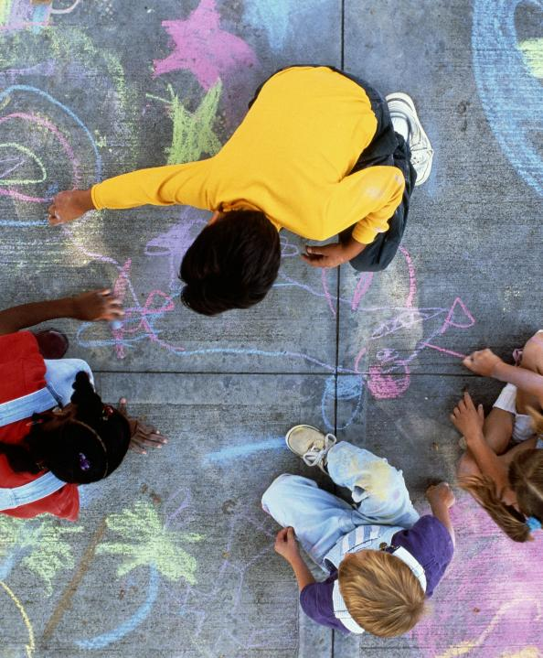
Physical abuse
Abuse which may involve hitting, shaking, throwing, poisoning, burning or scalding, drowning, suffocating or otherwise causing physical harm to a child
Physical harm may also be caused when a parent / carer fabricates the symptoms of, or deliberately induces, illness in a child

Slide 24
Discuss: what might you consider to be indicators of physical abuse?
These may include but are not exclusive to children
frequent injuries
unexplained or unusual fractures / broken bones
bruises at different stage of healing
unexplained
    bruises or cuts;
    burns or scalds;
    bite marks
behavioural changes
    flinching, shrinking away
    aggression
    hypervigilance
    fear of particular adults
    self harm / risky behaviours
who change the clothing they are wearing, or clothing inappropriate to the weather
who change their explanation, explanations do not match

Slide 25
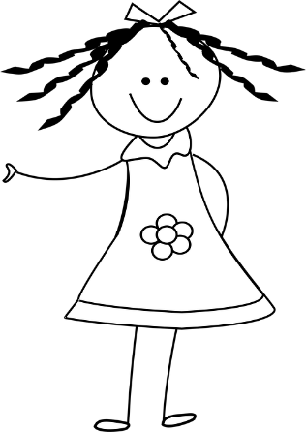
Common sites for accidental injury
forehead
nose
chin
elbow
bony spine
knee
hip
shin
Notes:
Remember the majority of injuries in young children are accidental - however be professionally curious

Slide 26
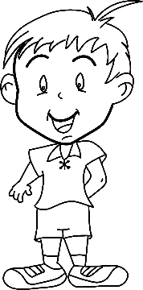
Common sites for non-accidental physical injury
SKULL – fracture, bruising or bleeding under skull
EYES - bruising, (particularly both eyes)
EARS - Pinch or slap marks, bruising
CHEEK/SIDE OF FACE - bruising, finger marks
NECK -bruising, grasp marks
MOUTH - torn frenulum
UPPER & INNER ARM - bruising, grasp marks
SHOULDERS - bruising, grasp marks
CHEST - bruising, grasp marks
GENITALS - bruising
BACK }
BUTTOCKS }
THIGHS }
KNEES - grasp marks
Linear bruising (outline of belt/buckles, scalds/burns

Slide 27


Emotional abuse
The persistent emotional maltreatment of a child such as to cause severe and adverse effects on the child’s emotional development. It may involve:
Some level of emotional abuse is involved in all types of maltreatment of a child, although it may occur in isolation
conveying to a child that they are worthless or unloved, inadequate, or valued only insofar as they meet the needs of another person
seeing or hearing the ill-treatment of another, serious bullying (including cyberbullying), causing children frequently to feel frightened or in danger, or the exploitation or corruption of children
not giving the child opportunities to express their views, deliberately silencing them or ‘making fun’ of what they say or how they communicate
age or developmentally inappropriate expectations being imposed on children

Slide 28
Discuss: what might you consider to be indicators of emotional abuse?
These may include but are not exclusive to :
Children who present as tired or lacking in self care, eating difficulties or significant changes in appetite
Children with low self esteem or lacking confidence or who show extreme compliance or eagerness to please
Children who have declining attendance and developmental progress
Children who are excessively withdrawn, fearful, or anxious about doing something wrong
Childre who have difficulty making and maintaining relationships
Children who withdraw from social situations, are unhappy, show emotional distress or self- blame
Children who display emotional volatility or have difficulty regulating emotions
Children who show delayed emotional and social development

Slide 29
Sexual Abuse
Involves forcing or enticing a child or young person to take part in sexual activities, not necessarily involving a high level of violence, whether or not the child is aware of what is happening
May involve physical contact, including assault by penetration (for example rape or penetration with an object) or non-penetrative acts such as masturbation, kissing, rubbing and touching outside of clothing
May also include non-contact activities, such as involving children in looking at, or in the production of, sexual images, watching sexual activities, encouraging children to behave in sexually inappropriate ways, or grooming a child in preparation for abuse (including via the internet)
Sexual abuse is not solely perpetrated by adult males - women can also commit acts of sexual abuse, as can other children

Slide 30
Discuss: what might you consider to be indicators of sexual abuse?
These may include but are not exclusive to:
Physical indicators: including discomfort, pain, itching, bleeding, sexually transmitted STI’s, pregnancy, recurrent UTI’s
Behavioural indicators: sexualised language behaviour and knowledge that is not developmentally appropriate. Inappropriate masturbation, sudden changes in behaviour, withdrawal, isolation, anxiety, depressions, low self esteem, fear
Emotional indicators: feelings of shame, guilt or self-blame, emotional distress, sleep difficulties, increased secrecy, difficulty trusting others, emotional outbursts
Educational indicators: reduced concentration and engagements, decline in achievement, poor attendance, reluctance to change for PE

Slide 31

Neglect
Persistent failure to meet a child’s basic physical and/or psychological needs, likely to result in the serious impairment of the child’s health or development
Failure to provide adequate food, clothing and shelter
Failure to ensure access to appropriate medical care or treatment.
Failure to protect a child from physical and emotional harm or danger; ensure adequate supervision (including the use of inadequate caregivers)
Neglect may occur during pregnancy for example through substance mis-use
It may also include neglect of, or unresponsiveness to, a child’s basic emotional needs.

Slide 32
Discuss: what might you consider to be indicators of neglect ?
These may include but are not exclusive to children:
living in a home that is indisputably dirty or unsafe
who are dirty with poor hygiene
with dirty, inadequate and unsuitable clothing
with nutrition, hunger, frequent request for food
faltering growth, weight loss or obesity
living in dangerous conditions (eg: around drugs, alcohol or violence)
who are often angry, aggressive or self-harm
who fail to receive basic health care
who are not taken for medical treatment when their children are ill or are injured
who are tiredness, lethargy
with poor attendance or frequent lateness to setting

Slide 33
What staff should do – reporting and recording

Slide 34

Let children know you're listening:
Responding to a child’s disclosure

Slide 35


If a child makes a disclosure or you have a safeguarding concern:
ACT ON IT IMMEDIATELY – do not assume colleagues have already done so
Speak with the Designated Safeguarding Lead – non-availability should not delay appropriate action being taken
Do not assume other professionals will share critical information - early information sharing is vital for effective identification, assessment and allocation of appropriate service provision
Notes:
Be clear that the expectation is for staff members to work in accordance with the setting policy and procedures (in that any concerns should be reported to the Designated Lead).
The DSL or DDSL should always be available to discuss safeguarding concerns. If in exceptional circumstances, they are not available, this should not delay appropriate action being taken. Staff should consider speaking to a member of the senior leadership team and/or take advice from local children’s social care. In these circumstances, any action taken should be shared with the designated safeguarding lead and recorded appropriately

Slide 36
If you have a safeguarding concern - for example, the child’s presentation:
“They are messy or unkempt”
INSTEAD - describe what this looks like
    food down the front of the jumper,
    hair unbrushed, nits in the hair,
    the sole is falling off the shoe that is too small
INSTEAD - describe the impact on the child
    becoming isolated because they smell dirty
    blisters on their feet
Notes:
When describing a concern – this could be an observation of presentation or behaviour, or a conversation with a parent or child – ensure that all staff are specific and factual with the detail.

Slide 37
What to do if a child discloses to you:
DO
Listen carefully
Establish the facts
Make accurate notes (using the child’s words)- date and sign these
Reassure the child they have done the correct thing by telling you
INFORM THE DSL OR DEPUTY
DO NOT
Promise confidentiality
Ask leading questions
Use your own words to describe something
Investigate
Make the child feel they are creating a problem or feel ashamed for reporting abuse
Notes:
Ensure staff are clear about how to record appropriately (is there a template for recording)

Slide 38
Record keeping is vitally
important
All concerns, discussions and reasons for decisions should be recorded in writing and include:
a clear and comprehensive summary of the concern that is factual and contains no personal opinions
details of how the concern was followed up and resolved
a note of any action taken, decisions reached (including rationale) and the outcome
use initials of other children involved
Notes:
Ensure staff are clear about how to record appropriately (is there a template for recording)

Slide 39
Parental engagement
Staff should feel safe in reporting and recording their concerns regardless of the response of the parent
They should consider the reasons and barriers as to why the parent may be difficult to engage
These may include behaviours such as
  Ambivalence
  Avoidance
  Confrontation
  Violence
  Disguised compliance
Professional curiosity should be maintained when working with families, with a focus on the child’s lived experience
Professionals should seek advice to gain better understanding, where there is a possibility of cultural factors making a family resistant to having professionals involved
Other potential barriers to consider when working with families:
mental health
learning disability
homelessness
financial difficulties
cultural differences
family history
substance misuse
large sibling groups
It’s important to 'think family’ when working with families
Notes:
It is best practice to:
involve the family in decisions
seek their consent for the best outcomes
assess the family’s needs as a whole
However, working with families can be challenging at times. Uncooperative families are those who will deliberately choose not to engage and / or co-operate with professionals and who will often display one or more of a wide range of uncooperative behaviours towards professionals. The SET procedures have details on this aspect in Section 6 Managing work with Families where there are obstacles and resistance
Ambivalence - can be seen when people are always late for appointments, or repeatedly make excuses for missing them; when they change the conversation away from uncomfortable topics and when they use dismissive body language. Ambivalence is the most common reaction and may not amount to uncooperativeness. All service users are ambivalent at some stage in the helping process which is related to the dependence involved in being helped by others.
It may reflect cultural differences, being unclear what is expected, or poor experiences of previous involvement with professionals.
Ambivalence may need to be acknowledged, but it can be worked through
Avoidance/Denial is a very common method of non-engagement and includes avoiding appointments, missing meetings, cutting short visits due to other apparent important activity, not allowing easy contact with a child, especially on their own or refusing to acknowledge abuse/problems. They may have something to hide, resent outside interference, not want to accept or discuss concerns about their children.
Confrontation is communication that tends towards anger, creates unnecessary conflict, and damages relationships, it includes challenging professionals, provoking arguments, extreme avoidance and often indicates a deep-seated lack of trust leading to a 'fight' rather than 'flight' response to difficult situations. Parents may fear that their children may be taken away or they may be reacting to them having being taken away. They may have difficulty in consistently seeing the worker's good intent and be suspicious of their motives.
Violence - threatened or actual violence by a small minority of people is the most difficult of non-engaging behaviours for the worker/agency to respond to. It may reflect a deep and longstanding fear and projected hatred of authority figures. People may have experience of getting their way through intimidation and violent behaviour.
Disguised (superficial) compliance: involves a parent or carer giving the appearance of co-operating with agencies to avoid raising suspicions, to allay professional concerns and ultimately diffuse professional intervention.
There are often other barriers to consider when supporting families – discuss the list on the right hand side of the slide.
Child Safeguarding Practice Reviews:
Many CSPR’s reference issues relating to hostility and / or disguised compliance from parents. In a 2008 review of 189 SCRs between 2005-2007, three quarters were found to feature lack of parental co-operation with services.
It is important that practitioners are professionally curious. Professional curiosity is a combination of looking, listening, asking direct questions, checking out and reflecting on information received. Consider the child’s lived experiences.
You can also make the point that the setting could become aware of safeguarding concerns in relation to a child’s sibling or siblings / wider family – that may be impacting on the child and need to be addressed.
Discuss support and supervision for staff who are supporting parents who are reluctant, lack engagement and/or are openly hostile
With regard to cultural differences, Professionals should:
be aware of dates of the key religious events and customs;
be aware of the cultural implications of gender;
acknowledge cultural sensitivities and taboos
consider asking for advice from local experts, who have links with the culture (being mindful of potential risks around forced marriage)
In such discussions the confidentiality of the family concerned must be respected - it is vital to remember potential risk where seeking advice around forced marriage – this could put a young person / couple at further risk if sharing information or concerns within the community
Do not use siblings or family members as interpreters – efforts must be made to speak to the child independently
These issues may not impact on capacity to parent, but settings should consider support through the Early Help process where appropriate – or, of course, referral to Social Care where concerns meet the threshold for significant harm
Think Family means securing better outcomes for adults, children and families by coordinating the support and delivery of services from all organisations When an individual first has contact with any service they should receive a welcome into a system of joined-up support and safeguarding together with coordination between adult and children's services.
In order to achieve this, services working with both adults and children should take into account family circumstances and responsibilities. Families do not exist in isolation, they are part of a wider network and Think Family aims to promote the importance of a whole-family approach, ensuring practitioners work in partnership and collaboration with families recognising and promoting resilience and helping them to build their capabilities.
The Social Care Institute for Excellence (SCIE) website talks in more detail about the concept of Think Family.

Slide 40
Key safeguarding topics
All staff should have an awareness of safeguarding issues that often overlap and can put children at risk of harm
Notes:
All staff should have an awareness of safeguarding issues that can put children at risk of harm.

Slide 41

Attendance
Settings should:
Build strong relationships with families – a support first approach
make attempts to contact parents / carers including using emergency contacts if a child is absent for a prolonged period of time, or if a child is absent without notification
consider patterns and trends in a child’s absences and their personal circumstances and use their professional judgement when deciding if the child’s absence should be considered as prolonged.
Consideration must be given to the child’s vulnerability, parent’s / carer’s vulnerability and their home life

Slide 42
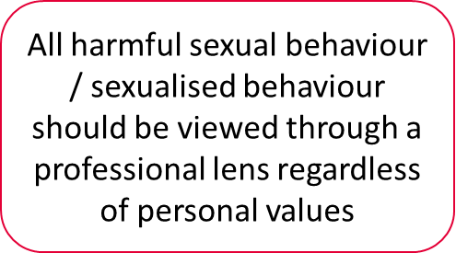
Child on child abuse
Harmful sexual behaviour
All staff should:
be aware children can abuse other children (inside and outside of an education setting), for example by bullying them
be aware this can occur online
understand that, even where abuse is not being reported, it does not mean it is not happening
understand the importance of challenging inappropriate behaviours between peers to ensure settings are safe environments and that there is a culture of not tolerating unacceptable behaviour
All staff must be aware that it is normal for some children to display sexualised behaviour towards other children as they develop.
Much of the behaviour displayed by small children will be developmental,
however sexualised behaviour between children must be reported to the DSL and recorded.

Slide 43
Serious violence
County Lines
Gangs / organised criminal networks involved in exporting illegal drugs using dedicated mobile phone lines or other form of ‘deal line’
Offenders exploit children to move and store drugs and money - they will often use coercion, intimidation, violence (including sexual) and weapons to ensure compliance of victims
Children increasingly being targeted / recruited on social media
County lines are widespread nationally, in rural and urban areas, they can involve the movement of drugs across county borders, but some lines supply the drugs market locally
County lines grooming can take place in a range of settings, including in homes, public spaces, schools and universities
There are a number of indicators, which may signal children are at risk from, or are involved in committing serious violence.
These may include:
increased absence from school or college,
a change in friendships or relationships with older individuals or groups,
a significant decline in educational performance,
signs of self-harm or a significant change in wellbeing, or signs of assault or unexplained injuries, and
unexplained gifts or new possessions could also indicate that children have been approached by, or are involved with, individuals associated with criminal networks or gangs and may be at risk of criminal exploitation.
Notes:
Consider these concerns in the wider context of families and siblings and the possible impact this may have on the children in your setting
Exploitation is an integral part of the county lines offending model with children and vulnerable adults exploited to move [and store] drugs and money. Offenders will often use coercion, intimidation, violence (including sexual violence) and weapons to ensure compliance of victims. Children can be targeted and recruited into county lines in a number of locations including schools, further and higher educational institutions, pupil referral units, special educational needs schools, children’s homes and care homes. Children are often recruited to move drugs and money between locations and are known to be exposed to techniques such as ‘plugging’, where drugs are concealed internally to avoid detection. Children can easily become trapped by this type of exploitation as county lines gangs create drug debts and can threaten serious violence and kidnap towards victims (and their families) if they attempt to leave the county lines network.
Some of the factors that may heighten a person’s vulnerability include:
• having contact with the criminal justice system – even for minor offences that do not appear to be related to county lines;
• having experience of neglect, physical abuse, sexual abuse/exploitation or a lack of a safe/stable home environment, now or in the past (including domestic abuse, parental substance misuse or parental criminal involvement) – trauma, including adverse childhood experiences, can negatively impact on an individual’s ability to develop trusted relationships or access support services;
• social isolation or social difficulties – the lack of a support network can mean someone is less able to get help;
economic vulnerability – offers of material possessions or money for victims or their family may be more readily accepted out of a feeling of necessity and lack of legitimate financial alternatives;
• homelessness or insecure accommodation status – there is a lack of a safe environment to provide security and privacy;
• connections with other people in gangs – some individuals are targeted through family or friends who are already involved in criminal activity themselves and sometimes a drug debt owed by them is passed on to peers or family members;
• having a physical or learning disability, or being neurodivergent – victims may be less able to recognise they are being exploited, or less able to communicate it or access support;
• having mental health issues – exploiters may target poor emotional wellbeing or low self-esteem
having substance misuse issues – victims are sometimes given substances in lieu of payment;
• being in or leaving care – the context behind why a person is brought into care can heighten a person’s vulnerability in itself, while those in semi-independent/independent accommodation, placed out-of-area or leaving care may have less access to support networks;
• being excluded from mainstream education, and/or a pupil at an alternative provision such as a pupil referral unit – factors influencing a child’s exclusion may indicate they are exposed to exploitation, while being disengaged from meaningful activity and peers can evoke feelings of disenfranchisement and, for those with a reduced timetable or not attending school at all, time spent unsupervised can offer opportunities for exploitation;
• insecure immigration status – for example, unaccompanied asylum-seeking children and refugees may have a number of vulnerability factors that can increase their exposure to exploitation, including social/cultural isolation on arrival to the country and potentially links to organised crime from their journey.
It is important to remember that risk factors such as these are never the cause of a vulnerable person’s exploitation into county lines activity; rather, they give rise to the imbalance of power which perpetrators often seek to abuse. Moreover, there are recorded cases of exploitation of individuals with no known risk factors and who were not previously known to services (sometimes referred to as “clean skins” by exploiters), as they were deemed less likely to attract attention from authorities
Further information on the signs of child’s involvement is available in Home Office guidance

Slide 44

Emotional wellbeing and mental health
All staff should be aware that emotional wellbeing problems may be an indicator that a child has suffered or is at risk of suffering abuse
Only appropriately trained professionals should attempt diagnosis of an emotional wellbeing problem (although education staff are well placed to observe children day-to-day and identify those whose behaviour suggests that they may be experiencing an emotional wellbeing problem, or be at risk of developing one)
It is key that staff are aware of how a child’s previous experience of abuse can impact on their emotional wellbeing, behaviour and education
Concerns should always be referred to the DSL or DDSL

Slide 45
Domestic abuse
The DA Act (2021)
defines DA as -
Behaviour of a person (A) towards another person (B) is ‘domestic abuse’ if:
(a) A and B are each aged 16 or over and are personally connected to each other, and
(b) the behaviour is abusive
The Act says behaviour is ‘abusive’ if it consists of any of the following:
(a)physical or sexual abuse;
(b)violent or threatening behaviour;
(c)controlling or coercive behaviour;
(d)economic abuse (see subsection (4));
(e)psychological, emotional or other abuse;
It does not matter whether the behaviour consists of a single incident or a course of conduct
can encompass a wide range of behaviours
may be a single incident or a pattern of incidents (can be, but is not limited to, psychological, physical, sexual, financial or emotional)
the DA Act recognises that children can be victims of domestic abuse - they may see, hear, or experience the effects of abuse at home and/or suffer domestic abuse in their own intimate relationships (teenage relationship abuse)
can have a detrimental and long-term impact on a child’s health, wellbeing, development, and ability to learn
Young people can also experience DA within their own intimate relationships (if under 16, will not be legally recognised as DA, but may constitute a child protection issue and require a response)
Notes:
All children can witness and be adversely affected by domestic abuse in the context of their home life where domestic abuse occurs between family members. Experiencing domestic abuse and/or violence can have a serious, long lasting emotional and psychological impact on children. In some cases, a child may blame themselves for the abuse or may have had to leave the family home as a result.
DISCUSSION:
Think about impact of DA on the child – what safeguarding concerns may be relevant as a result of witnessing DA?

Slide 46
Forced marriage
Honour or faith-based abuse
(including Female Genital Mutilation and forced marriage)
Forced Marriage Unit: fmu@fcdo.gov.uk
The right to choose: government guidance on forced marriage - GOV.UK
Honour or faith-based abuse (HBA) incidents or crimes which have been committed to protect or defend the honour of the family and/or the community, including:
female genital mutilation (FGM), forced marriage, and practices such as breast ironing
abuse may involve a network of family or community and can include multiple perpetrators
forced marriage where violence, threats or any other form of coercion is used to cause a person to enter into a marriage. Threats can be physical or emotional and psychological
Female genital mutilation (FGM)
National FGM Centre website
Mandatory reporting of female genital mutilation: procedural information - GOV.UK
Notes:
There is another specific presentation on this topic which you can use to train your staff in more detail

Slide 47

Homelessness
Being homeless or being at risk of becoming homeless presents a real risk to a child’s welfare
Settings can support in raising / progressing concerns with local authority - what is the impact on the child?
Homeless Reduction Act 2017 – places new duties on local authorities
Children may be homeless with their family, but older children may be homeless independently
Notes:
The Homelessness Reduction Act 2017 places a new legal duty on English councils so that everyone who is homeless or at risk of homelessness will have access to meaningful help including an assessment of their needs and circumstances, the development of a personalised housing plan, and work to help them retain their accommodation or find a new place to live. The following factsheets usefully summarise the new duties: Homeless Reduction Act Factsheets. The new duties shift the focus to early intervention and encourages those at risk to seek support as soon as possible, before they are facing a homelessness crisis.
In most cases school and college staff will be considering homelessness in the context of children who live with their families, and intervention will be on that basis. However, it should also be recognised in some cases 16 and 17 year olds could be living independently from their parents or guardians, for example through their exclusion from the family home, and will require a different level of intervention and support. Children’s services will be the lead agency for these young people and the designated safeguarding lead (or a deputy) should ensure appropriate referrals are made based on the child’s circumstances. The department and the Ministry of Housing, Communities and Local Government have published joint statutory guidance on the provision of accommodation for 16 and 17 year olds who may be homeless and/ or require accommodation

Slide 48
Children and the Court system
Children with a family member in prison
Children may be called to give evidence in court, either for crimes committed or crimes witnessed
Children under 10 who break the law are treated differently to adults or youths under 18 who commit a criminal offence. They cannot be charged with committing a criminal offence
Children between 10 and 17 can be arrested and taken to court if they commit a crime
Making child arrangements via the family courts following separation can be stressful and entrench conflict in families - this can be stressful for children
An estimated 192, 000 children every year have a parent in prison in England and Wales – children at risk of poor outcomes, including poverty, stigma, isolation and poor mental health
NICCO – support for professionals working with offenders and their children
Prisoners' Families Helpline offers free confidential advice for families
Barnardo's - Children with a parent or relative in prison
Notes:
Page 159 KCSIE Children are sometimes required to give evidence in criminal courts, either for crimes committed against them or for crimes they have witnessed. There are two age appropriate guides to support children 5-11-year olds and 12-17 year olds. The guides explain each step of the process, support and special measures that are available. There are diagrams illustrating the courtroom structure and the use of video links is explained. Making child arrangements via the family courts following separation can be stressful and entrench conflict in families. This can be stressful for children. The Ministry of Justice has launched an online child arrangements information tool with clear and concise information on the dispute resolution service. This may be useful for some parents and carers.

Slide 49

Online safety
Early years settings online safety considerations 2019
Settings should ensure they have considered filtering and monitoring arrangements for online safety
Technology provides a platform that facilitates harm - four main areas of risk:
        Content: exposure to inappropriate / harmful material
        Contact: : being subjected to harmful online interaction with other users or generative AI applications that simulate this
        Conduct: personal online behaviour that increases the likelihood of / causes harm
        Commerce: risks such as online gambling, inappropriate advertising, phishing and / or financial scams
Point for discussion
Younger children are more at risk on mobile devices than older children?
Notes:
Young children are often at greater risk – they do not have phones or devices of their own and use those of the parents. The parents will not have set these up with child security options instead having adult settings on their – this then increases the risk of the child accessing inappropriate content.
See Annex D for further information and resources
ESI / online safety: https://schools.essex.gov.uk/pupils/Safeguarding/ESafety/Pages/E-Safety.aspx
Online Safety (escb.co.uk)
Meeting digital and technology standards in schools and colleges - Filtering and monitoring standards for schools and colleges - Guidance - GOV.UK (www.gov.uk) – Settings may wish to review this document in line with their online safety policy (although it is mainly directed at schools and colleges)

Slide 50



Prevent
Notes:
1 July 2015, the Counter-Terrorism and Security Act 2015 placed a new duty on schools and other providers of education and care, in the exercise of their functions to have ‘due regard to the need to prevent people from being drawn into terrorism’.
Home Office guidance on what this means for schools and other providers: Prevent Duty Guidance - (updated 2023)
The Prevent strategy published by the government in 2011 is 1 of 4 elements in CONTEST – the Governments counter terrorism strategy
More detailed information on Prevent can be found in the Prevent Powerpoint presentation for settings to deliver to their staff

Slide 51
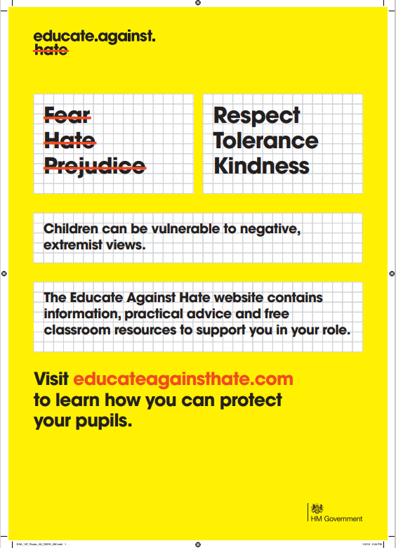
What is Prevent? Home Office video
As with other safeguarding risks, staff should be alert to changes in children’s behaviour, which could indicate that they may be in need of help or protection (KCSiE 2026)
Notes:
Use this video to illustrate what PREVENT is

Slide 52

Prevent definitions
Radicalisation - is the process of a person legitimising support for, or use of, terrorist violence
Extremism - the vocal or active opposition to our fundamental British values, including democracy, the rule of law, individual liberty and the mutual respect and tolerance of different faiths and beliefs
Terrorism - action that endangers / causes serious violence to a person/people; causes serious damage to property; or seriously interferes with / disrupts an electronic system. The use or threat must be designed to influence the government or to intimidate the public and is made for the purpose of advancing a political, religious or ideological cause
Channel - early intervention panel designed to safeguard vulnerable individuals from being drawn into extremist or terrorist behaviour
voluntary, confidential programme
multi-agency process, involving partners from the local authority, the police, education, health providers and others

Slide 53
Prevent in Essex
Jo Barclay Head of Education Safeguarding and Wellbeing – is the Prevent Lead for Education in Essex
There is a Prevent Strategic Board to oversee arrangements in Essex and implement Essex Prevent Strategy (Prevent Lead sits on this)
There is also a Prevent Police Team that works across the Eastern region
The Counter Terrorism Local Profile (CTLP) is a national document shared with Prevent Leads
Elements of the CTLP are shared with education safeguarding leads to explain national and regional data and trends
Settings should use this information to inform their Prevent risk assessments
Practitioners should report any concerns to their DSL
The DSL should share concerns with an appropriate agency, and may make a Prevent referral
If there is immediate risk of significant harm call the police, contact the Police Prevent Team or make a Request for support to the Children and Families Hub
The ECC Education Prevent Lead sits on the Channel Panel which meets monthly to discuss cases
This brings together all key agencies to agree a plan of support if needed
An education setting may be invited to the meeting to contribute
Notes:
Settings should have Prevent a risk assessment, which is informed by the CTLP, to assess risk of children being drawn into terrorism, including support for extremist ideas that are part of terrorist ideology
Staff should be aware of the latest trends and risks
Geography is not as much of a concern due to the online risks of radicalisation that can happen anywhere
There is a separate presentation on PREVENT which you may which to use with this (or at a later date to develop learning)
Protecting children from risk of radicalisation should be seen as part of settings’ wider safeguarding duties - similar to protecting children from other forms of harm and abuse
There is no single way of identifying whether a child is likely to be susceptible to an extremist ideology. Background factors combined with specific influences such as family and friends may contribute to a child’s vulnerability. Similarly, radicalisation can occur through many different methods (such as social media or the internet) and settings (such as within the home). However, it is possible to protect vulnerable people from extremist ideology and intervene to prevent those at risk of radicalisation being radicalised. As with other safeguarding risks, staff should be alert to changes in children’s behaviour, which could indicate that they may be in need of help or protection.
The Lead Practitioner (and any deputies) should be aware of local procedures for making a Prevent referral. The DSL/Lead Practitioner only should complete the Prevent referral form if it is required
Channel is a programme which focuses on providing support at an early stage to people who are identified as being vulnerable to being drawn into terrorism. It provides a mechanism for schools to make referrals if they are concerned that an individual might be vulnerable to radicalisation. An individual’s engagement with the programme is entirely voluntary at all stages. Guidance on Channel is available at: Channel guidance, and a Channel awareness e-learning programme is available for staff at: Channel General Awareness. The school or college’s Designated Safeguarding Lead (and any deputies) should be aware of local procedures for making a Channel referral. As a Channel partner, the school or college may be asked to attend a Channel panel to discuss the individual referred to determine whether they are vulnerable to being drawn into terrorism and consider the appropriate support required.

Slide 54
‘IT COULD HAPPEN HERE’

Slide 55
Concerns about the conduct of member of staff
‘IT COULD HAPPEN HERE’
All staff members should be made aware of boundaries of appropriate behaviour and conduct – set out in the ‘Staff Code of Conduct’ (and signed for by all staff)
Staff should refer any concerns about another member of staff (including supply staff / volunteers) to the Manager / Owner
If a concern is about the Manager, staff should refer to the Committee / Trustees or to the LADO if the Manager is the sole proprietor
All staff should feel able to raise concerns about poor or unsafe practice / potential failures in safeguarding arrangements – and should know concerns will be taken seriously by management
Where staff feel unable to do so to their employer, or feel issues are not being addressed, they could contact the NSPCC whistleblowing helpline on: 0800 028 0285 (line is available from 8:00 AM to 8:00 PM, Monday to Friday) or by email at: help@nspcc.org.uk
Notes:
Talk to your staff here about the importance of an open culture whereby staff feel able to report any concerns about colleagues
DISCUSSION:
Discuss the concept of grooming – abusers groom adults around them to aid / hide their abuse
Discuss the Staff Code of Conduct – why is this important? (It protects staff and children)
‘Position of trust' is a legal term that refers to certain roles and settings where an adult has regular and direct contact with children. It's against the law for someone in a position of trust to engage in sexual activity with a child in their care, even if that child is over the age of consent (16 or over).
There are many roles which are not legally defined as being positions of trust, such as swimming coaches or faith group leaders. This means it's not currently against the law for people in these roles to have a sexual relationship with a 16– or 17-year-old in their care.
Examples of positions of trust include:
Teachers
Care workers
Youth Justice workers
Social Workers
Doctors.

Slide 56
The role of the Local Authority Designated Officer (LADO)
The LADO is involved where there is a concern or allegation that someone working or volunteering with children has:
behaved in a way that has harmed a child, or may have harmed a child;
possibly committed a criminal offence against or related to a child;
behaved towards a child or children in a way that indicates he or she may pose a risk of harm to children; or
behaved or may have behaved in a way that indicates they may not be suitable to work with children
Notes:
Role initially introduced within ‘Working Together to Safeguard Children’ guidance in 2006 – reflected in SET procedures
4 LADOs in Essex within the Children Safeguarding Team
Further information on ESI: https://schools.essex.gov.uk/pupils/Safeguarding/Managing_allegations_in_the_Childrens_Workforce/Pages/ManagingAllegationsInTheChildrensWorkforce.aspx

Slide 57
Essex Effective Support
Early help, indicators of need and levels of support

Slide 58
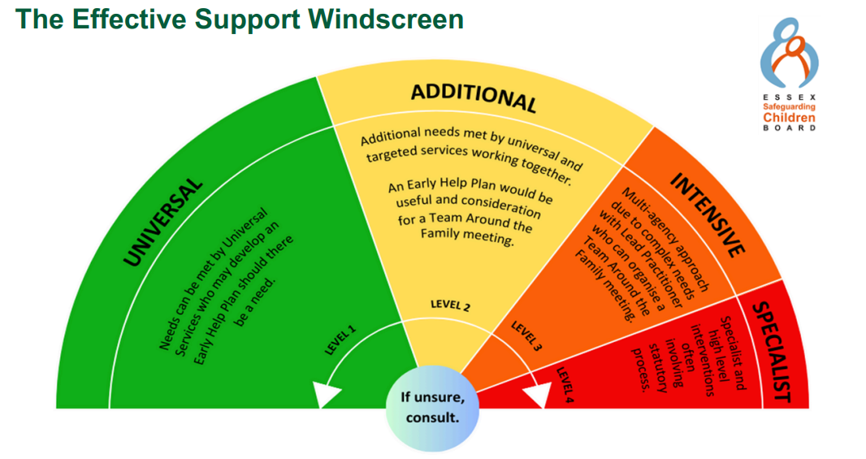
Essex Effective Support Windscreen
Universal Level 1
All children who live in the area have core needs such as parenting, health and education – children are supported by their family and in universal services to meet all their needs
Intensive Level 3
Vulnerable children and their families with multiple needs or whose needs are more complex, such as children and families who, have a disability resulting in complex needs exhibit anti-social or challenging behaviour suffer neglect or poor family relationships, have poor engagement with key services, are not in education or work long term
Specialist Level 4
Children or young people who have suffered or are likely to suffer significant harm as a result of abuse or neglect
Children with significant impairment of function / learning and / or life limiting illness
Children whose parents and wider family are unable to care for them
Families involved in crime / misuse of drugs at a significant level
Families with significant mental or physical health needs
Additional Level 2
Children and families with additional needs who would benefit from or who require extra help to improve education, parenting and / or behaviour, or to meet specific health or emotional needs or to improve material situation
The Children and Families Hub –
the front door into children's social care
Welcome to the Children and Families Hub
Notes:
This image is from the ‘Effective Support for Children and Families in Essex’
This whole document has been updated and re-published this month – October 2024.
The windscreen of need has not changed in principle, but the size of each section has changed. The windscreen represents the Levels of Need in Essex and is intended to provide practitioners with a shared understanding and common language around need and harm.
It is a conceptual model of need, and in reality, children and families will move across the windscreen and no two families will be the same.
It illustrates how services will respond to the requirements of children and families across the four levels of need (Universal, Additional, Intensive and Specialist). In this model, all services and interventions seek to work openly with the family (or with young people on their own where it is age appropriate) in order to support them to address their needs at the lowest possible level.
Services should actively work with children and families to prevent their needs escalating to a higher level. Services at a higher level should only be sought after everything possible to meet need has been undertaken at the current level.
The CFH is the central point for requests for support and Child Protection work
This slide contains a link to a presentation which talks about the role of the CFH, should you wish to share this with staff

Slide 59
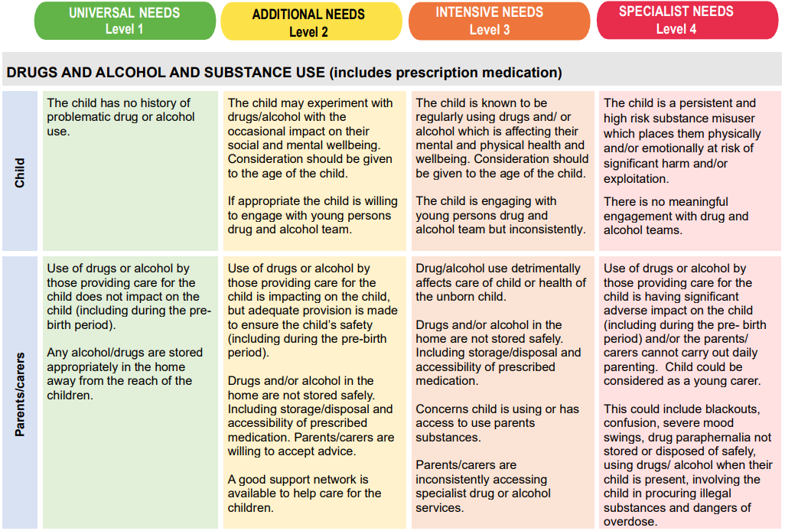
Indicators of Need
Notes:
The Indicators of need which are within the Essex Effective Support document are for professionals to use to assess level of need for a child and family and whether or not this tips into risk. It corresponds to the windscreen moving from universal need across to specialist at level 4

Slide 60
Statutory assessment - children in need / at risk of or subject to significant harm:
Children may be assessed under the Children Act 1989
Section 17 - Child in Need (CIN): a child who is unlikely to achieve or maintain a reasonable level of health or development, or whose health and development is likely to be significantly or further impaired, without the provision of services; or a child who is disabled (may be placed on a CIN plan)
Section 47 – Child protection (CP): Children suffering or likely to suffer significant harm. Local authorities, with the help of other organisations as appropriate, have a duty to make enquiries under section 47 of the Children Act 1989 if they have reasonable cause to suspect that a child is suffering, or is likely to suffer, significant harm (may be placed on Child Protection Plan)
Consider whether any further specialist assessments or services are required
Notes:
Section 17 needs parental consent and there will need to be several risk factors at level 3 a level 4
Section 47 – parental consents can be over-ridden and there will be risk of or actual significant harm.

Slide 61

Why is it so important?
It is important for children to receive the right help at the right time to address risks and prevent issues escalating. Research and Child Safeguarding Practice Reviews have repeatedly shown the dangers of failing to take effective action. Poor practice includes:
  failure to act on and refer the early signs of abuse and neglect
  poor record keeping
  failure to listen to the views of the child
  failure to re-assess concerns when situations do not improve
  sharing information too slowly
  a lack of challenge to those who appear not to be taking action

